Slide 1

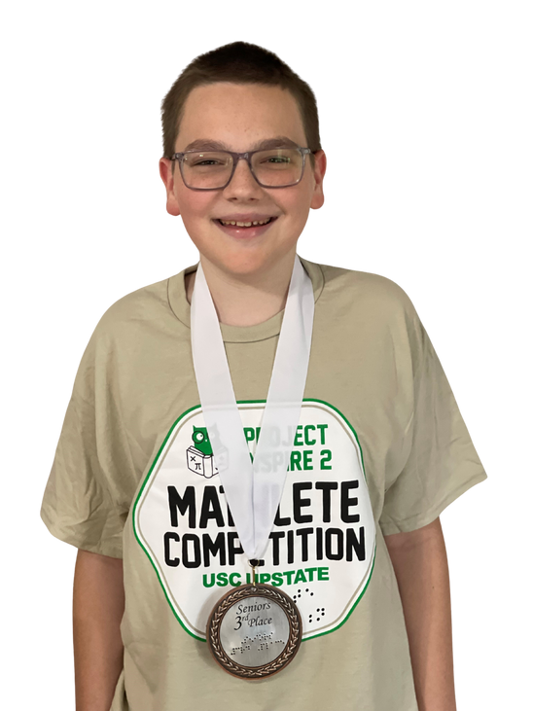

Save the Date
for the
2026 Project INSPIRE
Virtual Mathlete Competition
Important Dates
  Registration Opens February 15
  Strategies Session: March 21
  Practice Session: April 11
  Competition: May 2
  Awards Ceremony: May 16
All activities are on Zoom from
11:30-1:00 PM Eastern
Email: rosenblu@arizona.edu
Visit our website to learn more!

