Slide 1
Colorado School of Mines: NFB
Haptic Vision Project

Slide 2
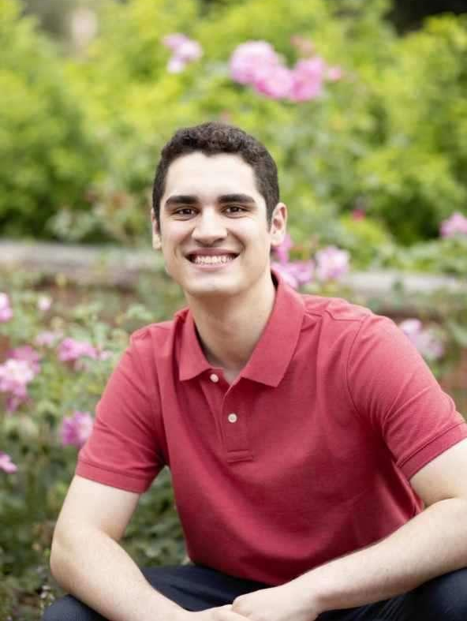
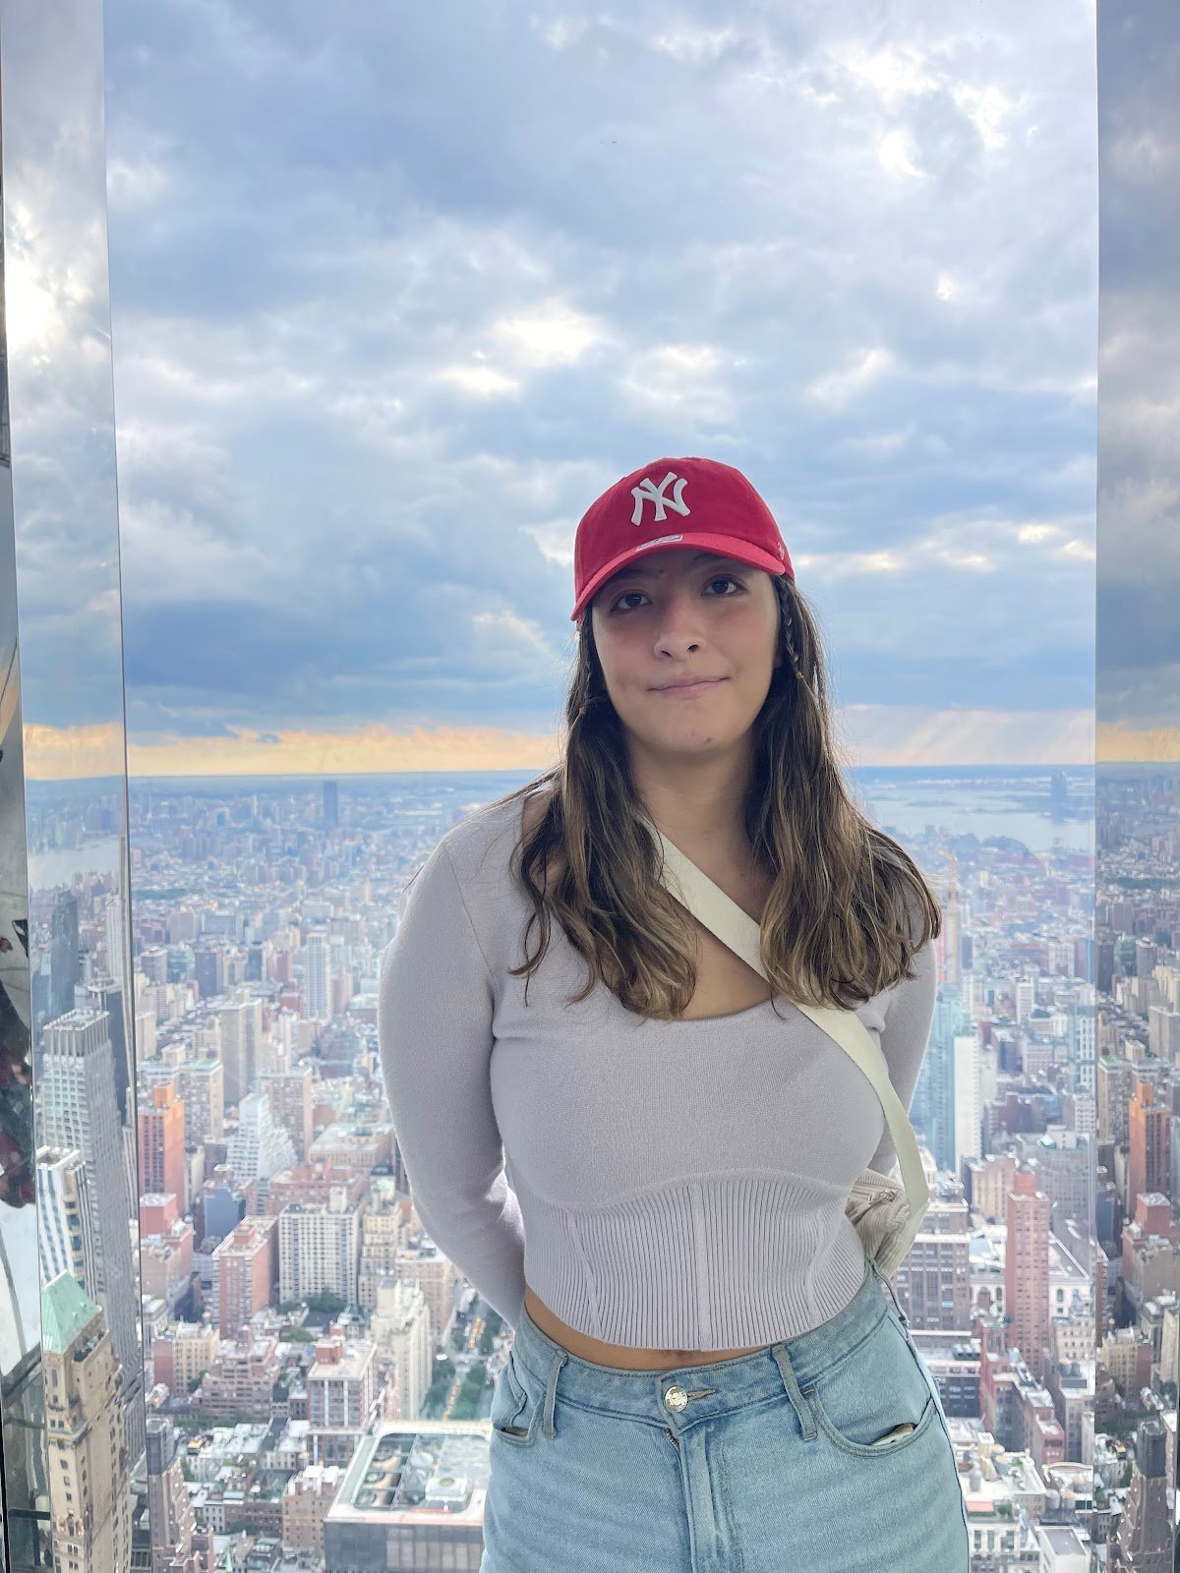
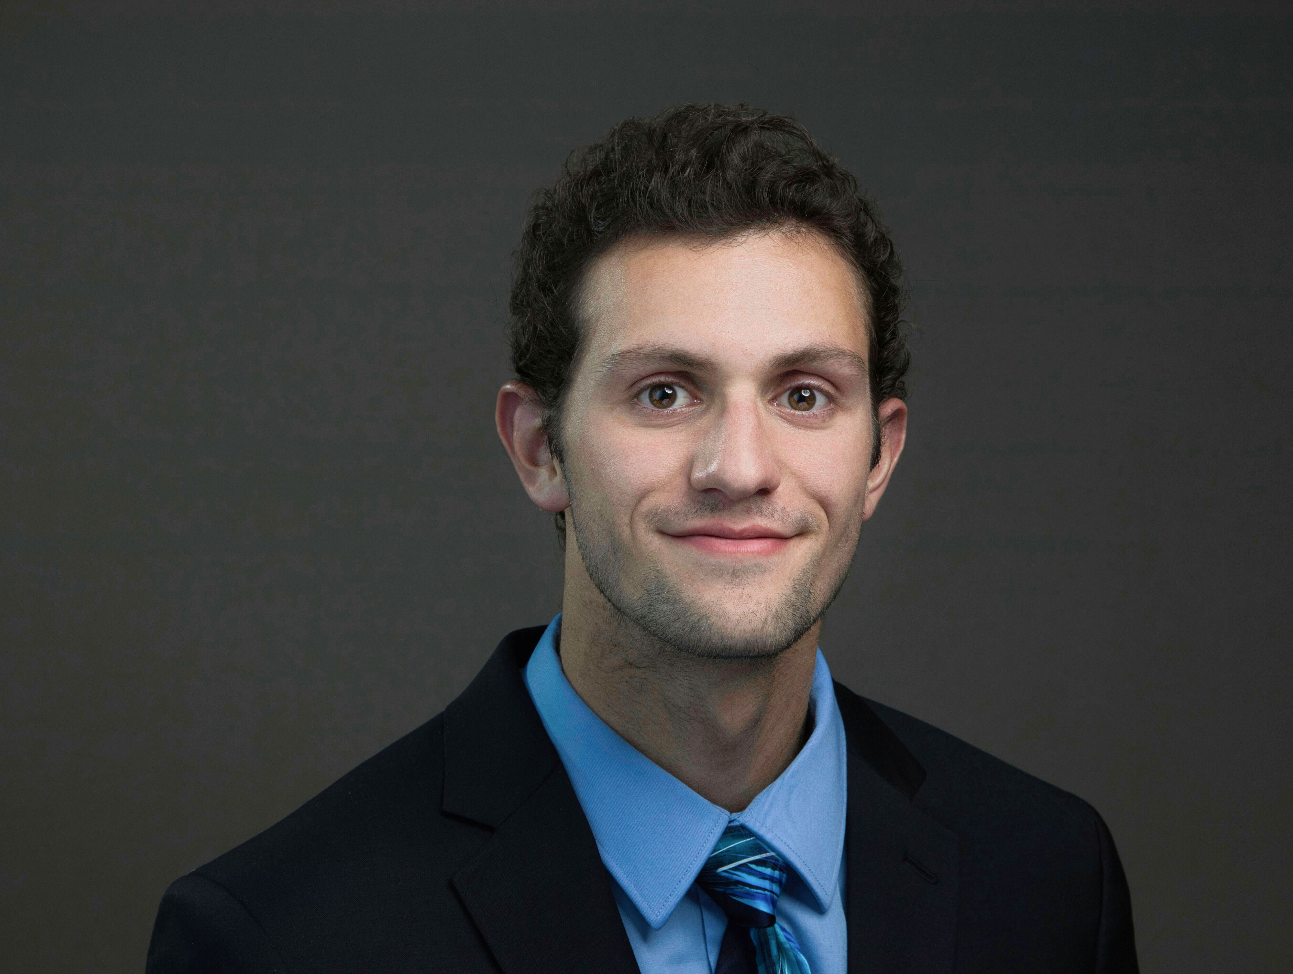
Meet the Team
Jack Walters
Benjamin Clay
Camila Gonzalez-Rodriguez
Jaron O'Grady
We are a bunch of students passionate about helping where we can in the blind and low vision community

Slide 3
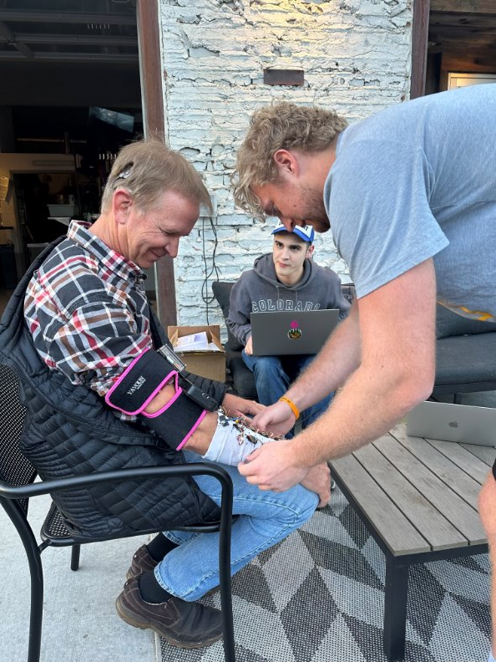
Why are we here?
Share the research that we are doing at Colorado School of Mines
Provide people who are blind and low vision with more information situationally through the use of assistive technology
Notes:
We are here to share the research that we are doing at Colorado School of Mines and hopefully get whoever wants to be involved involved!
What we are doing is conducting research with the goal to provide people who are Blind and Low Vision with more information in social interactions using assistive technology
Part of this process is conducting various types of interviews to learn what type of information the interviewees find most important.
We are trying to learn peoples stories in the BLV community and if there is anything us Colorado School of Mines student researchers can do to help.

Slide 4
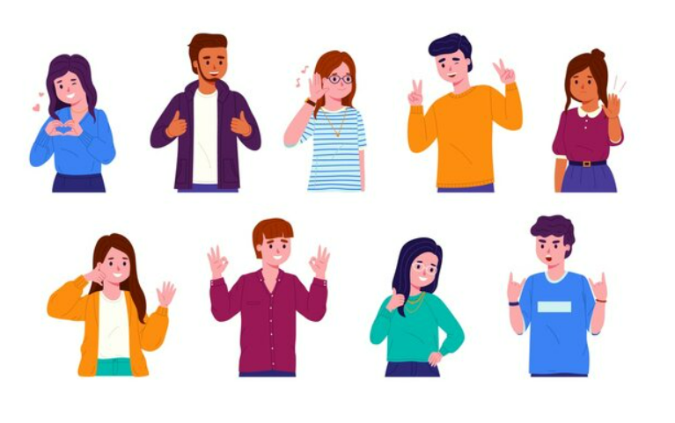
What have we found?
Nonverbal communication was the most common complaint
Gestures
Body Language
Facial Expression
70%-93% of communication is nonverbal
Notes:
We have met and spoke with over 50 members in the community, each of whom telling us a range of different pain points and wishes for information in a social interaction.
From our analysis we have determined that nearly every individual highlighted a component of nonverbal communication. The most popular components included hand gestures (Like directional pointing, waving, hand shake) , body language (arms crossed, leaned back), and facial expression (Happy, angry, nuetral) . This lines up with a common statisitic that 70%-93% of all communication is nonverbal.

Slide 5
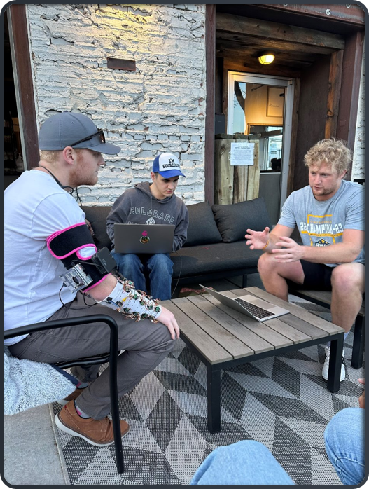
What are we doing?
Built prototype of a wearable AT
uses a camera with an AI model
reads NVC cues and translates them using haptic technology.
Validation: Interviewed and tested ~50 potential customers
Qualitative analysis
User testing analysis
Notes:
From all the feedback and research it has lead us to where we are now... We have built a prototype of a wearable assistive technology that uses a camera embedded on a hat or glasses with an AI model that reads NVC cues and translates them into haptic feedback on a forearm sleeve.
What that means is right now we are accurate in reading facial expression and gestures and getting to the point of reading body language too. With the NVC cues that the AI reads we are using intuitive haptic patterns that allow the user wearing the device to know what the person they are talking to is showing. The two parts of this AT work together.
For example, a certain pattern will play on your forearm and based off what the AI model reads it will tell the user that someone is smiling, and a very different pattern tells the user that someone is angry. This is goes for the 7 base facial expression/ emotions that we are translating: It should also be noted that these can be customized.
And the same goes for gestures as well. With this device you will be able to know when someone is waving, trying to shake your hand, and giving you a peace sign
Now this all sounds good on paper, but we had to go out and validate this. And that is exactly what we did.
The user testing we have done works in two ways we do intuitive testing where we will play 10 haptic patterns on the forearm and the user will tell us intuitively what NVC they think that pattern is associated with. So what that means is we will play a pattern and the will tell us if they think it indiactes smiling, happy, angry and that sort of thing.
We then will train the users on the patterns for no longer than one minute and play the patterns again and the user will tell us what they think. And the results have been incredible. After one minute of training the users are 95% accurate in identifying different facial expression and emotions.
We have also done a handful of testing on people with cognitive disabilites such as autism and the results after training have all been in the 95% identification range

Slide 6
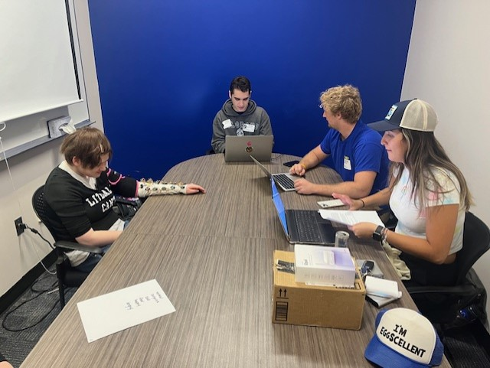
Where are we going?
Make the prototype as useful as possible
Body Language detection
Further problem discovery
Notes:
Make the prototype as useful as possible: We want to get the AT to read all components of NVC that people want it too, so users know what a conversation partner is expressing from their body language, from determining whether they’re talking with their hands to notifying if they are smiling. That is
Overall, We want to learn from the people we meet in the BLV community how we can build something that is useful and serves the mission of the NFB

Slide 7
Next Steps
Contact us if you would like to participate in an interview or user testing
Jackwalters@mines.edu or 720-280-8117
Beta testing opportunities
Customized device and will be recognized on our website
Survey
https://forms.gle/2WzJowLV3DD5ehZLA

Slide 8
Questions?

