Slide 1
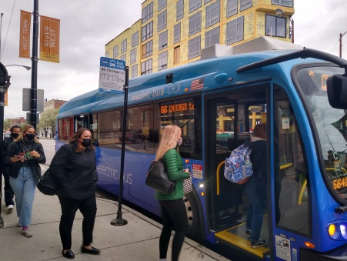
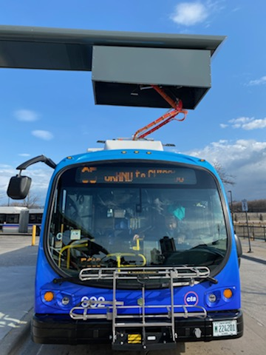
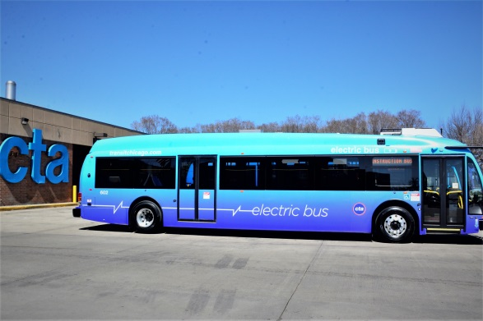
People with Disabilities are Invited to Become Familiar with CTA’s Electric Bus Saturday, June 26, 2021 Between 10:00 a.m. and 1:00 p.m. Jefferson Park Transit Station Bus Terminal 4963 N. Milwaukee Avenue, Chicago, IL 60630
Do not go to the Bus Bays. The Electric Bus will be stationed on the East side of the terminal. Turn left at the end of the long corridor if coming off the Blue Line “L” or Metra Train.
CTA instructors and safety personnel will assist participants as they explore the accessibility and safety features of CTAs new Electric Bus.
Contact Amy Serpe, Manager ADA Compliance Programs – 312-350-2301 aserpe@transitchicago.com – by Tuesday, June 21st if you:
Plan to attend this event. (Your RSVP will assist us in our event planning).
Require a reasonable accommodation. (General/Open Access Sign language interpreters will be available).
The CTA is excited to offer
this opportunity to the
disability community in celebration and acknowledgement of the
31st anniversary of the signing of the
Americans with Disabilities Act of 1990 (ADA).

