Slide 1
2020 E-SCOOTER PILOT
DECEMBER 22, 2020
NOT FOR DISTRIBUTION

Slide 2
Agenda
Recap of pilot purpose and rules
What was different in the 2020 pilot?
Preliminary data overview
Initial response
Pilot successes
Next steps
Feedback and thoughts on the future

Slide 3
Pilot Overview
^{Pilot Purpose:}
To better understand if commercial shared e-scooters should be permanently permitted to operate in the City of Chicago, and, if so, how a permanent program should be operated and administered. More specifically, the 2020 pilot aims to determine:
Whether e-scooters can effectively improve mobility and accessibility for residents who face elevated economic, health, mobility and/or accessibility barriers.
Whether potential dangers to both e-scooter users and non-users, especially people with disabilities, as well as inconveniences caused to other street users by e-scooter operations, can be substantially limited.
Whether e-scooters can meaningfully reduce single-occupancy vehicle trips.
What practices, structures and policies would be needed to best administer a permanent program.

Slide 4
Pilot Overview
Pilot was citywide, excluding Central Business District, Lakefront Trail, The Bloomingdale Trail (The 606), O’Hare area and other limited exceptions
City selected 3 vendors using objective criteria from four applications received: Bird, Lime & Spin
City administrative costs covered by fee paid by vendors: $1/day/scooter
Each vendor was allowed to deploy up to 3,333 devices
All devices were required to utilize lock-to capability
An equity priority area covered approximately 43% of total pilot area where 50% of devices had to be deployed
Vendors were required to include contact information on every device in braille

Slide 5
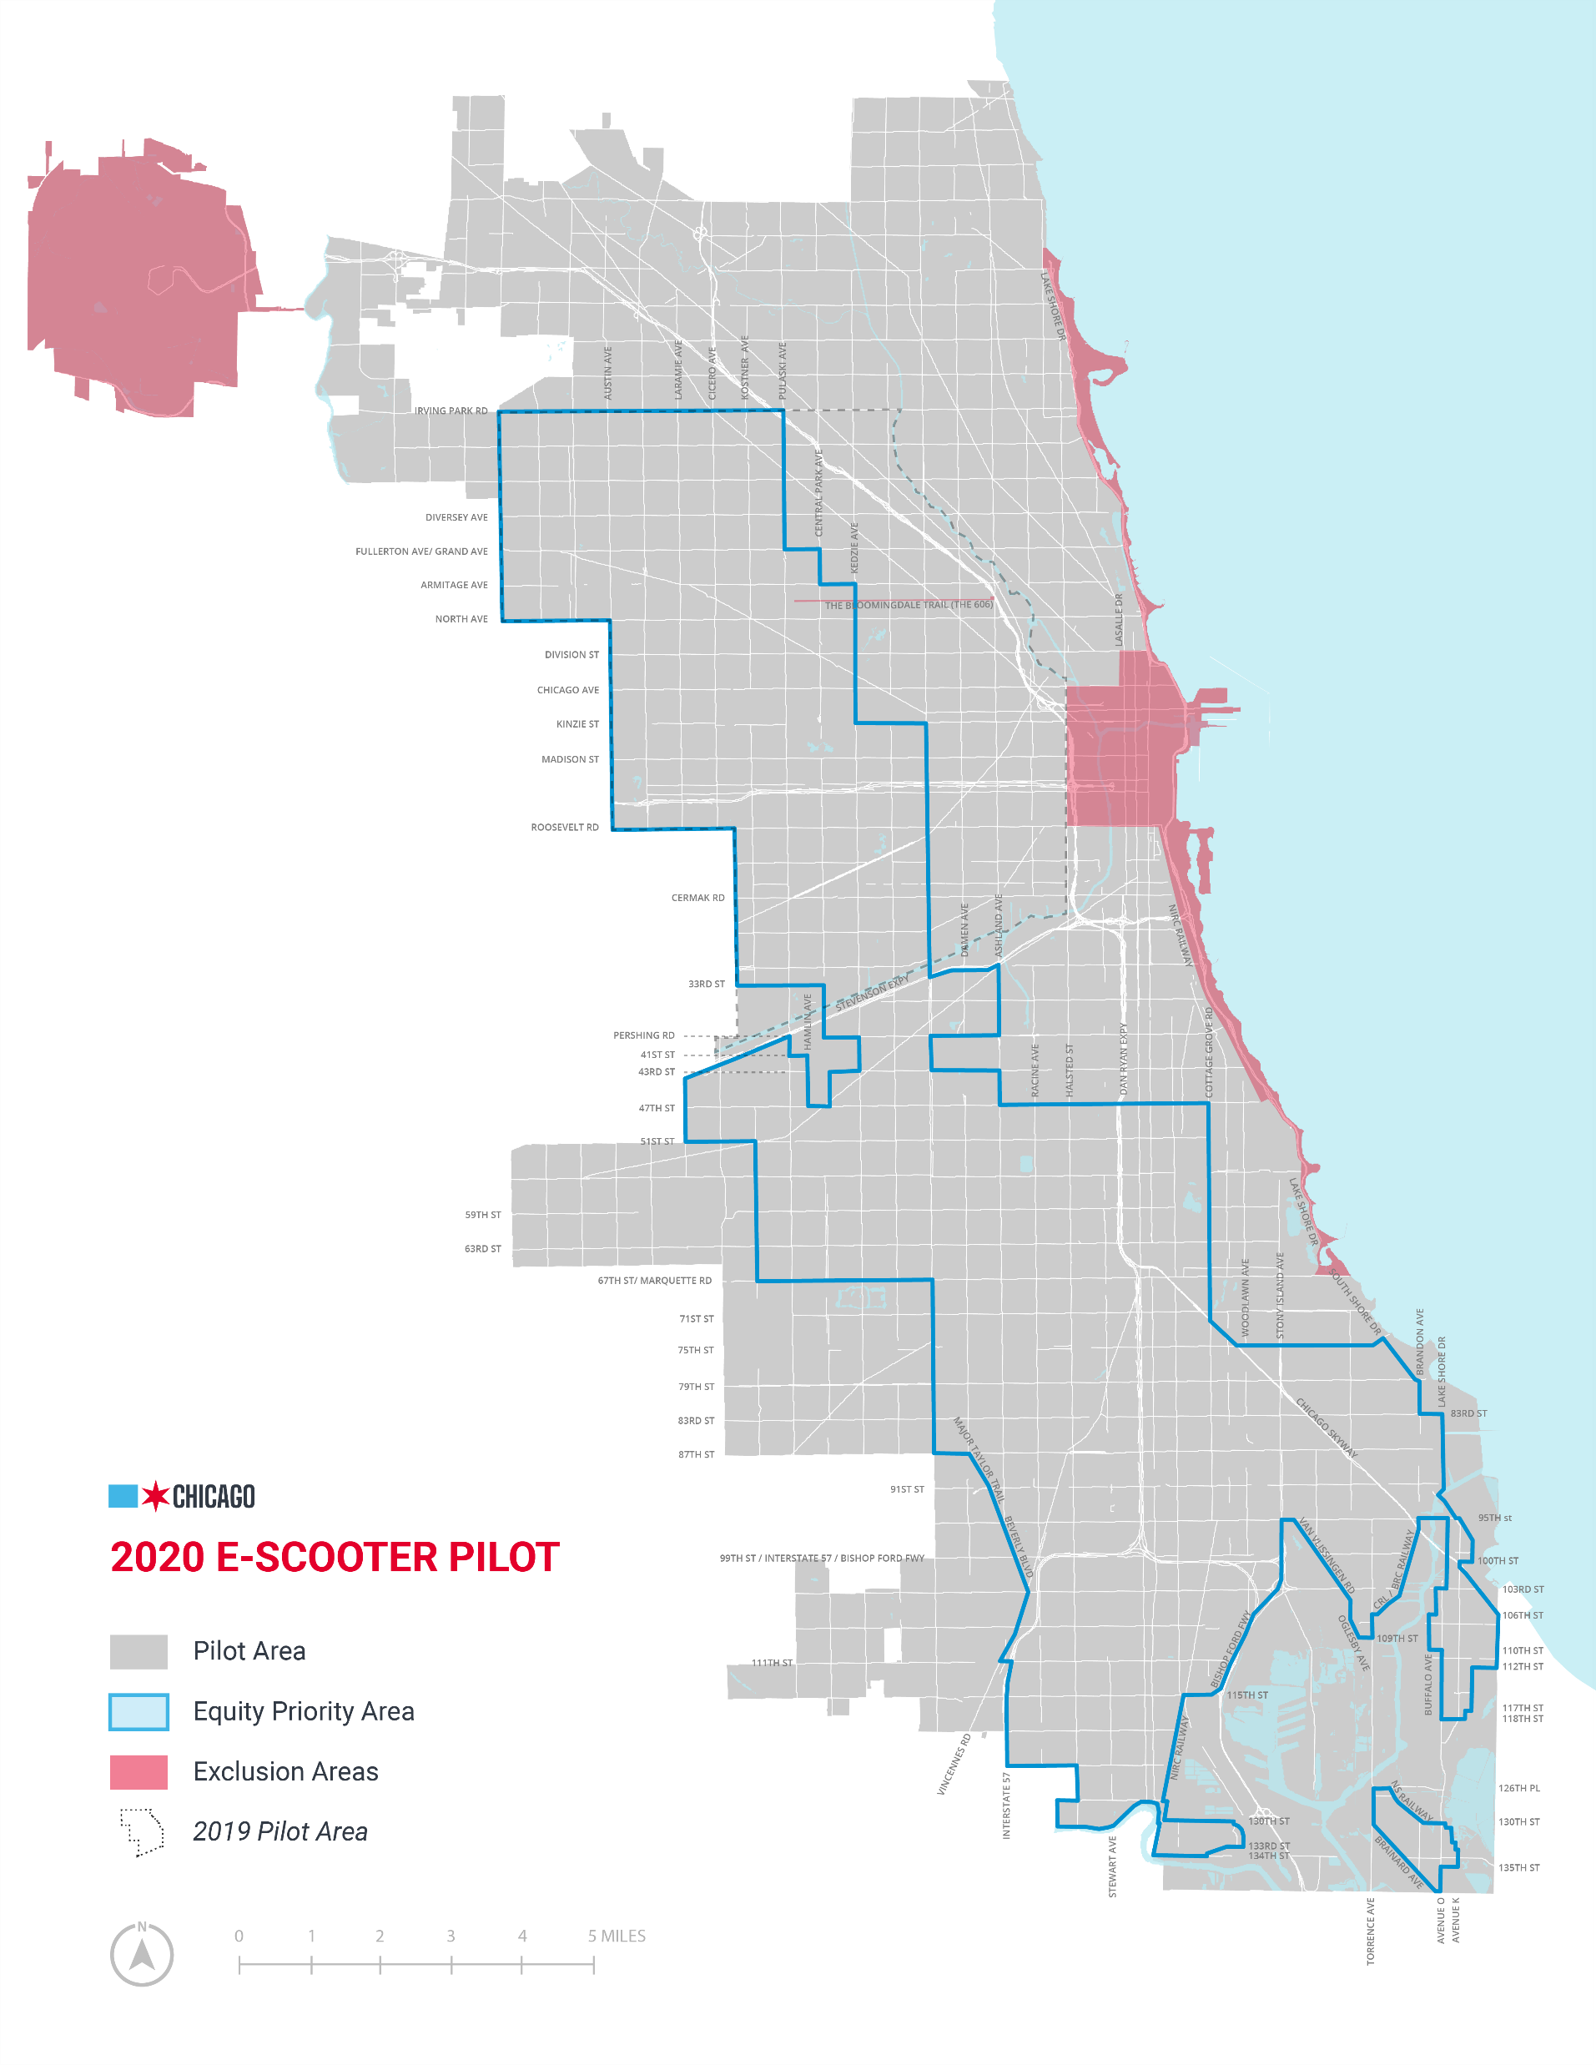
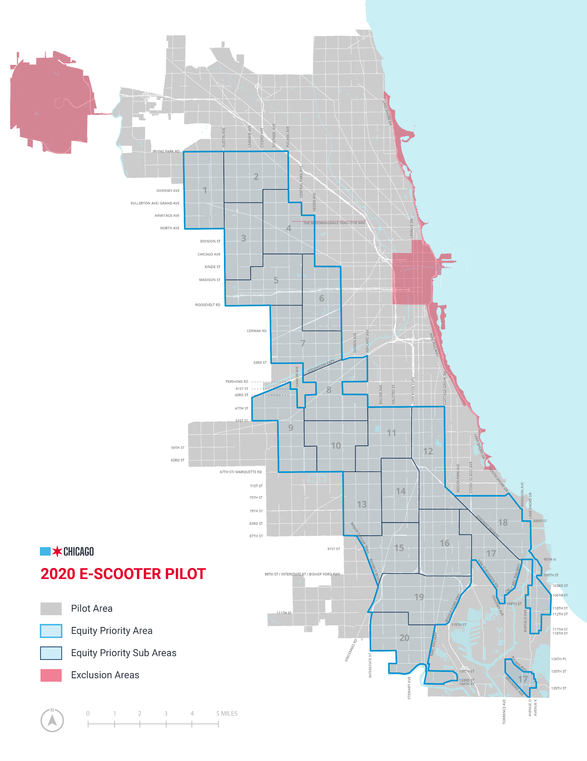
Pilot Overview
^{Priority Area}
^{43.4% of total Pilot land area}
44.6% of total Pilot population
50% of each vendors’ devices must be deployed in Priority Area
^{Priority Zones}
Priority Area divided into 20 zones, approximately 3.75 - 4.5 residential sq. miles each
2.5% of each vendors’ devices must be deployed in each Zone
Rebalancing will be tracked at 7am and 2pm each day

Slide 6
What Was Different in 2020?
Pilot covered 4x as much geography with 4x as many devices
Scooters had to be locked when parked
Pilot started and ended two months later than 2019
Vendors charged 2.5x as much per minute for rentals ($.39/minute vs. $.15/minute)
Divvy has expanded significantly since 2019, including introducing 3,000 new e-assist bikes
The pandemic changed travel behaviors (although Divvy saw increased ridership over 2019 in summer & fall)

Slide 7
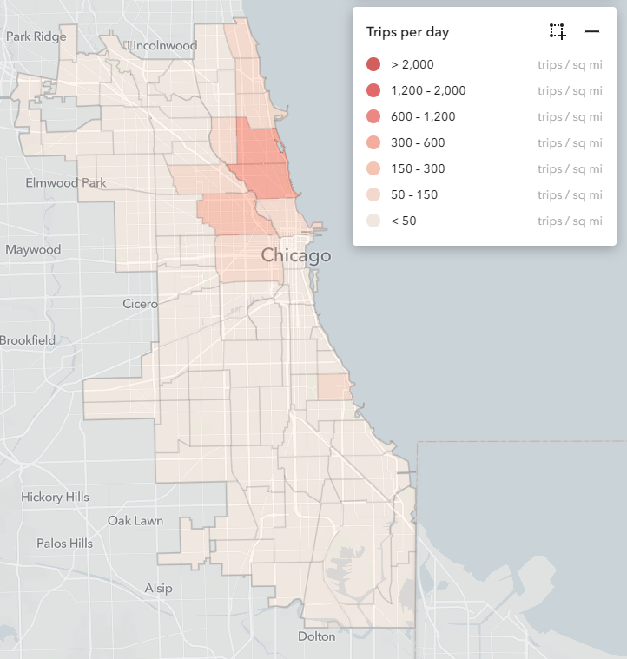
Preliminary Pilot Data
²⁰²⁰
^{Total Trips: 641,000}
Average Daily Ridership: 5,200 trips per day
Average Trip Distance: 1.64 miles
Trips per Device per Day: 0.71
Most Devices Deployed: 9,030 (Oct 14)
Most Single-Day Trips: 13,178 (Sept 5)
^{311 Reports per Day: 2.55}
^{Priority Area:} ^{Share of Deployments: 52%}
^{Share of Total Trips: 25%}
Average Trip Distance: 1.90 miles
²⁰¹⁹
^{821,000}
^{6,680 trips per day}
^{1.40 miles}
^{3.29}
^{2,244 (Sept 10)}
^{9,228 (June 22)}
^{2.7}
^{36%}
^{19%}
^{1.91 miles}
²⁰²⁰

Slide 8
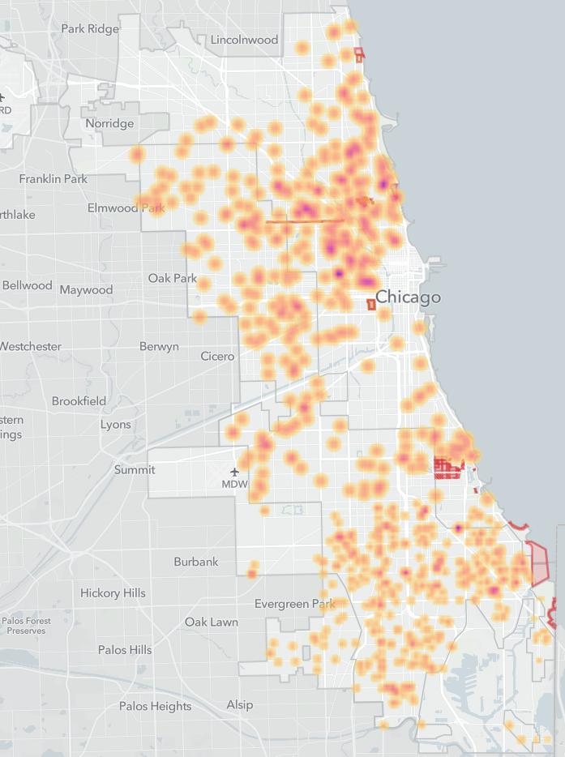
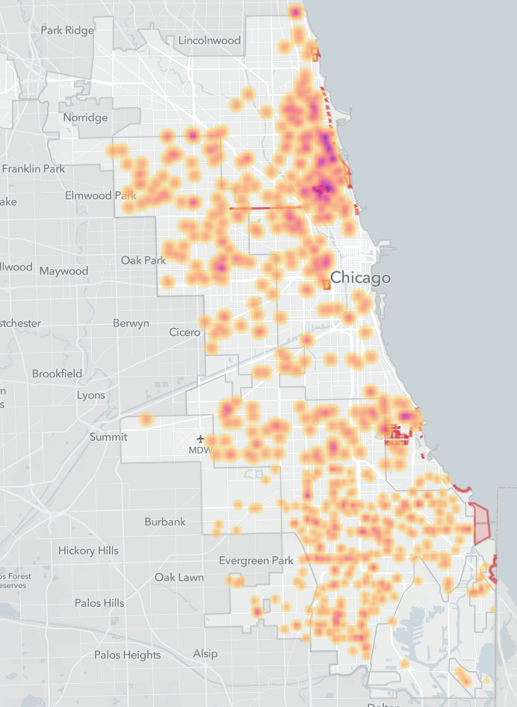
Preliminary Pilot Data
September 14
October 14

Slide 9
Initial Response
Initial feedback is that locking requirement helped mitigate a lot of nuisance & dangerous parking
However, some bicyclists reported it was more difficult to find parking because of scooters
Top 311 complaint was that a scooter was locked to private property (like a fence)
Like 2019, sidewalk riding was a concern despite promises by companies to address
No major issues on Bloomingdale Trail (606) or Lakefront Trail
No major issues impacting CTA operations

Slide 10
Pilot Successes
The final evaluation will measure how the pilot met its goals, but there are some initial successes:
The pilot demonstrated that an e-scooter program can be rolled out citywide in a relatively short amount of time
The pilot demonstrated that e-scooters can be consistently and properly deployed to priority areas
The City knows a lot more about locking technology and policies
The City knows a lot more about geofencing technology and policies
The City saw some significant benefits to limiting the number of e-scooter vendors
The City now has 4 months of additional trips and device deployment data to help better understand patterns and behaviors
The City partnered with researchers at UIC to deploy a survey of riders that utilized a rigorous randomized sampling process

Slide 11
Next Steps
Next Steps:
A thorough evaluation is under review, and the report is expected to be completed in early 2021
Public survey is now live: https://www.surveymonkey.com/r/2020PilotSurvey
We are beginning to debrief with vendors. We’ve sent them requests for feedback, data and reporting
We are debriefing with departments, agencies, community stakeholders and elected officials
Final report will pull together analysis of multiple datasets, including trips, deployments, 311 reports and citations
Future availability of shared scooters will require going to City Council

Slide 12
Feedback
Questions for Conversation:
What were the positive impacts of the e-scooter pilot?
What were the negative impacts of the e-scooter pilot?
How did the 2020 pilot work better or worse than the 2019 pilot?
What rules worked well and what rules should be changed?
Were there outstanding challenges that we still need to address?

