Slide 1
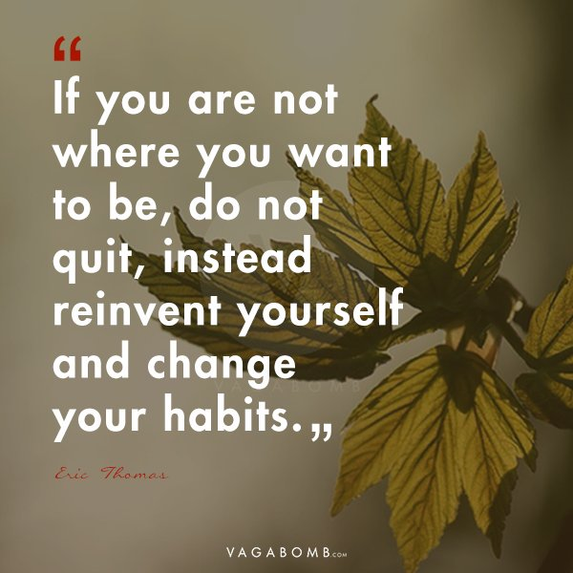
Practical, Spiritual and Motivational Support for Persons in Career Transition
Back On Track
Tuesday, Nov 30, 7pm-8:30pm
JOB SEARCH NOW OR WAIT UNTIL AFTER THE NEW YEAR?
JOIN THE BACK ON TRACK TEAM AND BIANCA MOREIRAS, CAREER DEVELOPMENT AND TRANSITION COACH AND BUSINESS DEVELOPMENT CONSULTANT
Let’s talk about having the perfect resume and have it ready to go
Putting together your accomplishments, strengths and weakness
Contacting references and letting them they might receive a call and to act promptly
The value of networking, LinkedIn, Indeed and recruiters
You get the interview, now what? Let’s practice those tough questions and the various answers that will work for you.
Negotiating the best salary for you, not just taking the offer.
Zoom link: https://zoom.us/j/9543841605
t
December 14
The Avent Season
With Deacon Nestor Cardenas
Open to all interested in attending! FREE! Bring a friend!
St Bonaventure Catholic Church Parish Center
1301 SW 136th Ave, Davie, FL 33325
Visit our Facebook page backontracknet for more information

