Slide 1

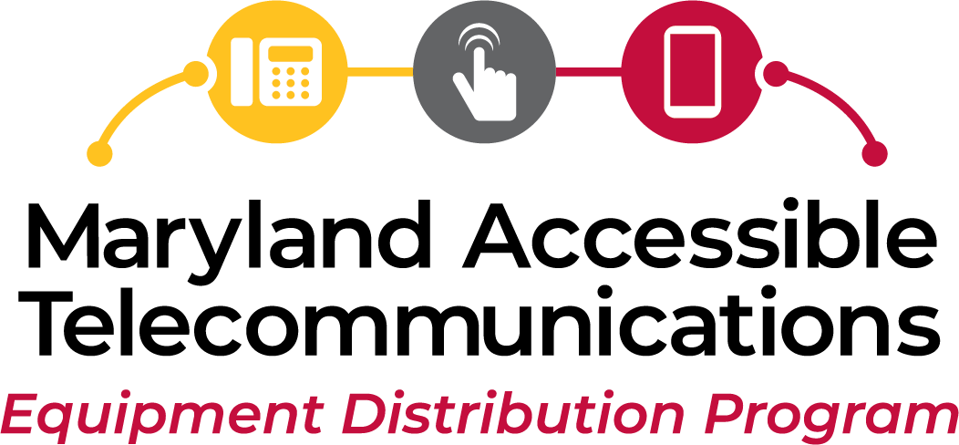
The Maryland Accessible Telecommunications (MAT) Program
Provides assistive telecommunications devices to qualified Marylanders.
Notes:
Thank you Tarita!
MAT is a sibling program to MD Relay and Maryland TAP.
So, what do we do, who do we serve and how do you get our services??
That’s what you’re about to find out!
The MAT program puts accessible telecommunication devices in the hands of people who otherwise might not be able to find or afford accessible equipment.

Slide 2


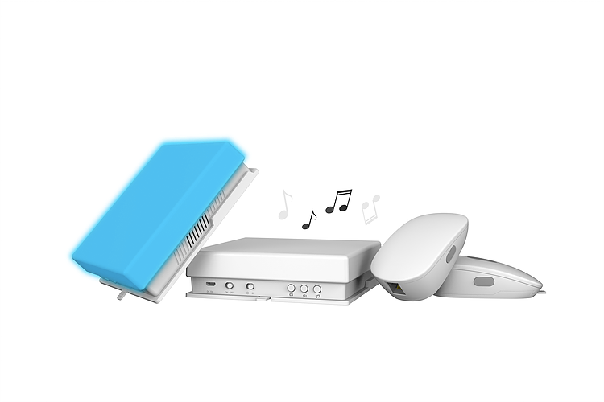
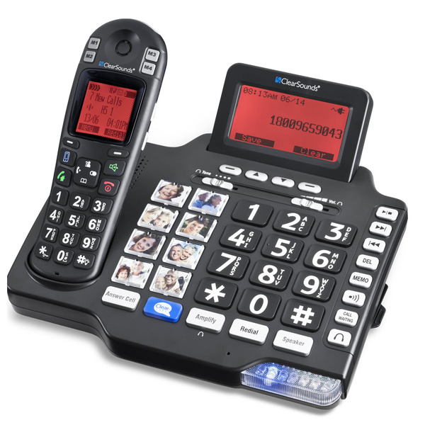
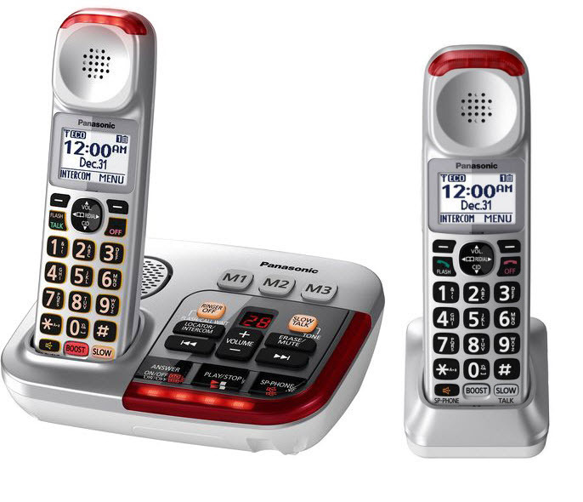
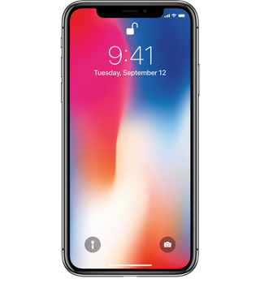
What Telecommunications Equipment is Available?
Amplified phones
Wireless devices
Large button phones
Picture phones
Captioned Telephones
Emergency dialers
Specialized switches
… and more…
Notes:
Telecommunication has evolved to not only mean traditional landline phones but wireless devices allowing video calls, zoom meetings, texting and emaliing.
Devices may also include switches, alerting devices and mounts.
However, we do not provide computers, telephone services or data plans.

Slide 3

Who Benefits From the MAT Program?
Deaf/Late-Deafened (severe to profound hearing loss)
Hard of Hearing (unable to hear speech on phone without amplification)
DeafBlind (severe to profound hearing loss AND loss of sight)
Difficulty Speaking (unable to speak intelligibly/loudly on phone)
Low Vision/Blind (blind/significant loss of field/acuity; legally blind)
Limited Mobility (little/no ability to grip, lift, hold or dial phone; difficulty walking)
Cognitive Difficulty (difficulty dialing series of numbers)
Notes:
Who do we serve – we focus on 7 areas of accessibility needs which include access to people who are….

Slide 4

MAT Program Eligibility–Who Qualifies?
Residents of Maryland
Persons at least
3 years and older
Persons on a limited income
Veterans receiving benefits
Persons who are certified as having difficulty using a standard telephone
Persons who have phone service (if the equipment requires it)
Notes:
To qualify for the MAT program individuals must …..

Slide 5
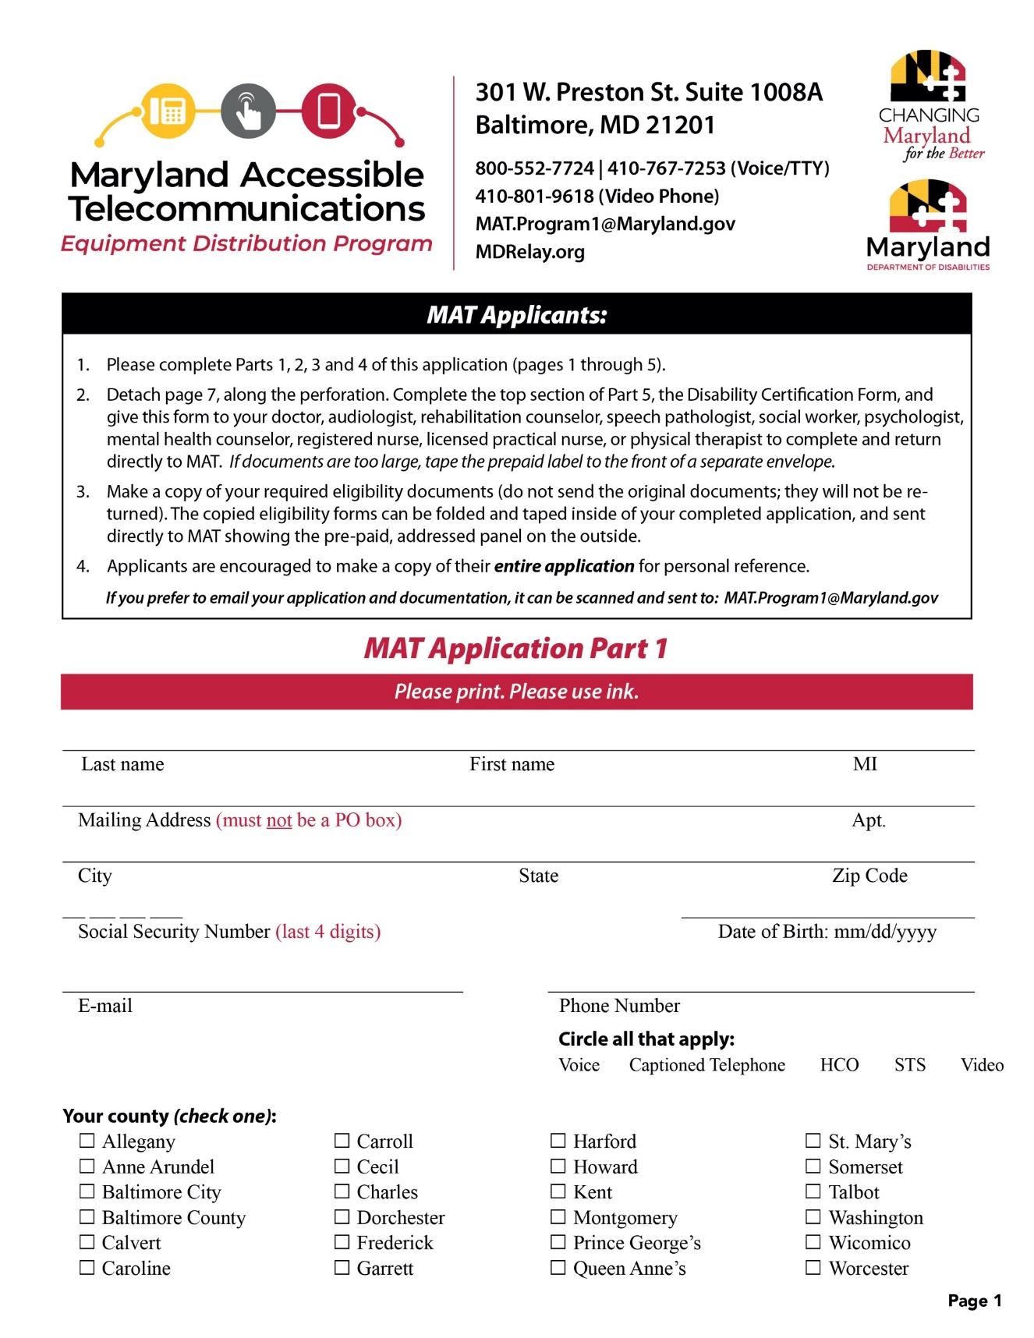
Application Details
  Available online at MDRelay.org – equipment tab
  Call 800-552-7724 or 410-767-6960 (Voice/TTY) or 443-453-5970 (Video Phone) to request by mail
  Email us at MAT.Program1@Maryland.gov and request an electronic application
Notes:
Find the application to the MAT program online at mdrelay.org – click on the equipment tab to find more info and a donwloadable application form.
You can also call or email us to request an application be sent electronically or by snailmail.

Slide 6
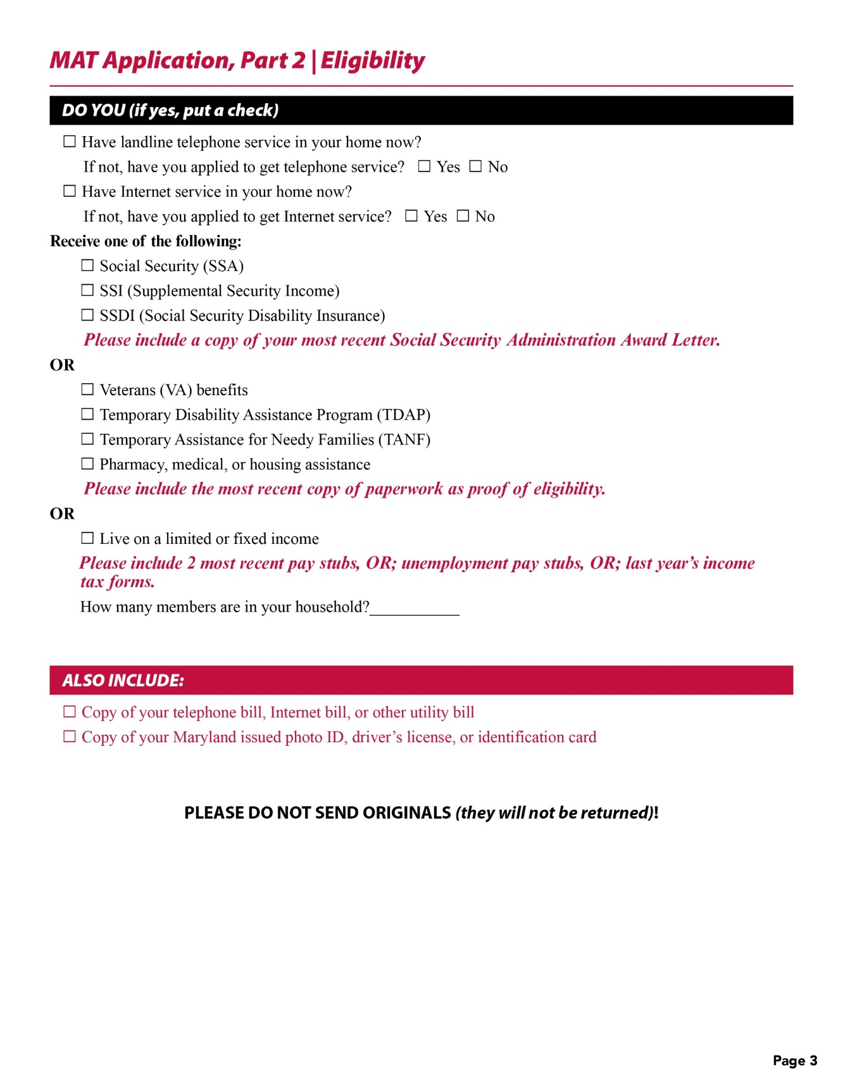
Required Documents
Copies of:
Internet, phone or utility bill
One proof of income
  Acceptable forms listed on application
Copy of Photo ID
Notes:
The application asks for some basic information and requires 3 supporting documents….
And, finally, the Disability Certification Form

Slide 7
Disability Certification Form (Part 4 and 5)
Who Can Sign on Part 5
Any licensed health care provider that can attest to the applicant’s disability
Social Worker
VR Counselor
PT, OT, audiologist
SLP, physician, nurse…
Notes:
This form is the confirmation by a licensed healthcare provider to the individual’s disability and that they would benefit from the MAT program.
The top is completed and signed by the individual and the bottom by the healthcare provider.

Slide 8
mat.program1@maryland.gov
Fax – 410-767-4276
USPS
Notes:
Once the application and supporting documents are completed, they can be submitted by email, fax or just dropped in regular mail.

Slide 9
What happens next???
Email or letter of approval is sent
Evaluator contact information shared
Assessment is scheduled remotely or in person
Equipment decision is made
Equipment received and follow-up services provided as needed
Notes:
So, what happens next….

Slide 10
About our Equipment….
We are a loan program
Equipment covered for 3 years
What if my needs change

Slide 11
Communication Facilitator
COMMUNICATION FACILITATOR
For Deafblind
Tactile and Protactile communicators
Services provided at home or in the community
Notes:
There is one other means of accessible telecommunication I want to introduce – it’s actually a service provided to Deafblind citizens of MD called Communication Facilitator.
Deaf individuals who use American Sign Language make phone calls through a videophone. They see each other so that they have full robust communication in their native language. If they speak to a hearing person, an ASL fluent operator appears on the screen and interprets what a hearing person says. This means of communication depends on sight. What happens if you are Deafblind and using tactile or protactile ASL to communicate?
I’m going to show you a short clip of a training hosted by the MAT program for Communication Facilitators working with Deafblind individuals to give you a better sense of how this mode of in-person communication works.

Slide 12
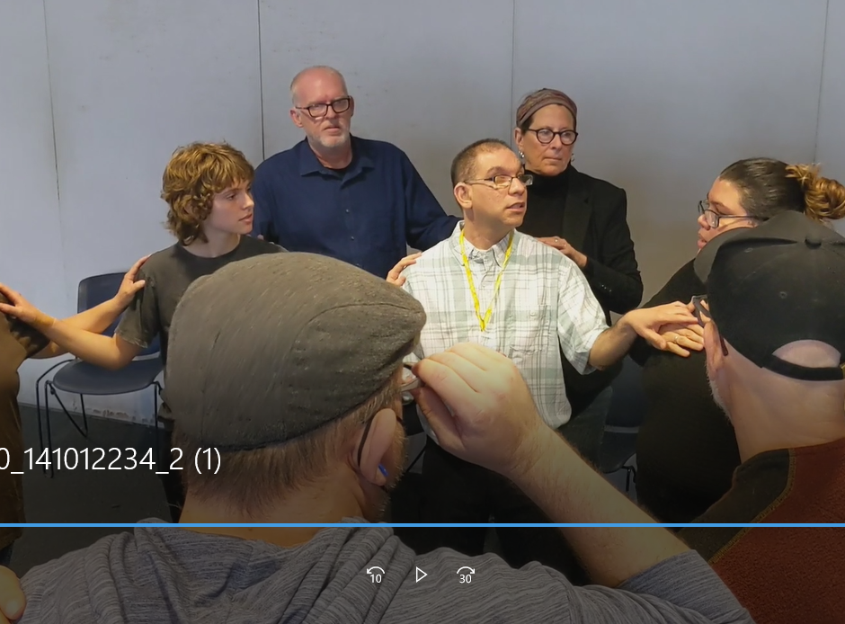
Notes:
First – what’s the difference between tactile and pro-tactile ASL?
Tactile is what

Slide 13


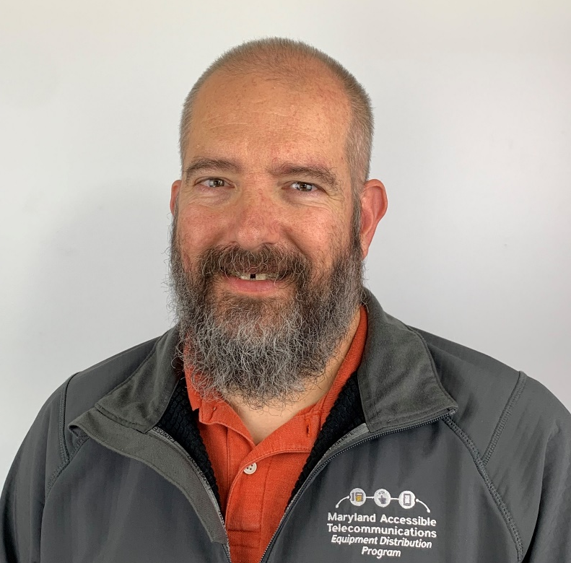

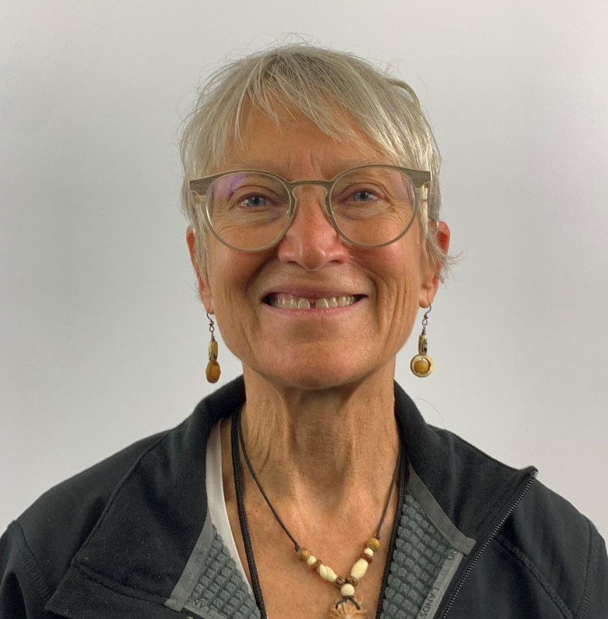



Contact Us
Kevin Steffy
MAT Program Manager
410-246-4418 (VRS)
443-852-6717 (Text)
Kevin.Steffy@maryland.gov
Tarita Turner
TRS Outreach Coordinator
410-767-8828 (Voice/TTY)
240-920-9594 (Cell)
tarita.turner@hamiltonrelay.com
Jane Hager
MAT Program Specialist
410-767-7253 (Voice/TTY)
301-974-1946 (Cell)
Jane.Hager@maryland.gov
MDRelay.org
MarylandRelay711
MDRelay711

Slide 14

Larry Hogan
Governor
Carol A. Beatty
Secretary
Boyd K. Rutherford
Lt. Governor
Christian J. Miele
Deputy Secretary

