Slide 1
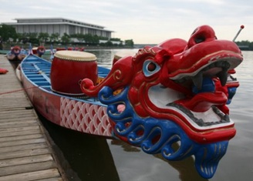
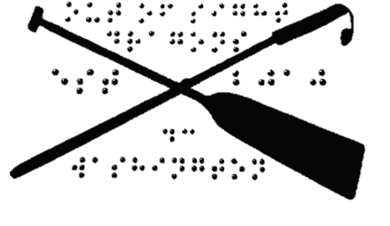
History of dragon boat racing
Join us!
Out of Sight Dragons
Membership is open to visually-impaired and blind individuals, sighted friends and family, and anyone in the greater DC area that has an interest in participating in a great sport with an awesome group of people. Members must be 16 or older.
Connect & Donate
http://outofsightdragons.org/
Send checks to
Out of Sight Dragons, Inc.
514 Constitution Ave NE, WDC 20002
(202) 599-7395
OutOfSightDragonsDC@gmail.com
www.facebook.com/outofsightdc
OSD is a 501(c)3 non-profit organization. Donations are tax-deductible to the extent allowed by the law.
Dragon boat racing emerged as far back as 2,500 years ago, during the Warring States Period (402-221 BCE). Originating among fishing communities along the Yangtze River in southern central China, it was initially a folk ritual designed to appease the rain gods, the dragon water deities, encourage rainfall and celebrate the summer rice planting.
Dragon boat racing began as a modern sport in 1976 in Hong Kong. In 1991, the International Dragon Boat Federation (IDBF) was established along with a set of institutional rules and regulations governing the sport.
It is one of the fastest growing sports in the world. Now, dragon boat racing is practiced in over sixty countries around the world, with over 50 million dragon boaters.
WASHINGTON DC
Join us for Team Building, Exercise, Fun and Friendship!

Slide 2
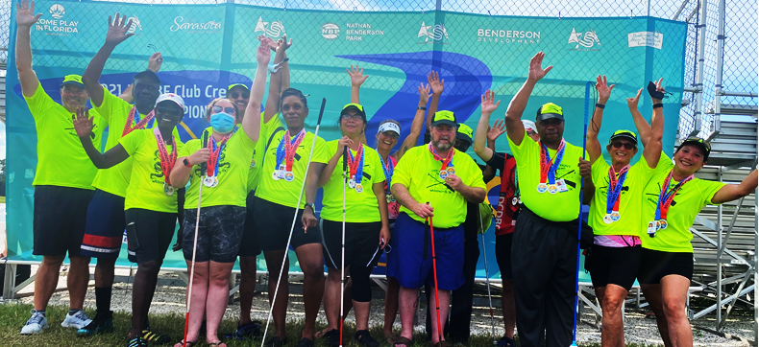
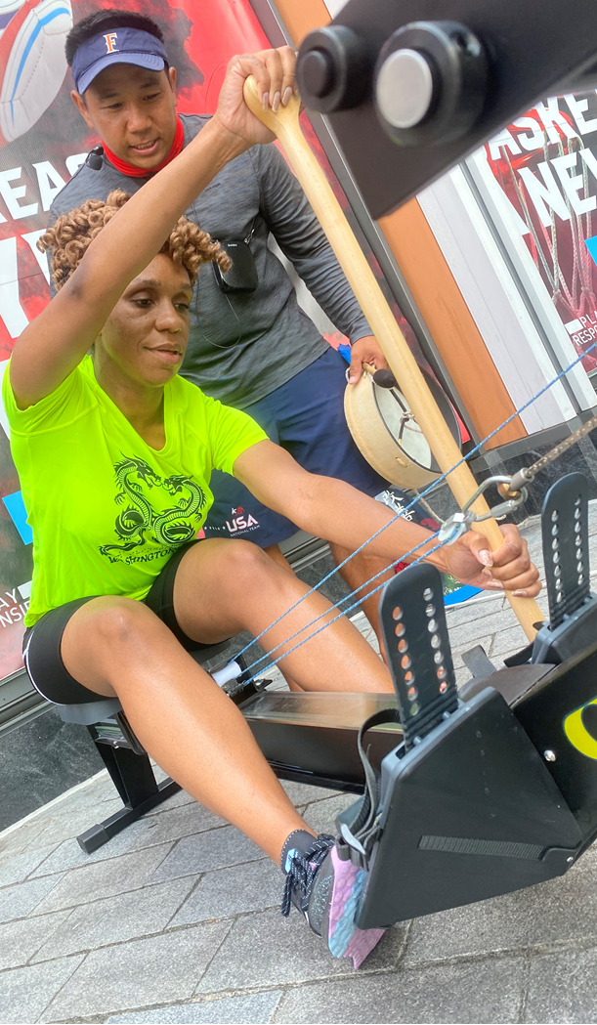
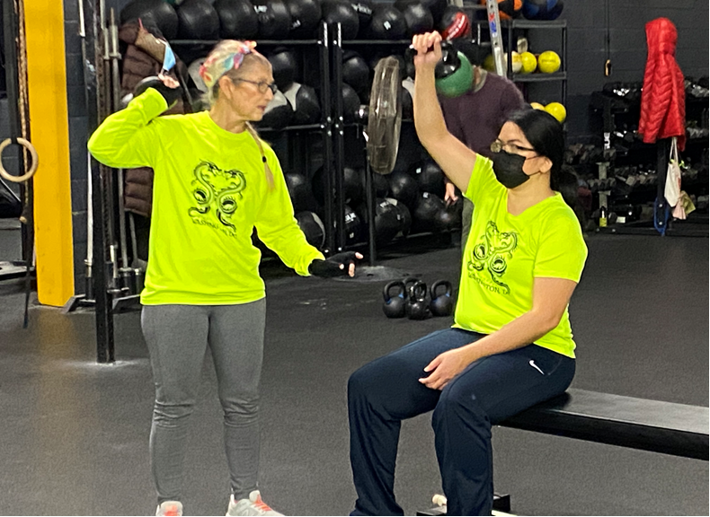
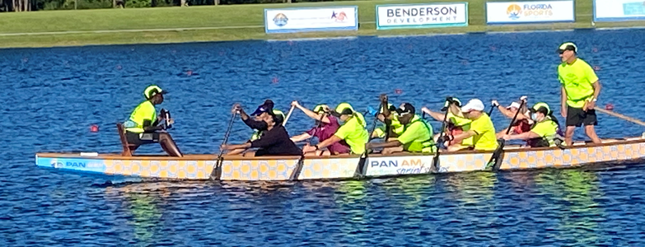
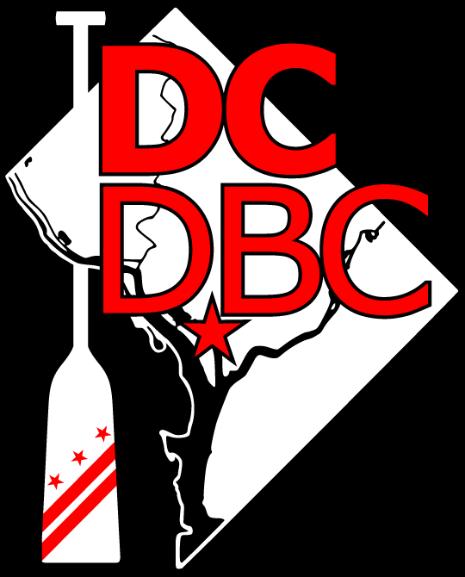
Our team
Training
Volunteers
& Donors
Blind and visually impaired paddlers receive on-land and in-boat training from highly skilled and experienced sighted coaches. Practices incorporate stroke timing, paddling techniques, and strength and endurance training. This sport provides excellent core exercises to build stamina, full body physical conditioning and opportunities to be on the water.
During the off-season, paddlers keep up their workouts with winter pool practices at local gyms in the DC Metro area.
We practice at The Wharf in southwest DC, meeting at the Maine Lobsterman Memorial at Market Pier.
It is in between the metro stations of L’Enfant Plaza and Waterfront/SEU.
Coaches and paddling instructions are generously provided by our host club, the DC Dragon Boat Club.
http://dcdragonboat.org/OSD
The Out of Sight Dragons (OSD) is the premier dragon boat team of the blind and visually impaired in the Mid-Atlantic area.
Dragon boat racing is an international sport, similar to canoeing, that uses paddles. Each boat has 10 or 20 paddlers sitting side-by-side, a drummer and an oarsperson to steer the boat. It is governed by the International Dragon Boat Federation (IDBF).
OSD provides a fabulous opportunity for visually-impaired individuals to learn a water sport as well as meet others who believe in physical well being through competition.
We regularly compete in the DC Dragon Boat Festival in May and the National Harbor Regatta in August. The team hopes to start travel competition to Baltimore, Philadelphia, New York and beyond.
This team would not exist without the support of volunteers.
We currently need help in the following areas: walking escorts, drivers, paddlers, event managers, public relations, website design, equipment managers and more.
Thank you to our Sponsors who have generously donated to support us:
DC Dragon Boat Club
Lions Clubs of DC, MD, and VA
DC Council of the Blind
Episcopal Church of the Ascension
Carol Schwobel

