Slide 1
PROJECT UPDATE Gathering Input on the Draft Plan
June 17, 2020

Slide 2
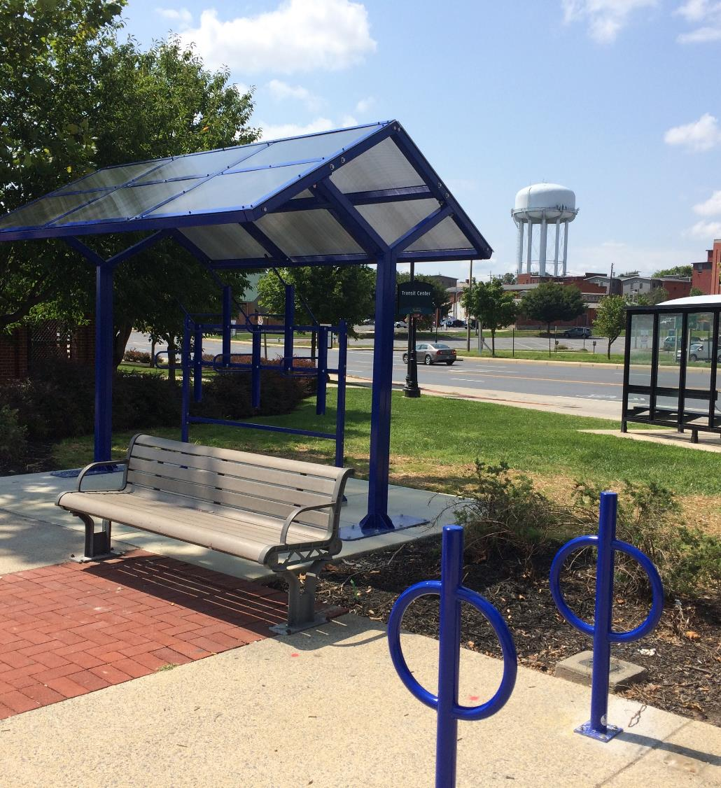
PRESENTATION OUTLINE
RTP Background
Draft Plan Overview
Review Process & Next Steps
Questions

Slide 3
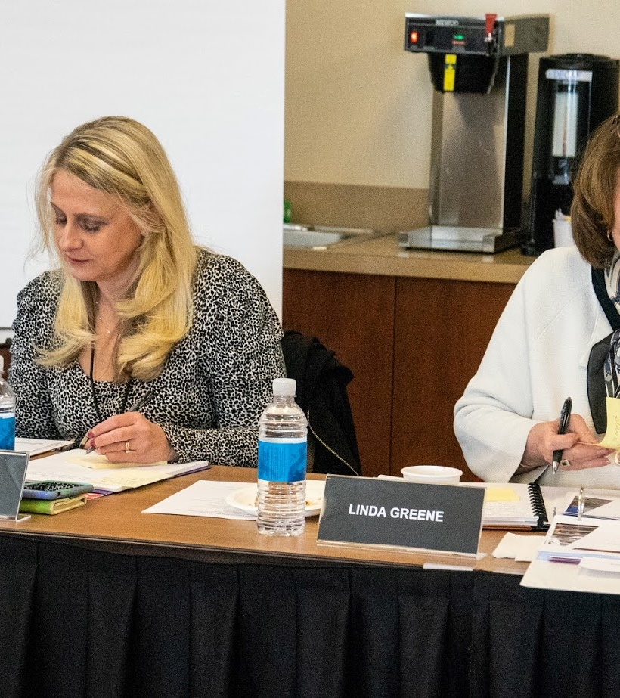
RTP BACKGROUND

Slide 4
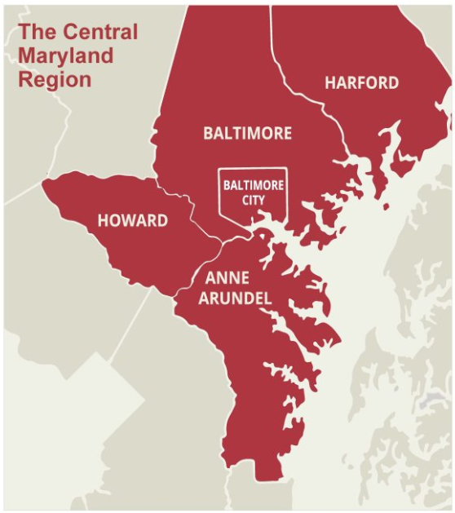
RTP Background | Purpose & Approach
BACKGROUND:
MDOT MTA is developing this 25-year plan to meet Central Maryland’s transit needs
The Plan looks at traditional transit (buses and trains) and explores new mobility options and technology
The Plan includes MDOT, Locally Operated Transit Services (LOTS), and paratransit providers

Slide 5
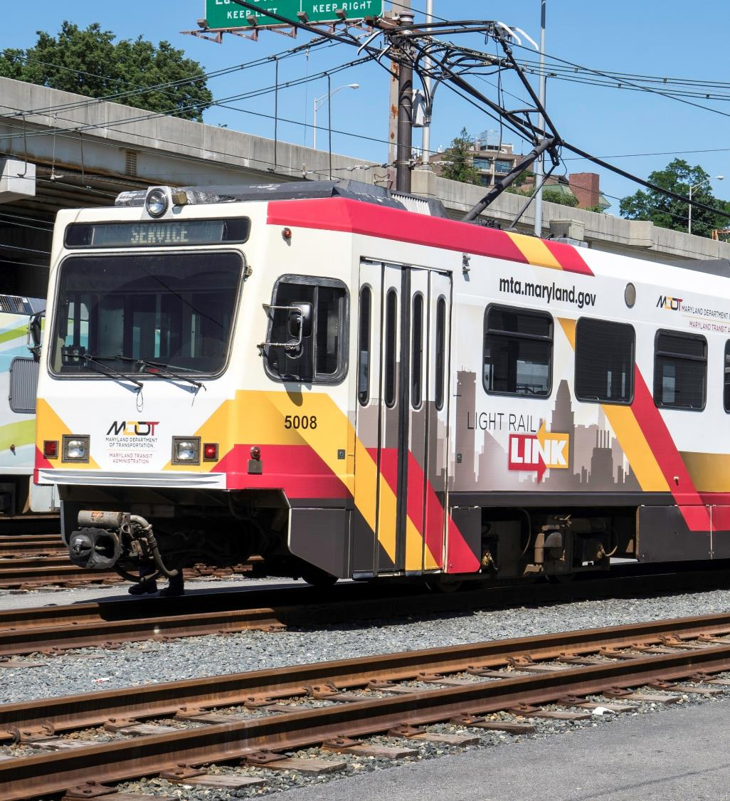
DRAFT PLAN OVERVIEW

Slide 6
Goals
Optimize existing transit services
Improve connectivity & integration of existing & future transit services
Enhance fiscal sustainability
Objectives
Provide Faster, More Reliable Service
Grow Ridership
Increase Access to Jobs & Opportunities
Improve the Customer Experience
Be Equitable
Prepare for the Future
Initiatives
Strategies
Transit Network Improvements
Regional Transit Corridors
Regional Transit Plan Structure

Slide 7
Draft Plan Overview | Strategies to support transit equity
Objective: Be Equitable
Strategy: Improve trip scheduling
Strategy: Incorporate disability sensitivity training for front-line transit employees
Strategy: Ensure there is good transit service to grocery stores, medical facilities, and educational institutions
Strategy: Synchronize paratransit span of service with local bus service

Slide 8
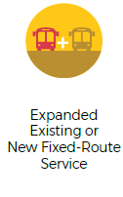
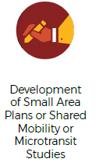
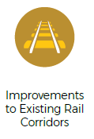
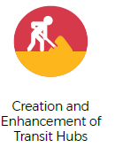
Draft Plan Overview | Transit Network Improvements
TRANSIT NETWORK IMPROVEMENTS expand or enhance current or previous investments.

Slide 9
Draft Plan Overview | Regional Transit Corridors
REGIONAL TRANSIT CORRIDORS demonstrate:
Transit demand that justifies infrastructure, service, and/or technology improvements.
Demand supporting all-day frequent service.
Regional significance, often providing connectivity between different jurisdictions.

Slide 10
Draft Plan Overview | Targets
The Plan identifies targets, which will be tracked on a Progress Dashboard. Examples are:
Increase MDOT MTA’s on-time performance for Core Bus to 85% by 2025.
Maintain MDOT MTA’s standing as one of the safest transit systems out of the top 12 U.S. transit agencies.
Reach and maintain on-time performance for MDOT MTA paratransit service to 95% across the region by 2025

Slide 11
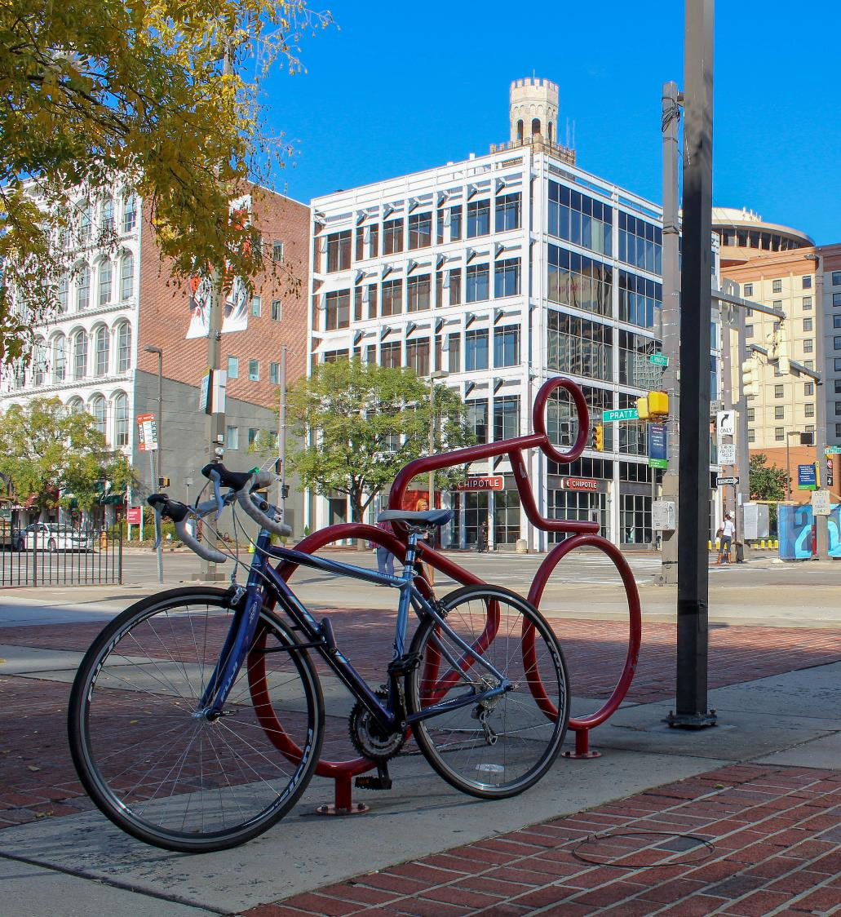
REVIEW PROCESS & NEXT STEPS

Slide 12
Web-based Outreach & Review
Primarily virtual outreach due to COVID-19
Project website for review and comment
Interactive web tool facilitates easy review and comment
Project email list
Targeted outreach with geo-targeted social media ads and presentations to key groups (like this one!)

Slide 13
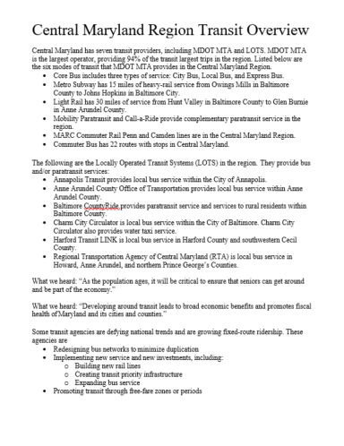
Traditional Outreach & Review
Additional avenues for outreach include:
Plan overview to share with community groups/organizations
Newspaper ads in local papers to notify regional residents
Accessible draft Plan documents
Project hotline to call for additional information
Live Chat with Project Team members to ask questions about the draft Plan

Slide 14
Next Steps and Key Dates
The Draft Plan launched April 22nd and will be open for public comment through June 18th
Virtual Commission meeting June 18th to discuss comments/public input:
By computer: rtp.mta.maryland.gov/commission
Call-in: 408-418-9388
Enter Access Code: 713 207 356
The Plan must be finalized prior to October 1st

Slide 15
Questions
Thank you!

