Slide 1
Community Outreach Meeting
Valley Metro Paratransit
RideChoice and
Other Accessible Transit Services
June 2017

Slide 2
Meeting Overview
About Valley Metro
Our Commitment to Accessibility
Summary of Changes to Valley Metro Paratransit/Dial-a-Ride Services
New and Improved East Valley RideChoice Program
Choosing Between RideChoice and Paratransit
Other Valley Metro Services
Discussion, Questions and Comments

Slide 3
About Valley Metro
Established in 1986 to plan and provide regional transportation services in Maricopa County
Greater Phoenix region, including 15 communities, Gila Bend and Ajo
47 bus routes and light rail
400 Vanpool vans and the Regional RideShare and Commute Solutions programs
Regional Customer Service and ADA paratransit eligibility certification services
ADA paratransit and alternative transportation programs serving seniors and people with disabilities

Slide 4
Our Commitment to Accessibility
Valley Metro is committed to providing passengers with safe, convenient and comfortable service that is accessible to and usable by all
Bus and light rail service
Accessible transit stations and stops
Lifts/ramps and kneelers on all buses
Level boarding at all light rail stations
Multiple mobility device securement areas on all vehicles
Priority seating areas for seniors and people with disabilities near all boarding doors
On-board stop announcements for all buses and trains
Appropriate training for all staff regarding passenger awareness and sensitivity
Accessible website, online trip planner and mobile tools
Complementary ADA paratransit for those individuals who are unable to use fixed-route transit for some or all trips
Additional transportation programs and services that increase independence and expand travel options

Slide 5
Local & Regional Paratransit/Dial-a-Ride Service Area Map

Slide 6
Valley Metro Paratransit Service Changes
Pertain only to service provided by Valley Metro
No changes for:
Phoenix/Southwest Valley
Glendale
Peoria
Changes do impact
East Valley
Northwest Valley
Regional Paratransit

Slide 7
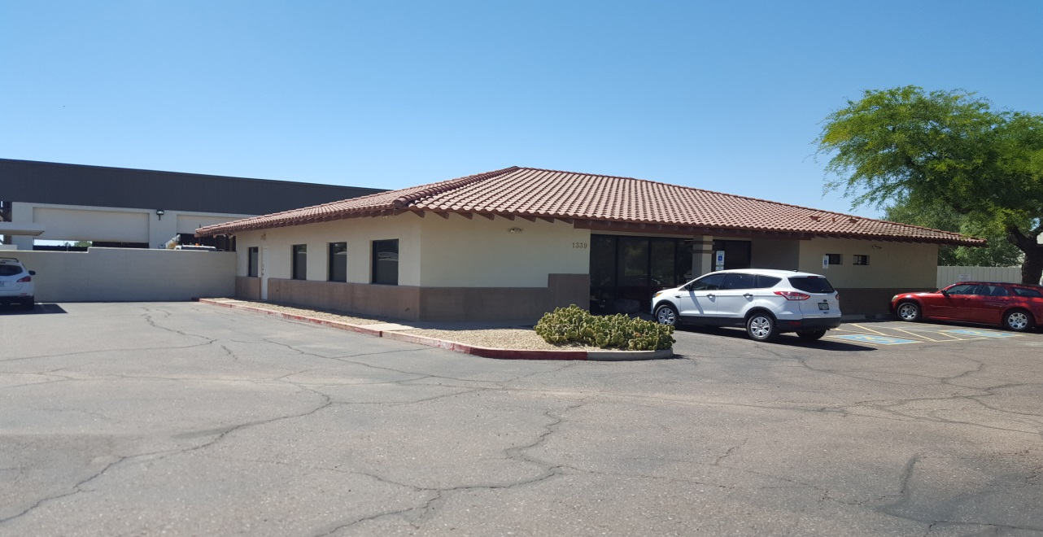
Valley Metro Paratransit Service Changes
New Provider – Transdev
Located at: 1339 W. San Pedro St., Gilbert

Slide 8
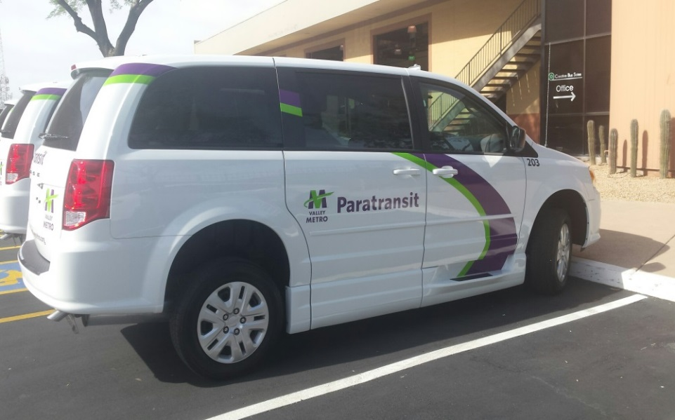
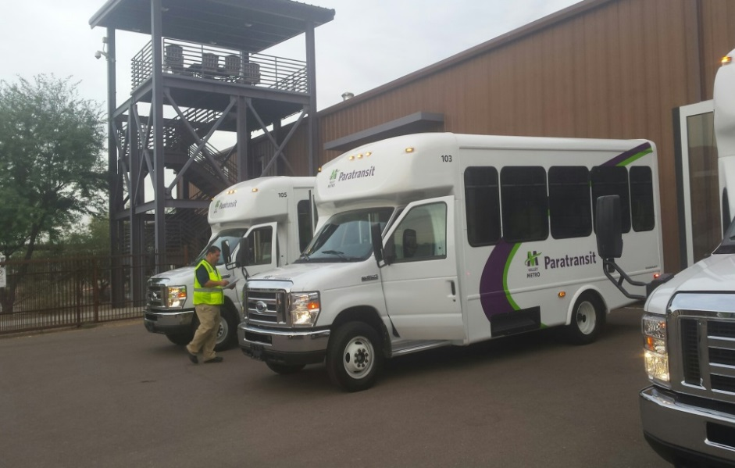
Valley Metro Paratransit Service Changes
New fleet
Lift-equipped vans, ramp equipped mini-vans
Fleet 100% wheelchair accessible
Supplemental taxi service provided by AAA

Slide 9
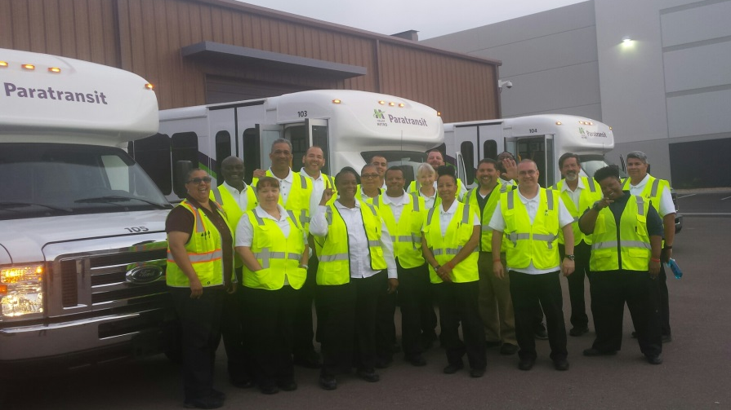
Valley Metro Paratransit Service Changes

Slide 10
Valley Metro Paratransit Service Changes
New Technology
July – Check on and cancel trips by phone
Later in 2017
Phone, mobile phone and online access for trip booking, confirmation, cancellation and ETAs
Later in 2017 – Automated calls, text messages or emails confirming trips on the night before travel and advising of the vehicle’s imminent arrival

Slide 11
Valley Metro RideChoice - Chandler
Up to $240 of service per month for 75% off
24 hours per day, 7 days per week
Choose your provider
No need to book ahead
No trip-sharing
Up to 3 additional passengers; no charge
Make a stop along the way
Wheelchair-accessible service available

Slide 12
Valley Metro RideChoice – Other EV Communities
$3 for up to a $18 trip
Up to 16 trips per month; more for work, school or medical
24 hours per day, 7 days per week
Choose your provider
No need to book ahead
No trip-sharing
Up to 3 additional passengers; no charge
Make a stop along the way
Wheelchair-accessible service available

Slide 13
Valley Metro RideChoice
Eligibility
Seniors 65+
ADA paratransit certified people with disabilities
Getting Started
No action needed for current customers.
Chandler residents will receive new blue card
Others: 16 trips loaded on your card each month, beginning July 1
Funds you have put on your RideChoice Card will transfer to the new card account.
Questions: Call Valley Metro at 602.716.2100

Slide 14
RideChoice vs. Paratransit
Use RideChoice for:
Short local trips
Last-minute trips
Trips involving a short stop along the way
Trips with more than one additional passenger
Use paratransit for:
Longer trips

Slide 15
Other Service Options
--ADA Platinum Pass
Bus and light rail at no cost
Must be ADA paratransit eligible to participate
Travel Training for people with disabilities
One on one training to use bus and light rail
No cost to participate

Slide 16
General Information
General Information Contact Valley Metro
602.716.2100
Paratransit@valleymetro.org
CSR@valleymetro.org
Complaints or concerns – 602-253-5000

Slide 17
Questions and Comments?

