Slide 1
April 2019

Slide 2
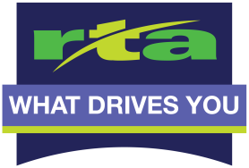
Help us with our plan…
Terence H. Fontaine
Executive Vice President
Government & Public Affairs
Potential for more reliable service ►
Right sized options►
More high-frequency routes ►
More options for connections ►
2020 RTA’s New
Bus Network
Notes:
Over time our region has changed by people leaving the area (recession), sprawling out into new areas, moving back into downtown (younger generations and urban living), as well as jobs coming back to the region. As this has occurred overtime, our system has relatively stayed static.
To respond to this lack of change, we can now use our leadership and technology to find ways to improve the overall look and function of our service.

Slide 3
Population, Service Hours, & Ridership
Why redesign now?
Montgomery County Population
Actual Revenue Hours
Boardings

Slide 4
Fare Box Recovery Rate Peer Comparison
Why redesign now?
2015
2016

Slide 5
Weekday Ridership (ONS) by Route (Feb 2018)
Why redesign now?
Notes:
Ridership on the local bus system has declined nearly ?% between 1999 and 2018
The Board of Directors committed to focusing on local bus service improvements.
How can we improve service for existing customers?
How can we attract new riders to the system and respond to ridership decline?
How can we create a system that will sustain the anticipated growth for the region?
RTA’s new local bus network will be better for you, better for our customers

Slide 6
Existing Service Feb 2018

Slide 7
Existing Service Feb 2018

Slide 8
Some basic and common redesign concepts:
Expanded coverage
Frequent service
30 minutes or less wait times
Faster, more direct service
Access to Jobs
Additional service hours
Connectivity between routes
On-demand, door to door service
Notes:
Designated bus lanes includes fewer bus stops, traffic light priority, possible bus only lanes, and frequent buses every 10 minutes to keep the route fast and consistent. This works on heavily dense areas.
Expanded coverage refers to route extensions or new routes to currently unserved areas.
High frequencies is how often a bus is expected to service a normal bus stop. Industry standards define a high frequency as a bus every 10 to 15 minutes. Relatively low frequencies are often considered 45 minutes to 1 hour.
Direct/walkable service refers to a customer being able to comfortably walk to a stop. It also means that a route is direct and avoids unnecessary deviations to keep the route as straight (linear) as possible. It is by definition preferred to have stops on walkable main thoroughfares to avoid deviations and door to door access to instead keep routes faster and more frequent.
30 minute or less wait times refers to simplifying large portions of the system to have easy to remember (and average) frequencies at 30 minutes. In other words, a bus is expected to service stops consistently every ½ hour. This is easy to remember.
Additional service hours means adding either weekday and/or weekend service hours to increase the customers ability to access service. This could mean moving to 24 hour service, but other alternative options should be considered as well.
Multi-modal refers to a customer using multiple RTA services on their daily commute. This could be fixed route with a Link bike for the last mile, RTA Connect to a fixed route bus to a Link bike for last mile service, etc.
Connectivity refers to route to route access that avoids forcing a customer from traveling back to a hub to transfer buses to reach a destination.

Slide 9
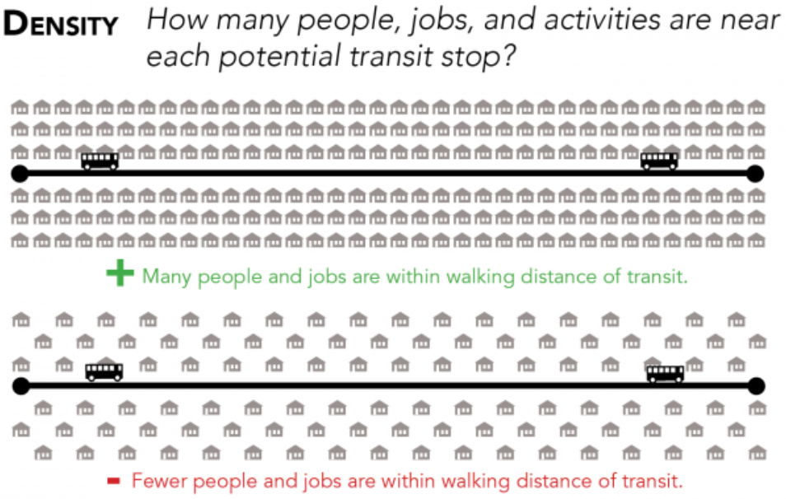
Ridership versus Coverage:
Source: Human Transit: The professional blog of transit consultant Jarrett Walker; https://humantransit.org/2015/07/mega-explainer-the-ridership-recipe.html

Slide 10
Ridership versus Coverage:
Ridership Network
Source: VTA’s next network: Your transit choices. Jarrett Walker& Associates. https://www.slideshare.net/SCVTA/vtas-next-network-your-transit-choices

Slide 11
Ridership versus Coverage:
Ridership versus Coverage:
Source: VTA’s next network: Your transit choices. Jarrett Walker& Associates. https://www.slideshare.net/SCVTA/vtas-next-network-your-transit-choices

Slide 12
Frequencies:
Wright Stop Plaza
9
11
12
14
16
17
18
19
22
34
4
2
1
8
7
X5
15 Minutes
25 Minutes
30 Minutes
40 Minutes
60 Minutes

Slide 13
Frequencies:
NW Transit Center
2
8
9
14
17
22
34
ET Transit Center
2
4
11
23
15 Minutes
25 Minutes
30 Minutes
40 Minutes
60 Minutes
South Transit Center
17
19
23
24
WT Transit Center
1
4
8
9
22
24

Slide 14
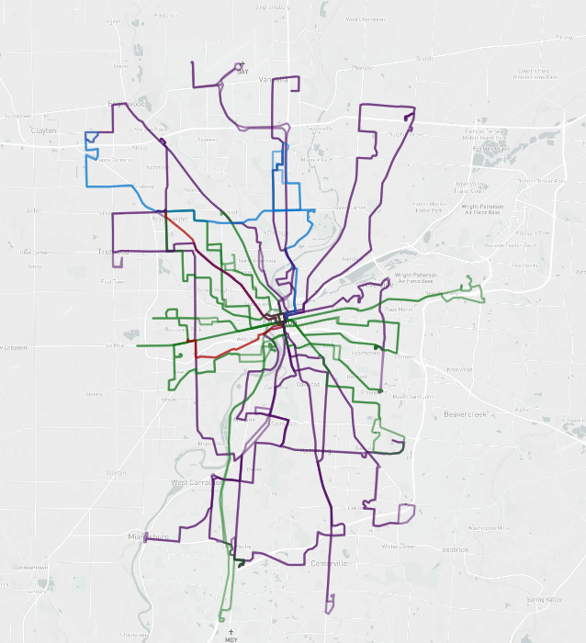
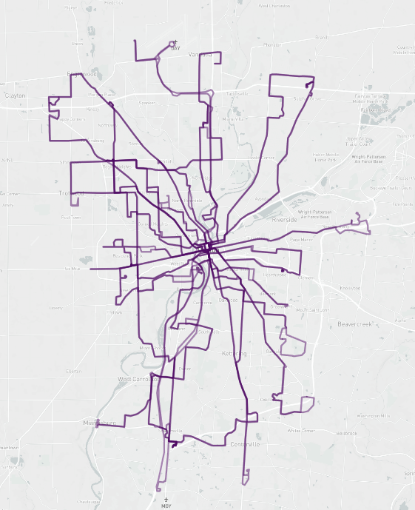
Additional Service Hours:
Saturday Sunday
Minutes
Less than 30
30-59
60-70
70+
Minutes
Less than 30
30-59
60-70
70+

Slide 15
Faster, more Direct Service:
Source: Human Transit: The professional blog of transit consultant Jarrett Walker; https://humantransit.org/2015/07/mega-explainer-the-ridership-recipe.html

Slide 16
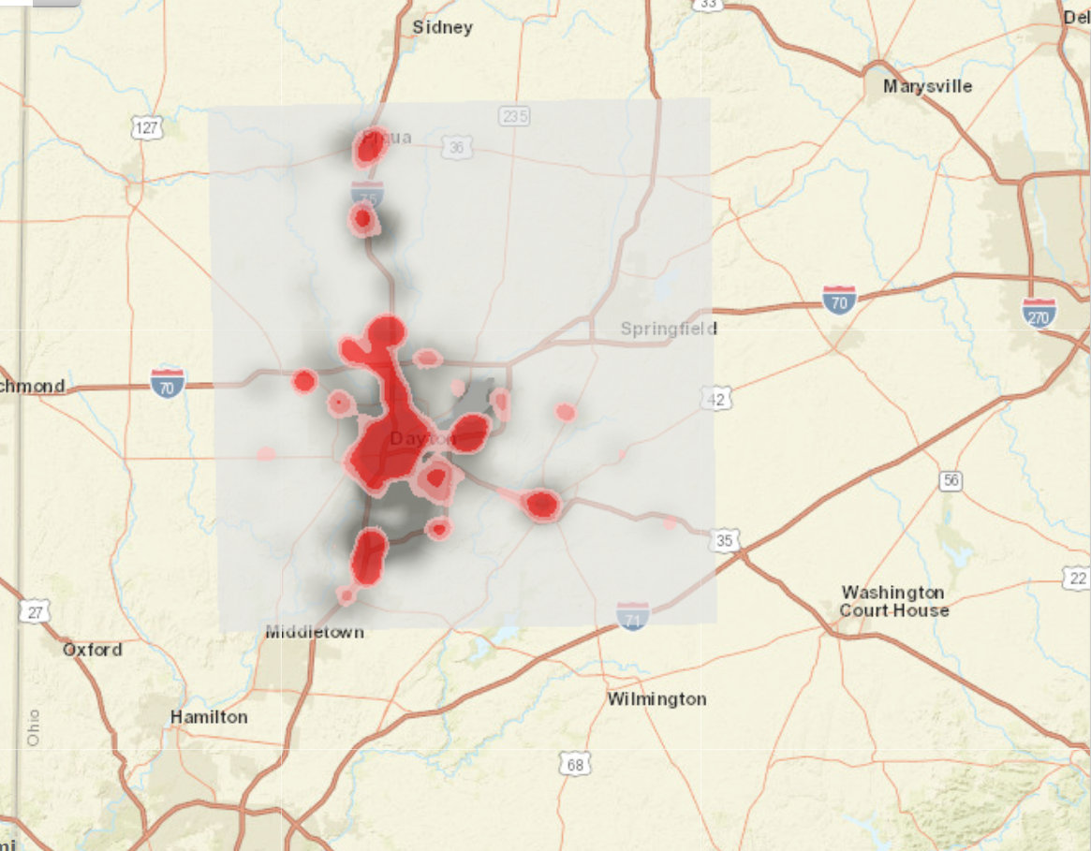
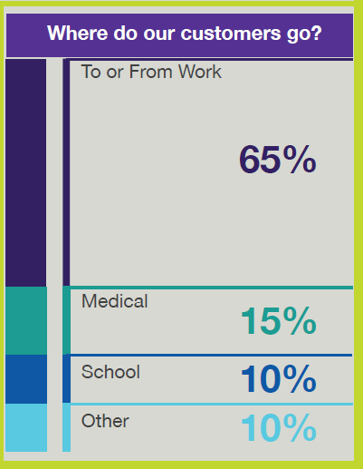
Job Access:

Slide 17
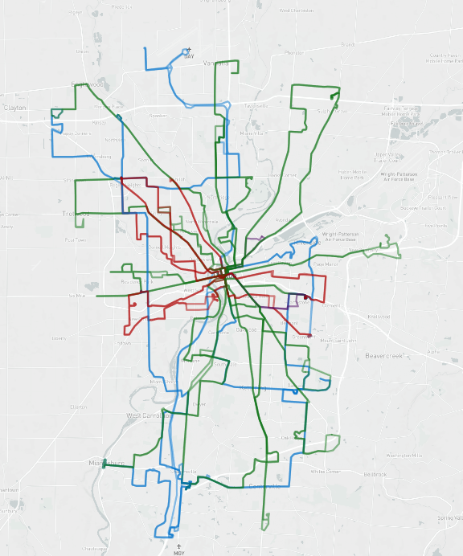
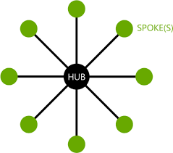
Connectivity:

Slide 18
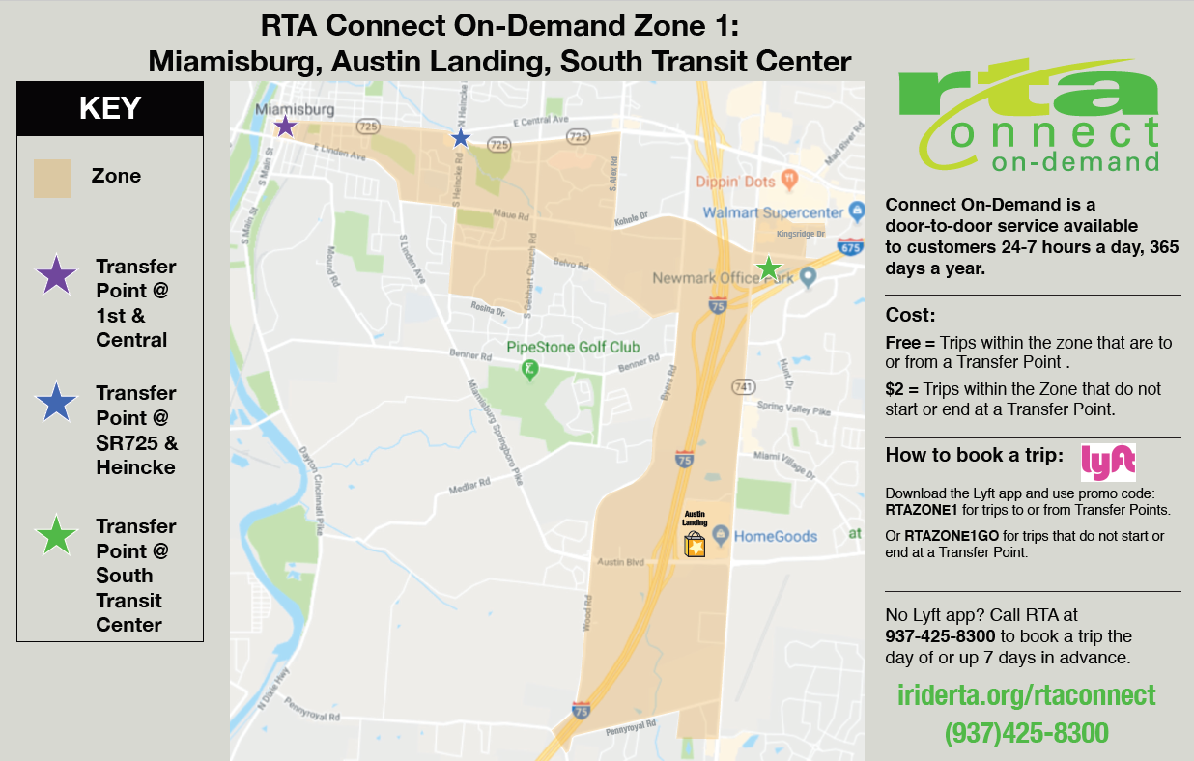
Connect On-Demand Zones:

Slide 19
Connect On-Demand Zones:

Slide 20
Mobilizing Our Greatest Resource
EVERY community member can provide input to help guide RTA’s redesign goals
EVERYONE working toward the successful implementation of the new bus network
Terence H. Fontaine
Executive Vice President
Government & Public Affairs
YOU
are critical to the success of this project.
PAGE 6
Notes:
Again, we are designing this to be from the ground up, so your input and ideas today are highly valuable to us all.

Slide 21
Resources:
John Hoff
4 South Main
Dayton, OH 45402
(937) 425-8355 or (937) 425-8300 (Call Center)
jhoff@greaterdaytonrta.org
http://www.i-riderta.org/WhatDrivesYou
Terence H. Fontaine
Executive Vice President
Government & Public Affairs
PAGE 8

