Slide 1
Telecommunication Devices Access Program (TDAP)

Slide 2
What is TDAP?
The Telecommunication Devices Access Program (TDAP) loans adaptive telecommunications equipment to individuals who have a hearing, vision, speech, mobility, or cognitive impairment
The equipment is provided at no cost, and there are no income restrictions
Equipment is a loan from the State, and it does need to be returned when no longer in use or the individual moves out of Oregon
There are currently 6,500 active TDAP clients

Slide 3
Available Equipment
Several types of adaptive equipment available for persons with vision loss:
iPad & iPad Mini
JV35 Talking Phones (B&W)
CL-60 & CL-65 Cordless Phones
CapTel 2400i Captioned Phone
Alto & Alto Plus Amplified Phones

Slide 4
iPad & iPad Mini

Slide 5
iOS® Devices

Slide 6
Why the iPad vs Android
Apple Products
Standard OS
Standard Layout
Closed System
Easy to Operate
Built-in Standard Accessibility Features
App Approval Process
Insurance
Android Products
Multiple Systems
Multiple Layouts
Open System
Accessibility Features can Vary by Device

Slide 7
Introduction to the iPad® Air 2 & iPad® mini™ 3

Slide 8
Introduction to the iPad® Air 2 & iPad® mini™ 3

Slide 9
Laser Etched Asset Tag

Slide 10
What is the difference between Wi-Fi vs 4G Devices?
Wi-Fi
4G
Can connect to any open Wi-Fi network via the Settings
No additional contracts or payments outside of existing internet service (or using a free Wi-Fi source)
Requires a monthly data plan from a wireless carrier (AT&T, Sprint, T-Mobile, Verizon or some pre-paid carriers)
Consumers will need to pre-determine the carrier
PLEASE NOTE: SPECIFIC MODELS ONLY WORK ON SPECIFIC CARRIERS
Consumers can add a device to an existing plan
Consumers can establish a plan with the device provided by the State

Slide 11
1081 West Innovation Drive Kearney, MO 64060 Toll Free: 888.515.8120 (V/TTY) Fax 816.635.4043 www.teltex.com info@teltex.com
Specializing in Customized Services and Equipment Management for State Telecommunication Equipment Distribution Programs

Slide 12
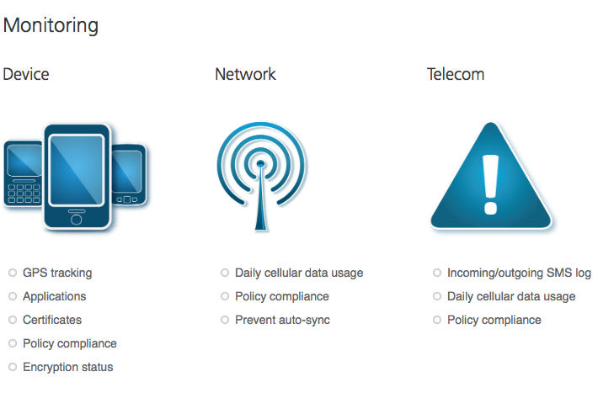
AirWatch Agent

Slide 13
AirWatch Agent
Each iOS® device is enrolled into a server at Teltex that allows for the following services to be conducted remotely, and reports provided to the State:
Track and/or locate the device
For example, is the device still within the State
Is the device being used
For example, no activity could equate to the device being lost or stolen
Customization of device
For example, open/close App Store

Slide 14
AirWatch Agent
Application Management & Custom App Store for State
Send messages to the device and consumer
Send updates of software and apps to the device
Push new apps directly to the device
Remove apps from the device
Remote diagnostics and fixing of service issues
Reset screen lock password
View remaining storage capacity and physical memory
Configure email accounts
Ability to help consumer locate iOS® device with an alarm.

Slide 15
AirWatch Agent
Teltex CANNOT do the following through AirWatch:
Read emails
Read messages
Phone calls
Observe VRS calls
Listen to IPCTS calls
Read IPCTS records
Track confidential information such as banking

Slide 16
Accessibility Features
Settings
General
Accessibility

Slide 17
Native Blind & Low Vision Accessibility Features
VoiceOver
Speaks on Screen Text
Adjustable Speed
Pitch Change
Zoom
Magnifies Screen
Adjustable Zoom Levels
Invert Colors
Speech Options
Select Text on Screen for Speech Button to Appear
Full Screen Available
Auto-Text Corrections
Larger/Bold Text
Increase Contrast
Reduce Transparency
Darken Colors
Reduce White Intensity

Slide 18
Apple® Apps ~Communications & Telecommunications
Mail
Messages
FaceTime®

Slide 19
Accessibility Apps ~Deaf-Blind
Braille
HIMS Chat
Relay
Sprint Mobile IP Relay
Video Relay Service
Convo
Purple P3
Sorenson nTouch
Z5
Video Calls
ooVoo
Skype
IP Captioned Telephone Service
ClearCaptions
Hamilton CapTel
Wireless CapTel by Sprint
Communications
Weather
Emergency Preparedness
Miscellaneous

Slide 20
Deaf-Blind Communication
Facilitates face-to-face communication between a Deaf-Blind and sighted person using a Bluetooth Braille keyboard and an iOS device

Slide 21
Accessibility Apps ~Blind & Low-Vision
Zoom & Magnification
Zoom Contacts
Zoom Reader
Magnifying Glass
Big Broswer
Talking Apps
Talking SMS
Talking Calendar
VoiceBrief
Bar Code & Image Readers
Digit-Eyes
QR Reader
TapTapSee
EyeNote
Communication
HIMS Chat
Miscellaneous
BARD Mobile

Slide 22
Zoom & Magnification Apps
Zoom & Magnification allows a person with vision loss to access information in multiple font size and color combination choices.
The iPad® can accomplish this by accessing zoom and magnification through installed apps, and displaying the large print information on the iPad® screen.

Slide 23
Talking Apps
Talking Apps allow a person with vision loss to access information via auditory content-both receptively and expressively.
The iPad® can accomplish this by accessing content via installed apps and using the iPad® speakers or a headset to relay the information; or allowing the individual to input information into the iPad® via verbal commands.

Slide 24
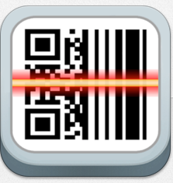
Bar Code & Image Readers
Bar Code & Image Readers allow a person with vision loss to access information via auditory content.
The iPad® can accomplish this by using the rear facing camera, installed apps and using the iPad® speakers or a headset to relay the information.

Slide 25
Communications, Emergency Preparedness & Weather
Engage by eView
Engage is the easiest and most exciting way to access information about deaf-related news and events, as well as emergency alerts in American Sign Language.
Nixle-Emergency Text Alerts
Over 7000 schools and police departments across the country use Nixle to keep consumers up to date on everything from crime reports to emergency alerts.
YouTube
Videos and training in American Sign Language, spoken English and fully closed captioned.
FEMA
FEMA app contains preparedness information for different types of disasters, an interactive checklist for emergency kits and info on how to stay safe and recover after a disaster.
Red Cross
The Red Cross apps are the complete solution consumers need to understand and prepare for emergencies.
Weather Channel
Fully accessible weather information
Advanced 911 - Text 911
Send text messages, photos, your address and GPS location to participating 911 centers/PSAPs.

Slide 26
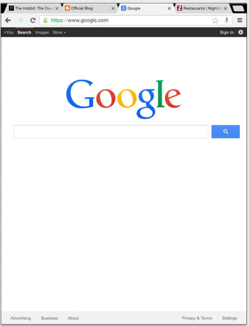
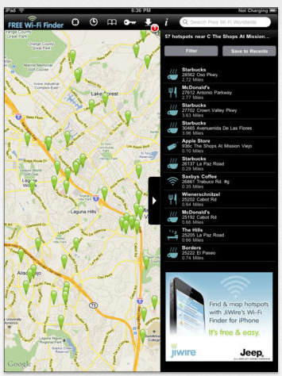
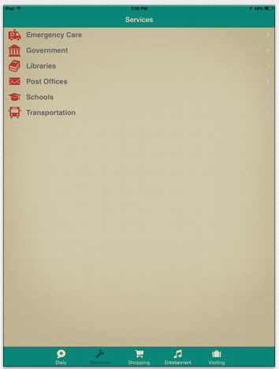
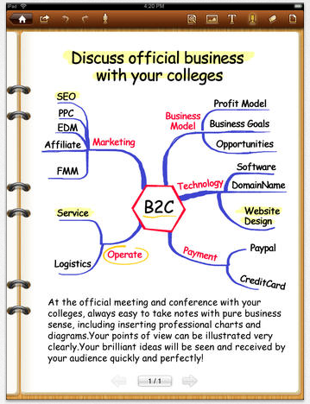
Miscellaneous
App City Life
An accessible format of lifestyle guides for living, working & playing within a community.
Chrome
Web browser by Google
Free WiFi Finder
Instantly find FREE Internet hotspots wherever you are in the world online or offline
Notebook Free
Free note taking app

Slide 27
What happens if the iPad® breaks?
The iOS® device has TeltexCare+
3 Years of bumper-to-bumper coverage that includes repair or replacement of units damaged by dropping, cracked screen displays and liquid damage.
DO NOT HAVE CONSUMERS TAKE THE DEVICE TO THE APPLE STORE, OR AN AUTHORIZED APPLE RETAILER OR ANY 3RD PARTY APPLE REPAIR CENTER

Slide 28
Tech Support
Teltex provides all operational and technical service directly to the client. This includes any type of repair service, re-installation of apps and iOS® updates.
Operational and technical service is provided in three primary ways:
Telephone
Monday – Friday, 8am to 5pm Central via voice or TTY
Email
iOS@teltex.com
Website & Social Media
www.iaccessibility.com
www.facebook.com/iOSAccessibility
www.twitter.com/i_accessibility
24/7/365 information in American Sign Language, spoken English with Closed Captions, and written English

Slide 29
Service
3 Years of coverage that includes:
AppleCare+ for 2 years (including the limited 1 year warranty)
Repair or replacement of units damaged by dropping, cracked screen displays and liquid damage.
TeltexCare requires the iOS® device to be distributed in an Otterbox Case (or similar) for the device’s protection.
TeltexCare+
Apple Limited Warranty for 1 Year
Teltex AppleCare+ for 2 Years
TeltexCare for 3 Years

Slide 30
Apple® ID
The iPad® arrives from Teltex with a pre-set Apple® ID. This Apple ID is part of the package of services from the State.
This Apple® ID is NOT to be deleted.
The Apple® ID is the user name to access Apple® services, such as the iTunes Store, the App Store, and iCloud® .
Please note: There may be charges for services and products that you use, rent or purchase when using your personal Apple® ID.
If you have an Apple® ID, you can add it to the device. If you do not have an Apple® ID, you can also create one.

Slide 31
www.iAccessibility.com

Slide 32
Training Videos ~ASL, English & Closed Captioned

Slide 33
3rd Party Apps Database

Slide 34
JV35 Talking Phones (B&W)

Slide 35
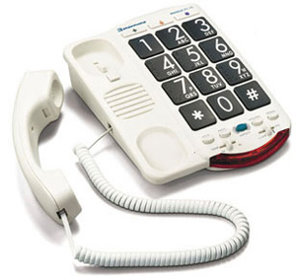
JV35-B Amplified Talking Phone
Black buttons with white numbers
Large buttons with Braille Characters
Voice announces each number when dialed
10 memory dialing buttons
Amplifies up to 37dB
Super loud ringer up to 85dB

Slide 36
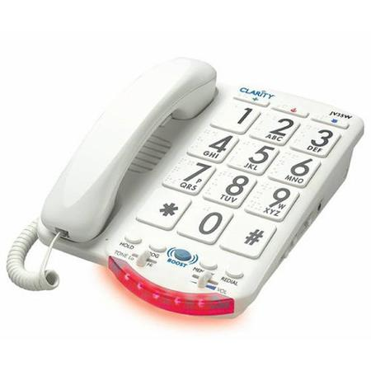
JV35-B Amplified Talking Phone
White buttons with black numbers
Large buttons with Braille Characters
Voice announces each number when dialed
10 memory dialing buttons
Amplifies up to 37dB
Super loud ringer up to 85dB

Slide 37
CL-60 & CL-65 Cordless Amplified Phones

Slide 38
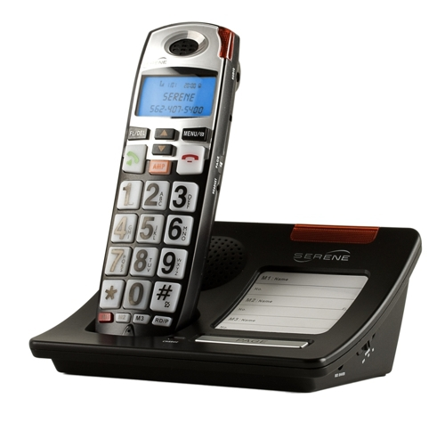
CL-60 Cordless Amplified Phone
Large backlit buttons
Caller ID on large display
Voice announces each number when dialed
3 one-touch speed dial memory buttons
Amplifies up to 55dB
Loud ringer and ring flashers

Slide 39
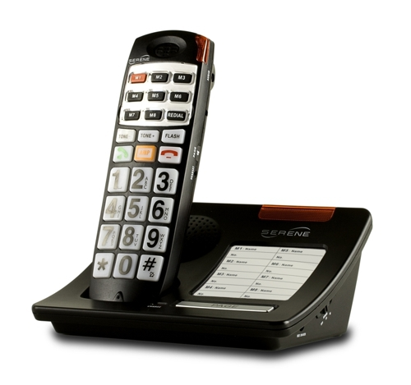
CL-65 Cordless Amplified Phone
Large backlit buttons
Voice announce Caller ID
Voice announces each number when dialed
8 one-touch speed dial memory buttons
Amplifies up to 55dB
Loud ringer and ring flashers

Slide 40
CapTel 2400i Captioned Phone

Slide 41
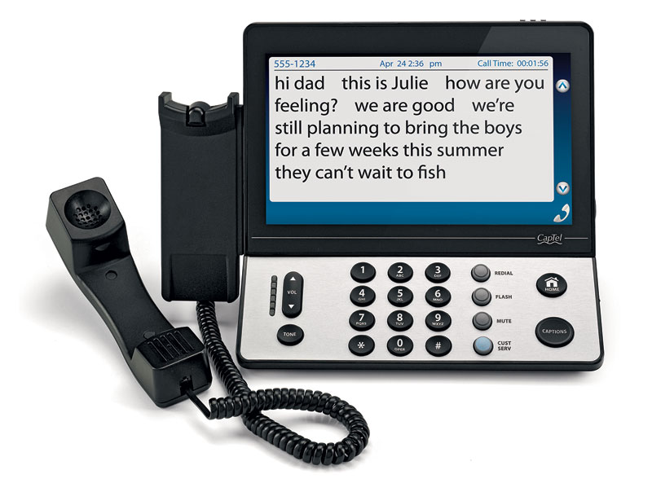
CapTel 2400i Captioned Phone
Provides word-for-word captions during calls
Large touch-screen display
Adjustable caption font sizes and colors for easier reading
Built in answering machine
Amplifies up to 40dB while captions are on
Hi-speed internet required

Slide 42
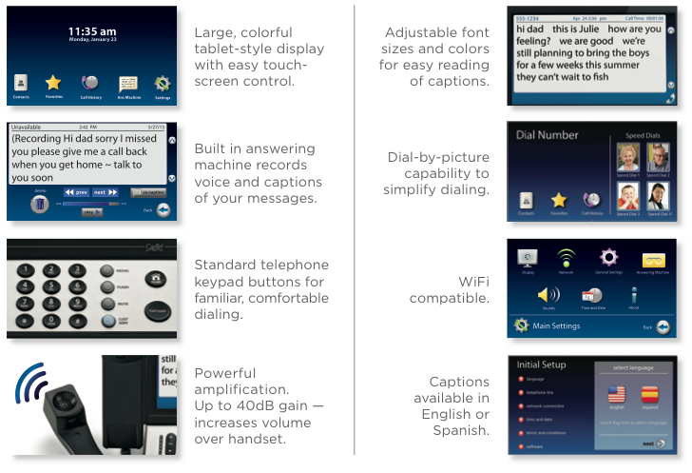

Slide 43
Alto & Alto Plus Corded Amplified Phones

Slide 44
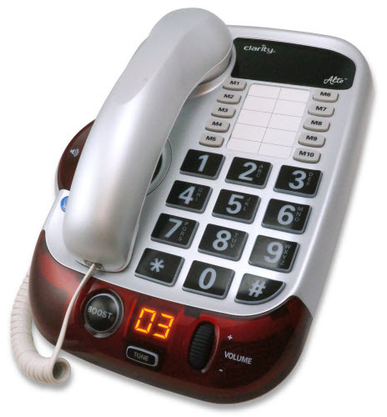
Alto Corded Amplified Phone
Speakerphone
Large backlit buttons
Voice announces each number when dialed
10 memory dialing buttons
Amplifies up to 53dB
Super loud ringer up to 100dB
Large bright visual ringer

Slide 45
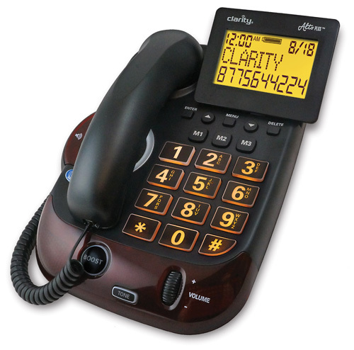
Alto Plus Corded Amplified Phone
Speakerphone
Large backlit buttons
Large print caller ID
3 memory dialing buttons
Amplifies up to 53dB
Super loud ringer up to 100dB
Large bright visual ringer

Slide 46
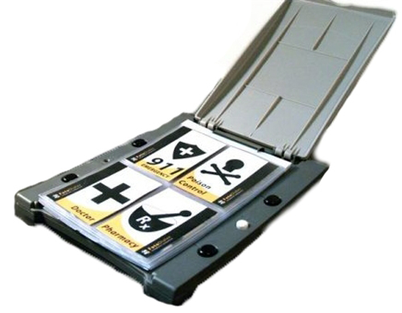
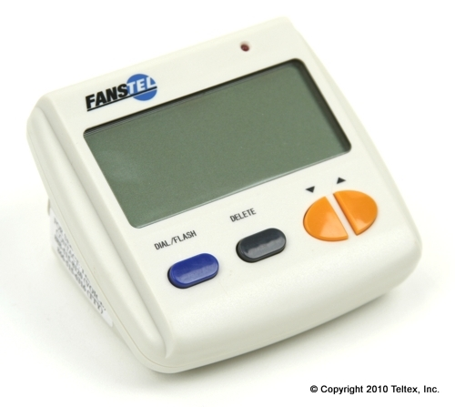
Accessories Available
Large Print Caller ID
Talking Caller ID
Signal Devices
Photo Dialers

Slide 47
Questions?

Slide 48
Contact Us
Telecommunication Devices Access Program (TDAP)
800-848-4442 V
800-648-3458 TTY
971-239-5845 VP
puc.rspf@state.or.us

