Slide 1
WELCOME TO THE POWER OF POSITIVE PARENTING
With Valerie Anderson From Turning Points for Children

Slide 2
INTRODUCTIONS AND CHECK- IN

Slide 3
ZOOM ETTIQUETTE
Listen to one another, mute yourself when someone is talking to help control background noise.
Be flexible and patient with self and others around the technology.
Be nonjudgmental
Respectfully Agree to Disagree
Respect Confidentiality
Speak for yourself
Be Open Minded allow for empathy and acceptance

Slide 4
OVERVIEW
Our hopes and dreams
The realities of being a parent
Children’s behavior: the tough part of parenting
What is positive parenting?
Five key principles of positive parenting
Take home messages
Questions and Reflections

Slide 6
Parenting is a skill. These are the skills children need:
Good communication and social skills
Ability to manage feelings
Independence Skills
Problem- solving skills

Slide 7
WHAT IS POSITIVE PARENTING?
Having a safe, interesting environment
1
Having a positive learning environment
2
Using assertive discipline
3
Having realistic expectations
4
Taking care of yourself as a parent
5

Slide 8
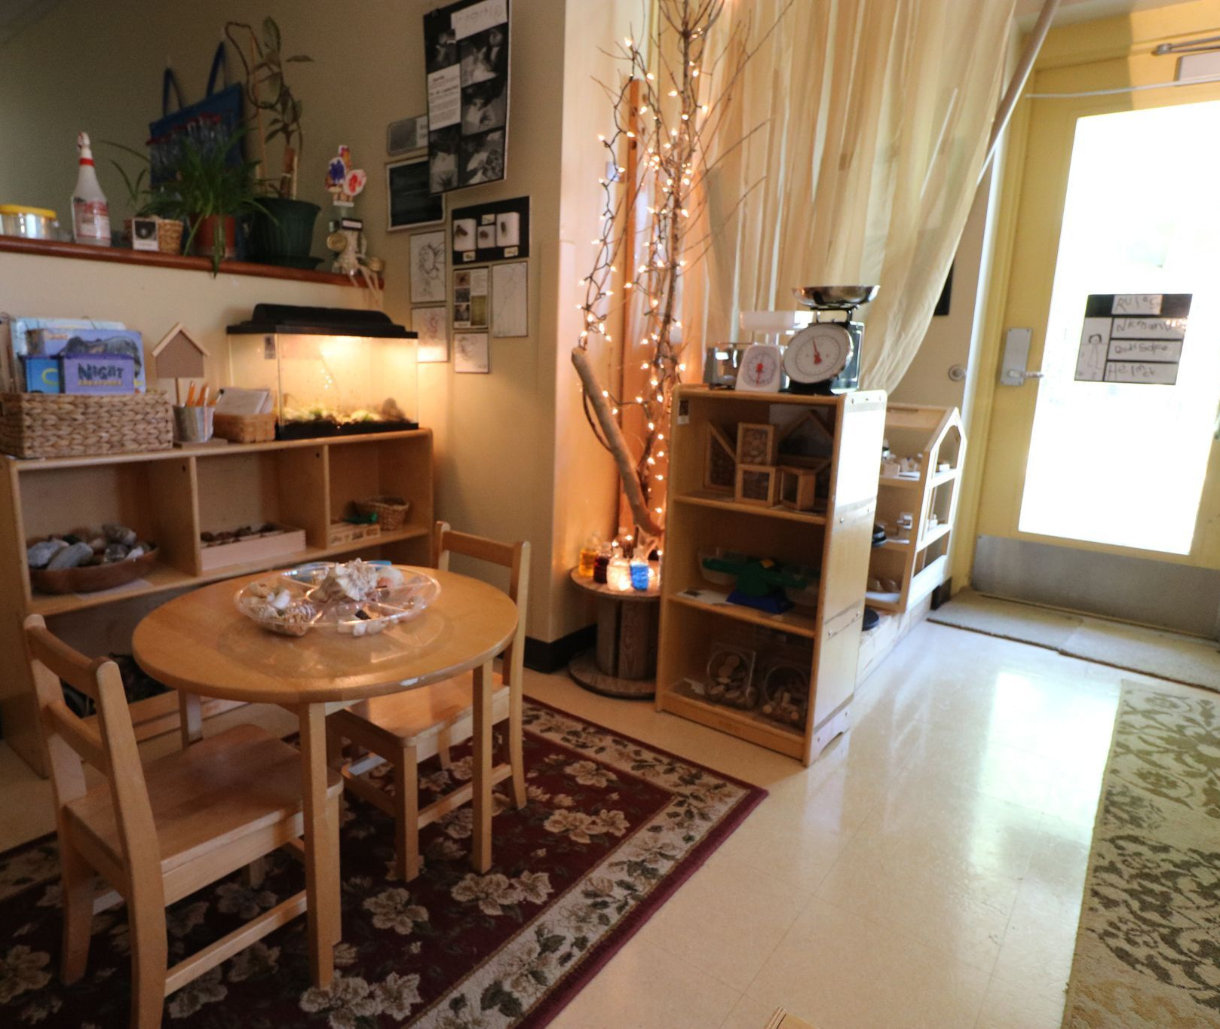
PRINCIPLE # 1 CREATING A SAFE AND INTERESTING ENVIRONMENT

Slide 9
Principle 1
Provide supervision
Have interesting things to do
Develop predictable routines
Teach your child road safety rules
Provide safety equipment
Be safety conscious near schools
Teach your child about personal safety

Slide 10
PRINCIPLE # 2 HAVING A POSTIVE LEARNING ENVIRONMENT

Slide 11
Principle 2
Spend time with your child
Speak nicely
Chat and listen often
Share your own experiences
Be affectionate
Use descriptive praise
Give your child attention
Use incidental teaching
Get involved in your child’s school

Slide 12
PRINCIPLE # 3 USING ASSERTIVE DISCIPLINE

Slide 13
Discipline works best when:
Children live in a predictable world
Children receive plenty of attention for good behavior
Parents have reasonable expectations
Parents use fair, predictable consequences consistently
Parent support each other

Slide 14
Principle 3
Prepare in advance
Arrange activities
Set some ground rules
Praise good behavior
Watch and supervise
Use planned ignoring for minor misbehavior
Use your voice effectively

Slide 15
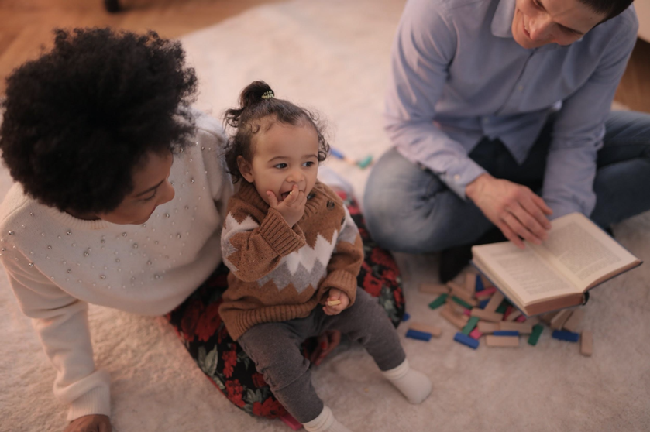
PRINCIPLE #4 HAVING REALISTIC EXPECTATIONS

Slide 16
Principle 4 Things to Consider:
Your expectation of your child: What do I expect? Is this rule necessary? Can my child understand or do this?
What other parents expect
What your child’s school expects
Your expectation of yourself: Are my expectations reasonable?

Slide 17
PRINCIPLE #5 TAKING CARE OF YOURSELF

Slide 18
TAKE HOME MESSAGES
Create a warm, loving, safe environment for your child.
Use positive strategies to encourage your child’s learning.
Use assertive discipline to help your child take responsibility for their actions.
Have reasonable expectations of both your child and yourself.
Take care of yourself by looking after your own needs, balancing work and family responsibilities, challenging negative thinking, and working as a team.

Slide 20
AFRICAN PROVERB

