Slide 1
Voting and Accessibility
Diane Gordian, Language Access and Civic Engagement Coordinator
Pennsylvania Department of State
August 7, 2024

Slide 2
Voting & Accessibility Laws
Title II of the Americans with Disabilities Act (ADA) requires state and local governments (“public entities”) to ensure that people with disabilities have a full and equal opportunity to vote.
The Voting Rights Act of 1965 (VRA) also contains provisions relevant to the voting rights of people with disabilities. The VRA requires election officials to allow a voter who is blind or has another disability to receive assistance from a person of the voter’s choice (other than the voter’s employer or its agent or an officer or agent of the voter’s union). The VRA also prohibits conditioning the right to vote on a citizen being able to read or write, attaining a particular level of education, or passing an interpretation “test.”
The Voting Accessibility for the Elderly and Handicapped Act of 1984 (VAEHA) requires accessible polling places in federal elections for elderly individuals and people with disabilities. Where no accessible location is available to serve as a polling place, voters must be provided an alternate means of voting on Election Day.
The National Voter Registration Act of 1993 (NVRA) aims, among other things, to increase the historically low registration rates of persons with disabilities. The NVRA requires all offices that provide public assistance or state-funded programs that primarily serve persons with disabilities to also provide the opportunity to register to vote in federal elections.
The Help America Vote Act of 2002 (HAVA) requires jurisdictions responsible for conducting federal elections to provide at least one accessible voting system for persons with disabilities at each polling place in federal elections. The accessible voting system must provide the same opportunity for access and participation, including privacy and independence, that other voters receive.

Slide 3
Important Links
Information regarding all options discussed in this presentation is available on the Department of State’s “Accessible Voting” page:
https://www.pa.gov/en/agencies/vote/voter-support/accessible-voting.html
You can also find important information referenced in this presentation on these pages:
Election Directives and Guidance (https://www.pa.gov/en/agencies/dos/resources/voting-and-elections-resources/directives-and-guidance.html)
Your Rights and the Laws (https://www.pa.gov/en/agencies/vote/voter-support/your-rights-and-the-law.html)

Slide 4
Voting Systems and ADA compliance
Every polling place in Pennsylvania must have at least one accessible voting system. Sometimes this is the general voting system used by all voters, or it may be a separate system with accessible features.
Each county uses one of several voting systems that has been certified for use in Pennsylvania by the Secretary of the Commonwealth.
To learn what system is used in your county, you can use this link: https://www.pa.gov/en/agencies/vote/voter-support/voting-system-demos.html.
Every county is required to train poll workers on using the voting system, including how to use the accessible features of the voting system available at each polling place.

Slide 5
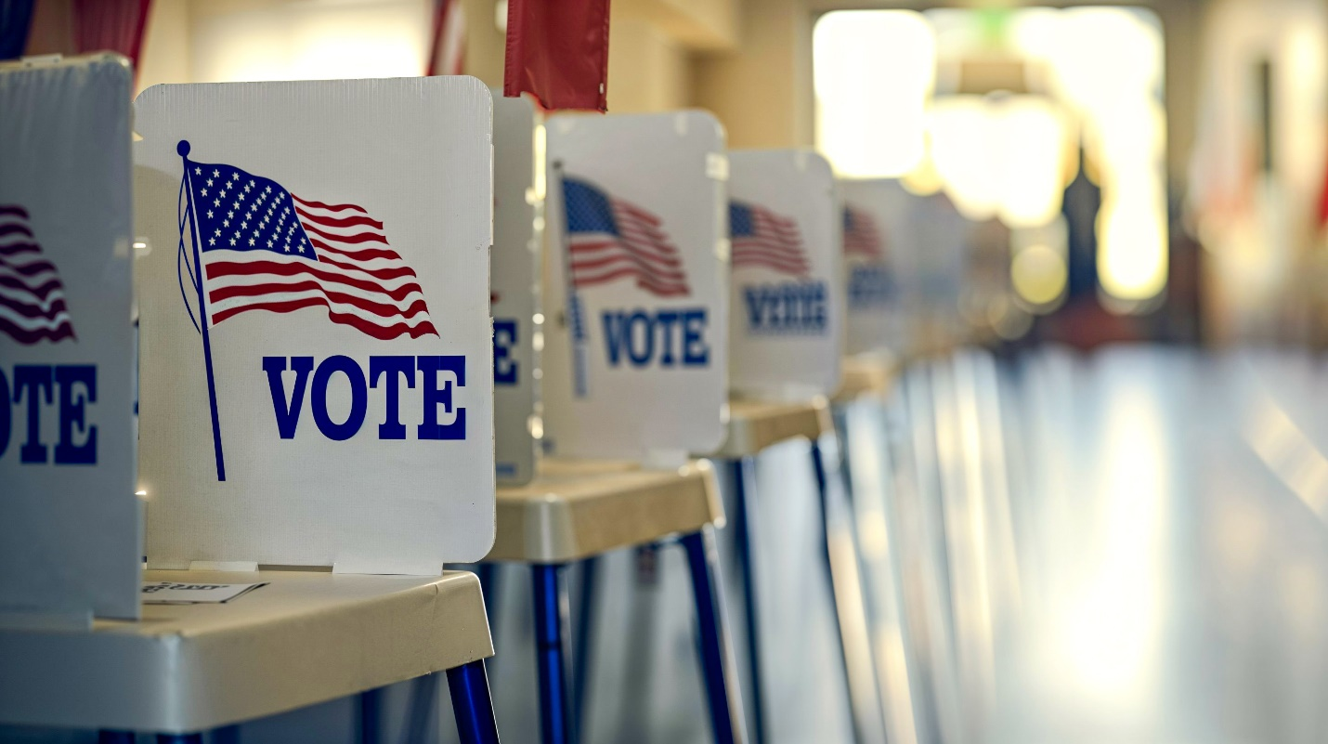
Voting on Election Day

Slide 6
If You Need Help on Election Day
You have the right to assistance at the polls.
Let a poll worker know you need assistance at check-in.
If you need help voting due to a disability, you may bring a person of your choice to assist you in the voting process.
There are a few restrictions on who you may bring, including that you may not choose a person who is:
A Judge of Elections
Your union representative
Your employer or an agent of your employer.

Slide 7
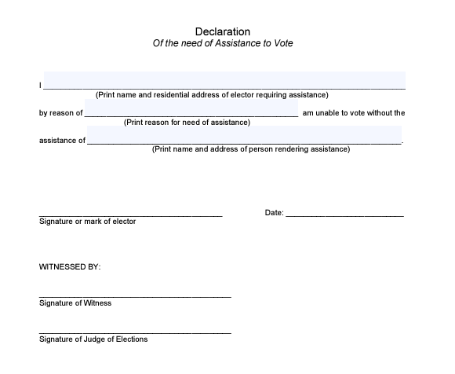
Declaration of Need of Assistance
Before receiving assistance to vote, election officials at your polling place will ask you to complete and sign a form called a Declaration of Need of Assistance.
You are required to provide the reason why you need assistance.
After the first time you receive assistance, your registration record will note that you completed the form.
This declaration is also available in Spanish, Traditional Chinese, Simplified Chinese, and Vietnamese.
Links to these forms are available through the Accessible Voting page on the Department’s website.

Slide 8
Ways That You May Receive Assistance with Voting
Voters may receive assistance for any number of reasons, not just a physical disability. A voter may need assistance because they have difficulty reading, writing, or comprehending the written information on the ballot, even if it is because they are more comfortable communicating in a language other than English.

Slide 9
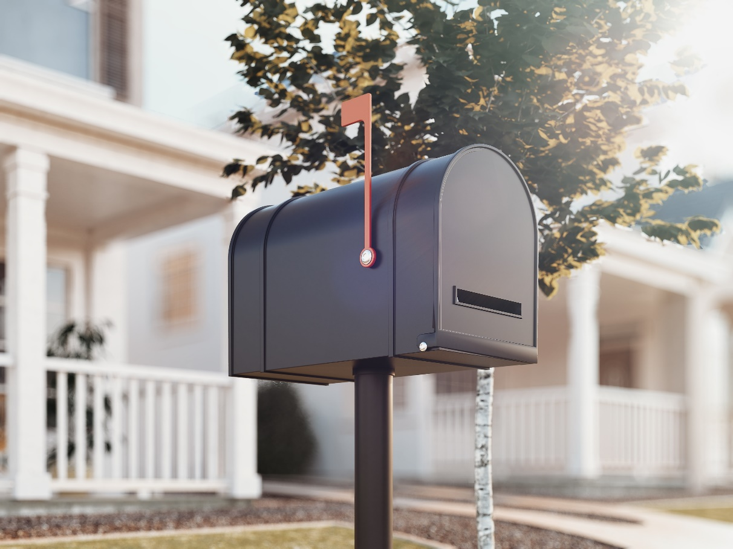
Voting by Mail-in and Absentee Ballot

Slide 10
Emergency Absentee Ballots
You must apply to vote by absentee or mail-in ballot by 5:00 p.m. on October 29, 2024.
If an issue arises after 5:00 pm on October 29, 2024 that would prevent you from appearing at your polling place on Election Day, you may be eligible to apply for an emergency absentee ballot.
Some examples of situations that could arise after the October 29, 2024 deadline that might justify an emergency absentee ballot (not exhaustive):
You are injured and hospitalized.
Your employer directs you to travel outside of your municipality on Election Day.
The deadlines to apply for and to return a voted emergency absentee ballot are both 8:00 p.m. on Election Day (11/5/24), but you should apply for an emergency absentee ballot as soon as possible.

Slide 11
Completing Your Absentee and Mail-in Ballot
You are entitled to have someone assist you in voting your absentee or mail-in ballot.
You must sign the voter’s declaration on the outer return envelope. If you are unable to sign without help because of your illness or physical disability, you may make a mark or have someone help you make a mark in lieu of signing. A witness must sign and complete the appropriate section next to the voter’s declaration

Slide 12
Returning Your Mail-in or Absentee Ballot to Your County Election Office
Each voter must return their own ballot, unless they have a disability that prevents them from delivering their own mail ballot and they have properly designated a third party to return their voted ballot in writing using the designated agent form.
The forms are available in English, Spanish and Chinese and can be located here: https://www.pa.gov/en/agencies/vote/voter-support/accessible-voting.html
You may also use your designated agent to obtain your unvoted ballot materials.
Whether using a designated agent to obtain a ballot or return it, always keep a copy of your completed designated agent form for your designated agent to have on hand when receiving or returning ballot materials on your behalf.
IMPORTANT: Your county elections office must receive your voted mail-in or absentee ballot by 8:00 p.m. on Election Day for your vote to count.

Slide 13
Returning Your Mail-in or Absentee Ballot Through a Designated Agent If you did not submit your completed designated agent form to the county previously, you can submit the original form with your ballot within the outer return envelope.
1 - Place ONLY your ballot inside of the yellow envelope. DO NOT place the designated agent form inside the yellow envelope.
2 - Make a copy of your completed designated agent form to give to your designated agent.
3 - Then, place both your yellow envelope and the original copy of your completed designated agent form inside the outer return envelope.
4 - Complete the voter’s declaration, and if necessary, the witness information on the outer return envelope.

Slide 14
Remote Ballot Marking

Slide 15
Accessible Remote Ballot-Marking Solution for Mail Voting
Accessible remote ballots allow voters who use screen readers and assistive devices to vote a mail ballot privately and independently.
To obtain an accessible remote ballot, an individual must:
Be a registered Pennsylvania voter.
Apply for a mail-in or absentee ballot by the deadline (October 29, 2024 at 5:00 pm).
Submit a request for an accessible remote ballot via one of these methods:
Accessible web-based request form; or
Accessible PDF application that can be mailed it to your county board of elections or emailed to ra-awib@pa.gov.
After applying for an accessible remote ballot, the voter receives materials both by mail and email from the county to complete their ballot.
The voter must return their voted ballot to the county by 8:00 p.m. on Election Day. POSTMARKS DO NOT COUNT

Slide 16
Issues with Voting

Slide 17
Issues While Voting at Your Polling Place
If you are having issues at the polling place, you should notify the Judge of Elections immediately. If possible, remain at the polling place.
Once you have signed the poll book at your polling place, if you leave, you should not assume that you will be permitted to reenter the polling place.
Once you have submitted and cast your ballot, it cannot be retrieved.
If you are unable to resolve your issue with the Judge of Elections, you may contact your county elections office or 1-877-VOTESPA.

Slide 18
Issues With Your Mail-in or Absentee Ballot
You can track the status of your mail-in or absentee ballot online at: vote.pa.gov/MailBallotStatus.
If you have specific questions about the status of your mail-in or absentee ballot, you should contact your county elections office.
If you have general questions about the absentee or mail-in ballot process, you may contact the Department of State Voter Hotline at 1-877-VOTESPA.

Slide 19
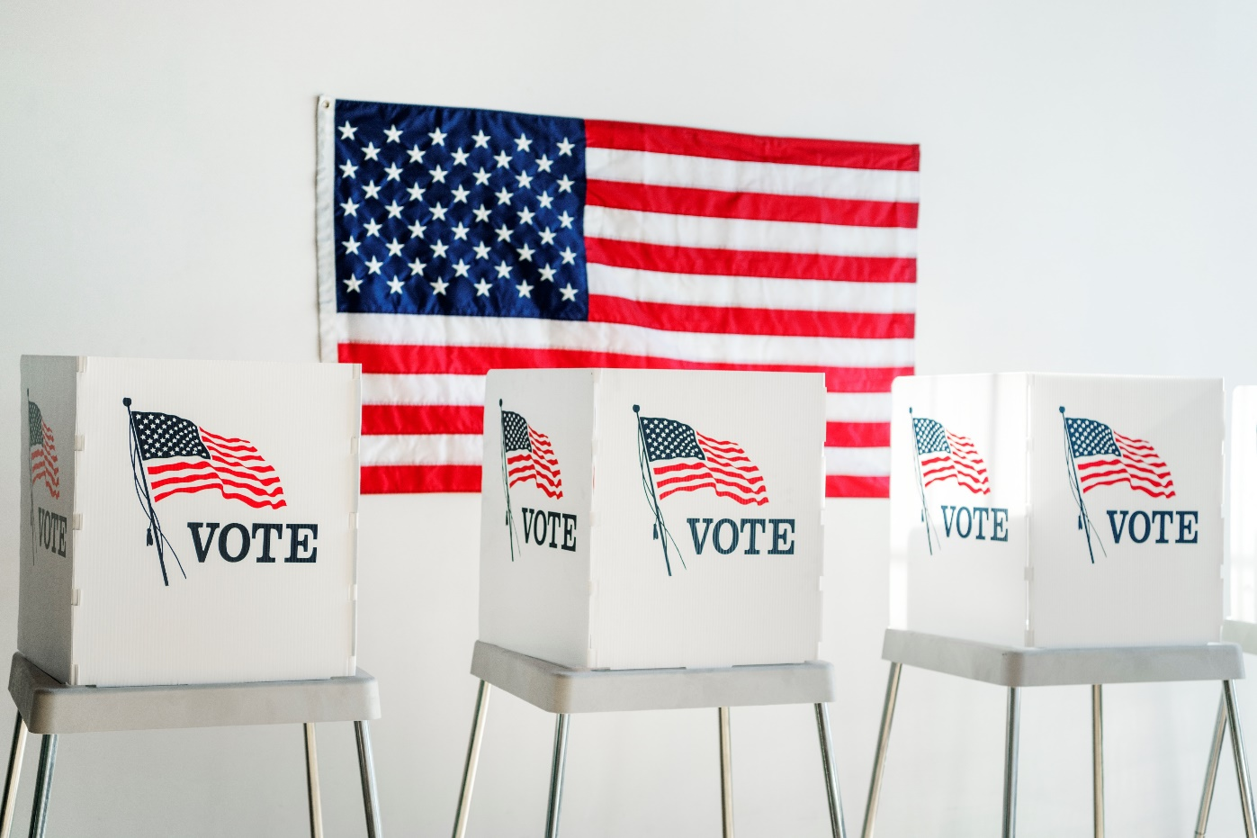
Questions?

