Slide 1

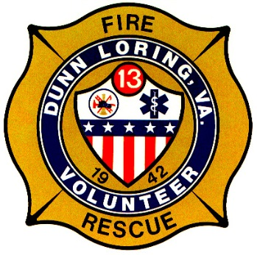
Fire Safety Presentation to
The National Federation of the Blind of Virginia

Slide 2
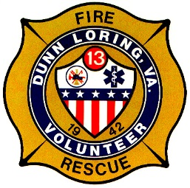
Fire and Community Safety
Introduction
When to Call 911
General Fire Safety
Carbon Monoxide Safety
Space Heater/Candle Safety
Improperly Disposing of Hot Stuff
The File of Life
COVID-19

Slide 3
Introduction
Shawn P. Stokes, Fire Chief
  22 Years at Dunn Loring
  Second Generation in the Fire Service
Proudly Representing our Members
  85 Strong – FF’s, EMT’s, Administrative
  Founded 1942, over 18,000 hours last year
Partners with Fairfax County Fire and Rescue
  1,400 Uniform FF’s, 125 Civilians, 700 Volunteers
We are here to serve you!

Slide 4
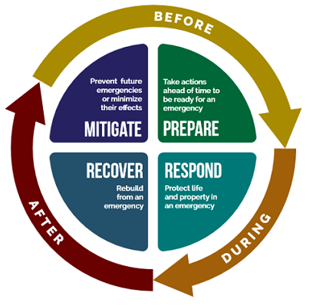
The Phases of Emergency Management

Slide 5
Home Fire Safety
9-1-1 Emergency Information
  When to call 9-1-1
  When NOT to call 9-1-1
  Know where you are
  Stay Calm. Follow Instructions.
  Don’t hang up. Ever.

Slide 6
Know When to Call 9-1-1
Life and Death emergency
  EVERY medical situation
  High priority police calls
  Fire & (current) Accidents & Gas Leaks
  Use good judgment
Crime happening NOW or Help needed NOW
Know when NOT to call 9-1-1.
  Fairfax County Non-Emergency: 703-691-2131
  Arlington County Non-Emergency: 703-558-2222

Slide 7

Know Where You Are
9-1-1 NEEDS TO KNOW WHERE TO GO
  “911, Where is your emergency?”
This isn’t TV.
Help us help you. Provide as much detail on your location as possible:
    apartment number
    landmarks
    cross streets
    Mileposts

Slide 8
9-1-1 Call
Information 9-1-1 needs to start help to you:
  Where are you?
    Apt / Room / Suite / Business Name / GPS Coordinates
  What is your name?
    First & Last
  What is the Phone Number you are calling from?
  What is the problem? Tell me exactly what happened.

Slide 9
Remain Calm; Be Prepared
Stay calm
Give information
  Calltakers are trained to get information
  Listen carefully
  Answer concisely
Follow all instructions
  You can save a life!
  Follow all the instructions the 9-1-1 call taker gives you
    CPR, Choking, Bleeding Control, etc.
Help is on the way

Slide 10
Home Fire Safety
Fire Safety Messages

Slide 11

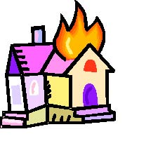
U.S. Home Structure Fires
In 2018, there were 1,318,500 fires reported in the United States.
These fires caused 3,655 civilian deaths, 15,200 civilian injuries, and $25.6 billion in property damage, ½ from wildland fire.
499,000 were structure fires, causing 2,720 (74%) civilian deaths,
  12,700 civilian injuries, and $11.1 billion in property damage.
181,500 were vehicle fires, causing 490 civilian fire deaths, 1,300 civilian fire injuries, and $1.4 billion in property damage.
607,000 were outside and other fires

Slide 12
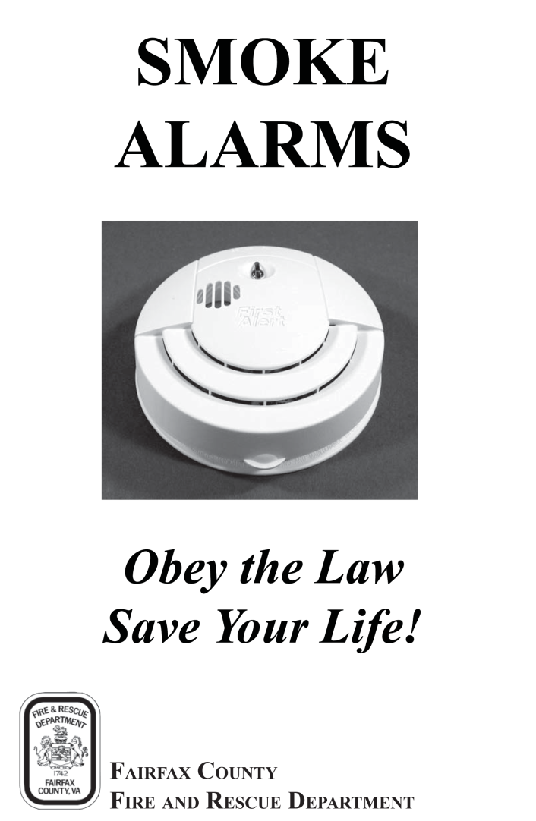
Smoke Alarms
INSTALLATION:
  On every level of the home and outside sleeping areas.
  For added safety, in every bedroom
MAINTENANCE:
  Check monthly.
  Replace batteries once a year.
  Lithium batteries last the lifetime of the smoke alarm.
  Replace alarm every 10 years.
  Clean regularly.

Slide 13
Close Before You Doze
Close your bedroom door before you go to sleep
Can be the difference between life and death
Amazing amount of protection by a hollow-core door
Provides tenable place to wait for the fire department

Slide 14
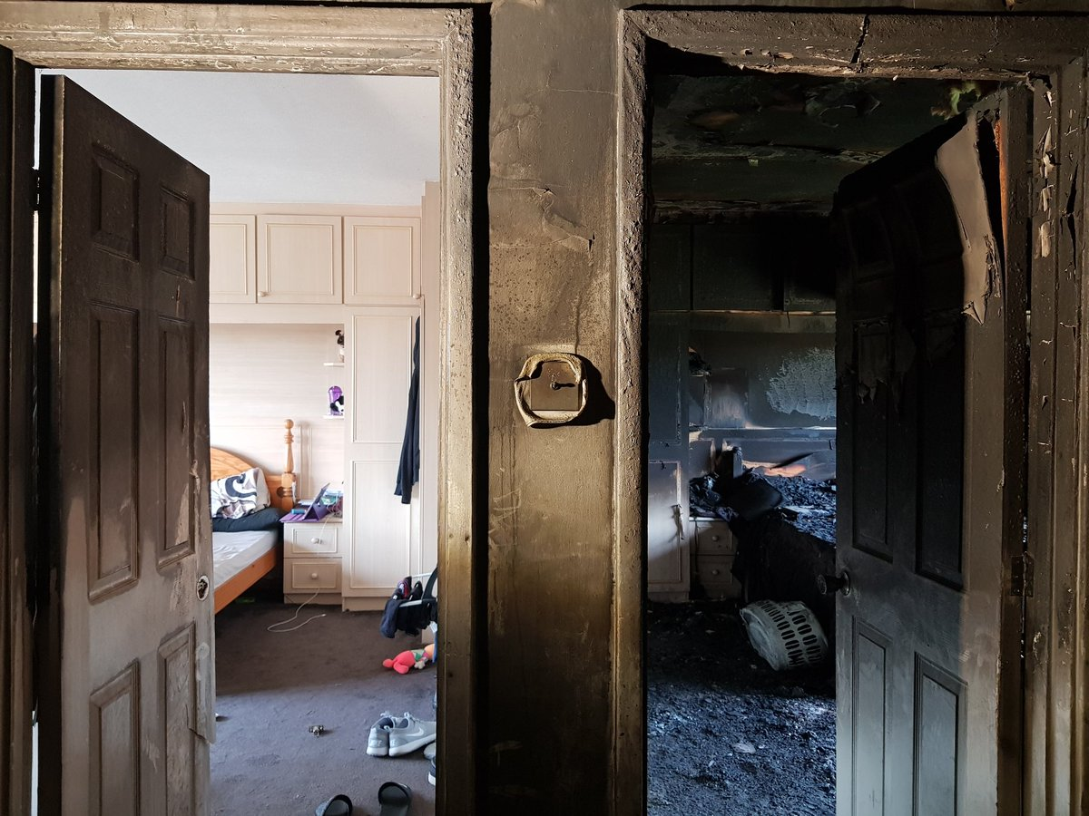
Close Before You Doze

Slide 15
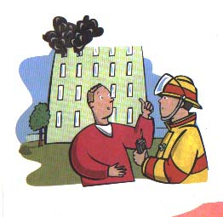
Home Escape Plans
Two exits from each room
An outside meeting place
Emergency phone number
Alternatives for family member needing extra assistance
Practice plan regularly

Slide 16
Home Escape Plans

Slide 17
Carbon Monoxide
Carbon Monoxide (CO) is a by-product of combustion; an invisible, odorless, and tasteless toxic gas.
Causes:
  Faulty gas, oil furnaces and water heaters.
  Cracked chimney flues.
  Indoor use of charcoal grills.
  Use of a gas oven or range to warm a room.
  Running a car in an enclosed area.

Slide 18

Carbon Monoxide
Carbon Monoxide Poisoning
  Mimics flu-like symptoms:
    Headache
    Fatigue
    Nausea
    Dizziness
    Confusion
    Unconsciousness
  Differentiator: CONCURRENT onset of symptoms

Slide 19
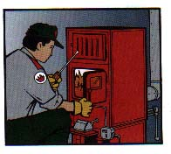
Carbon Monoxide
Prevention of Carbon Monoxide Poisoning:
  Install CO alarms.
  Have a qualified technician inspect your gas furnace and appliances.
CO alarms should be located on every floor.
If the alarm goes off, everyone should get out of the house at once and call 911.

Slide 20
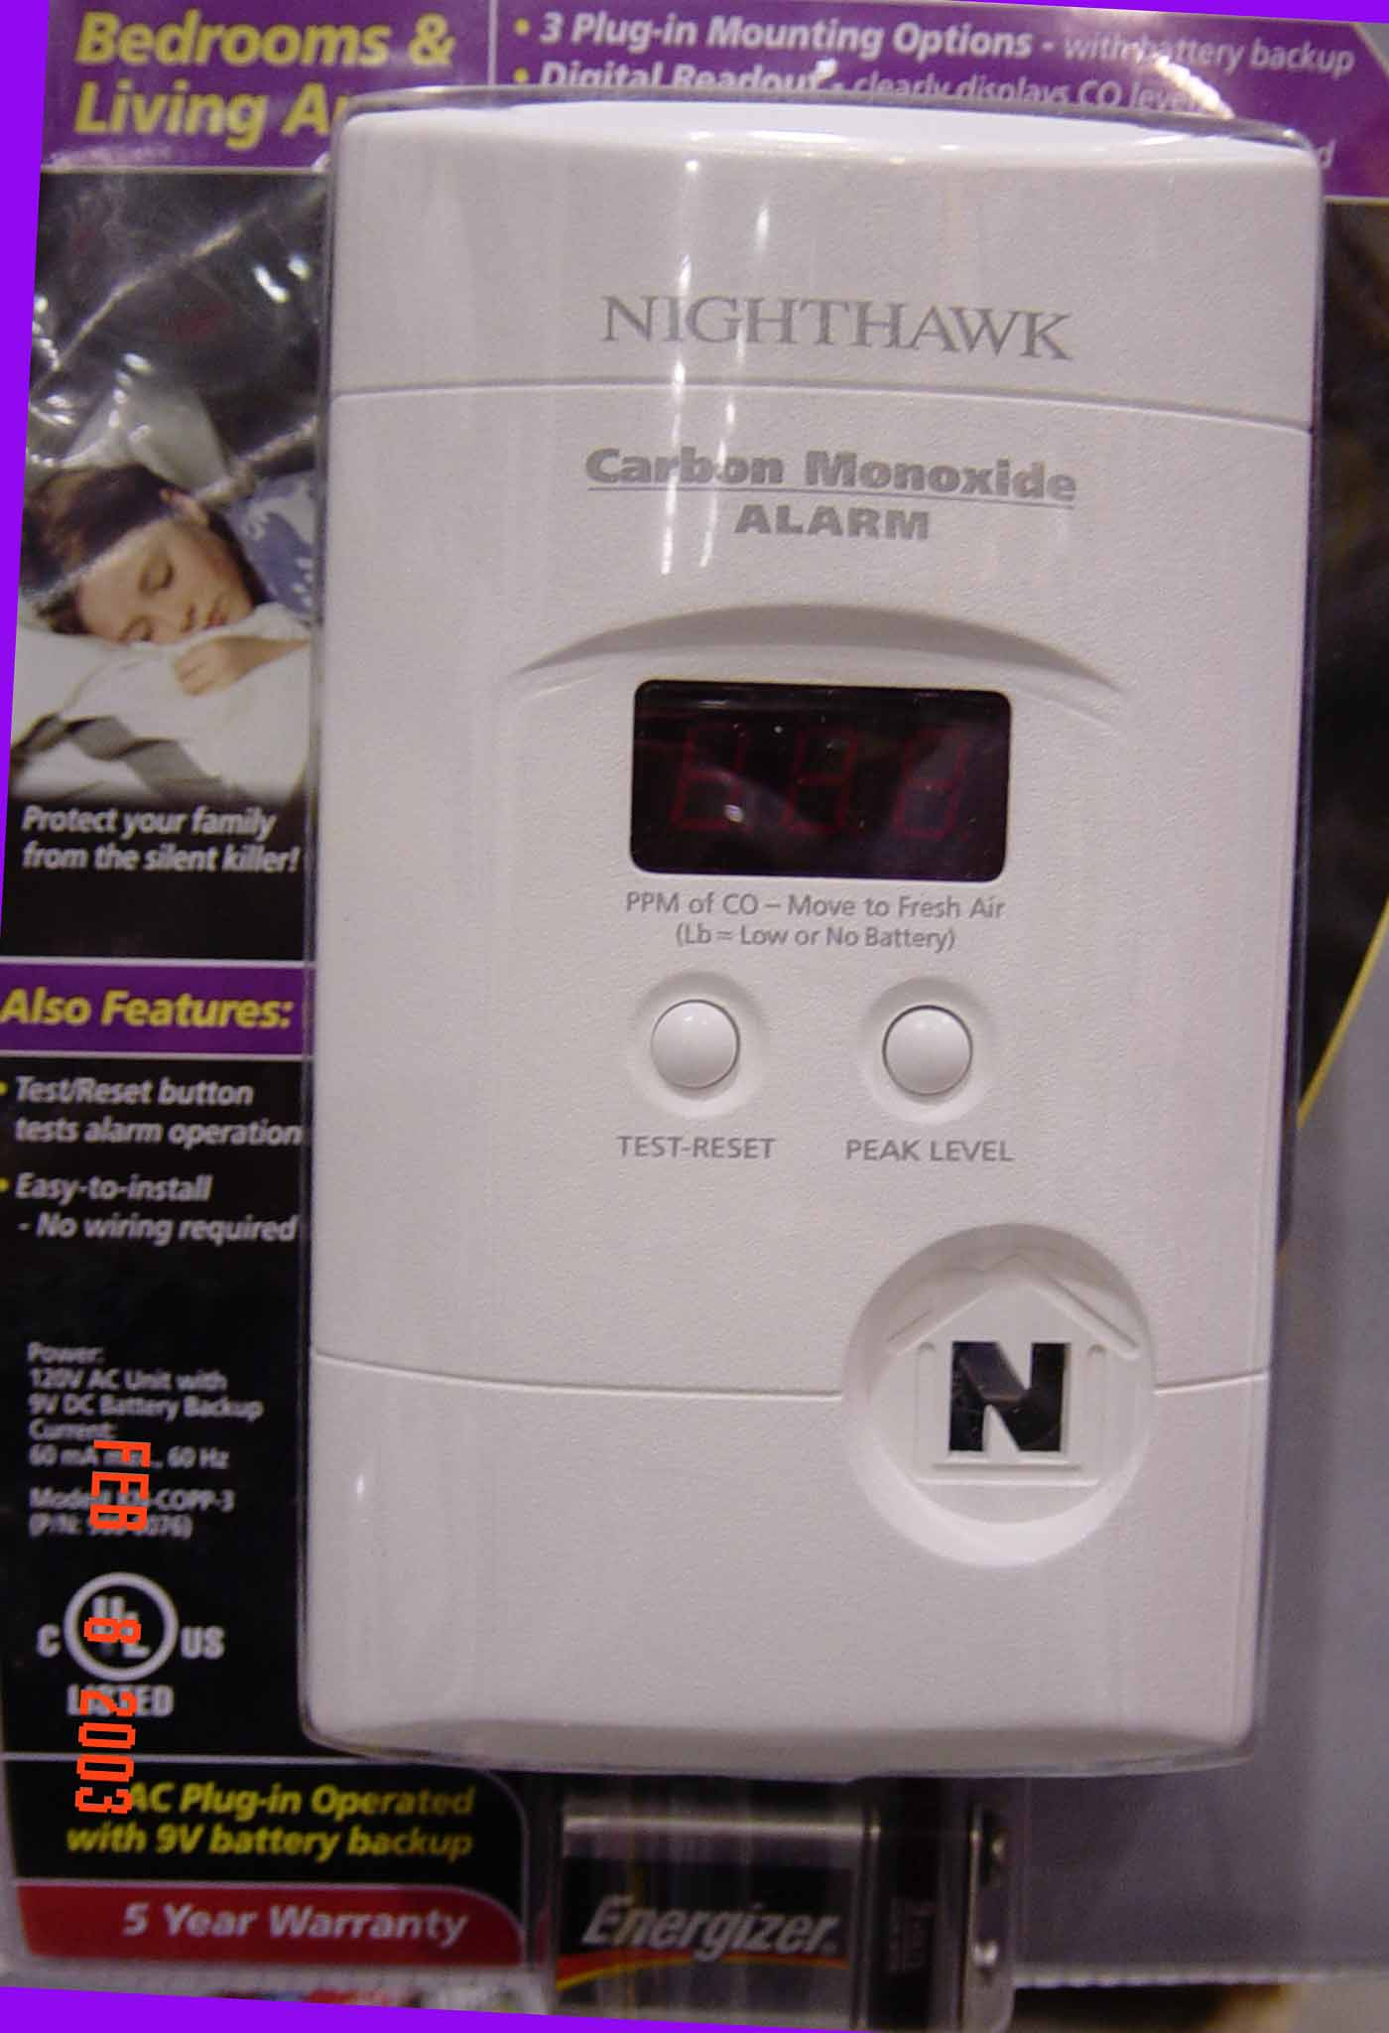
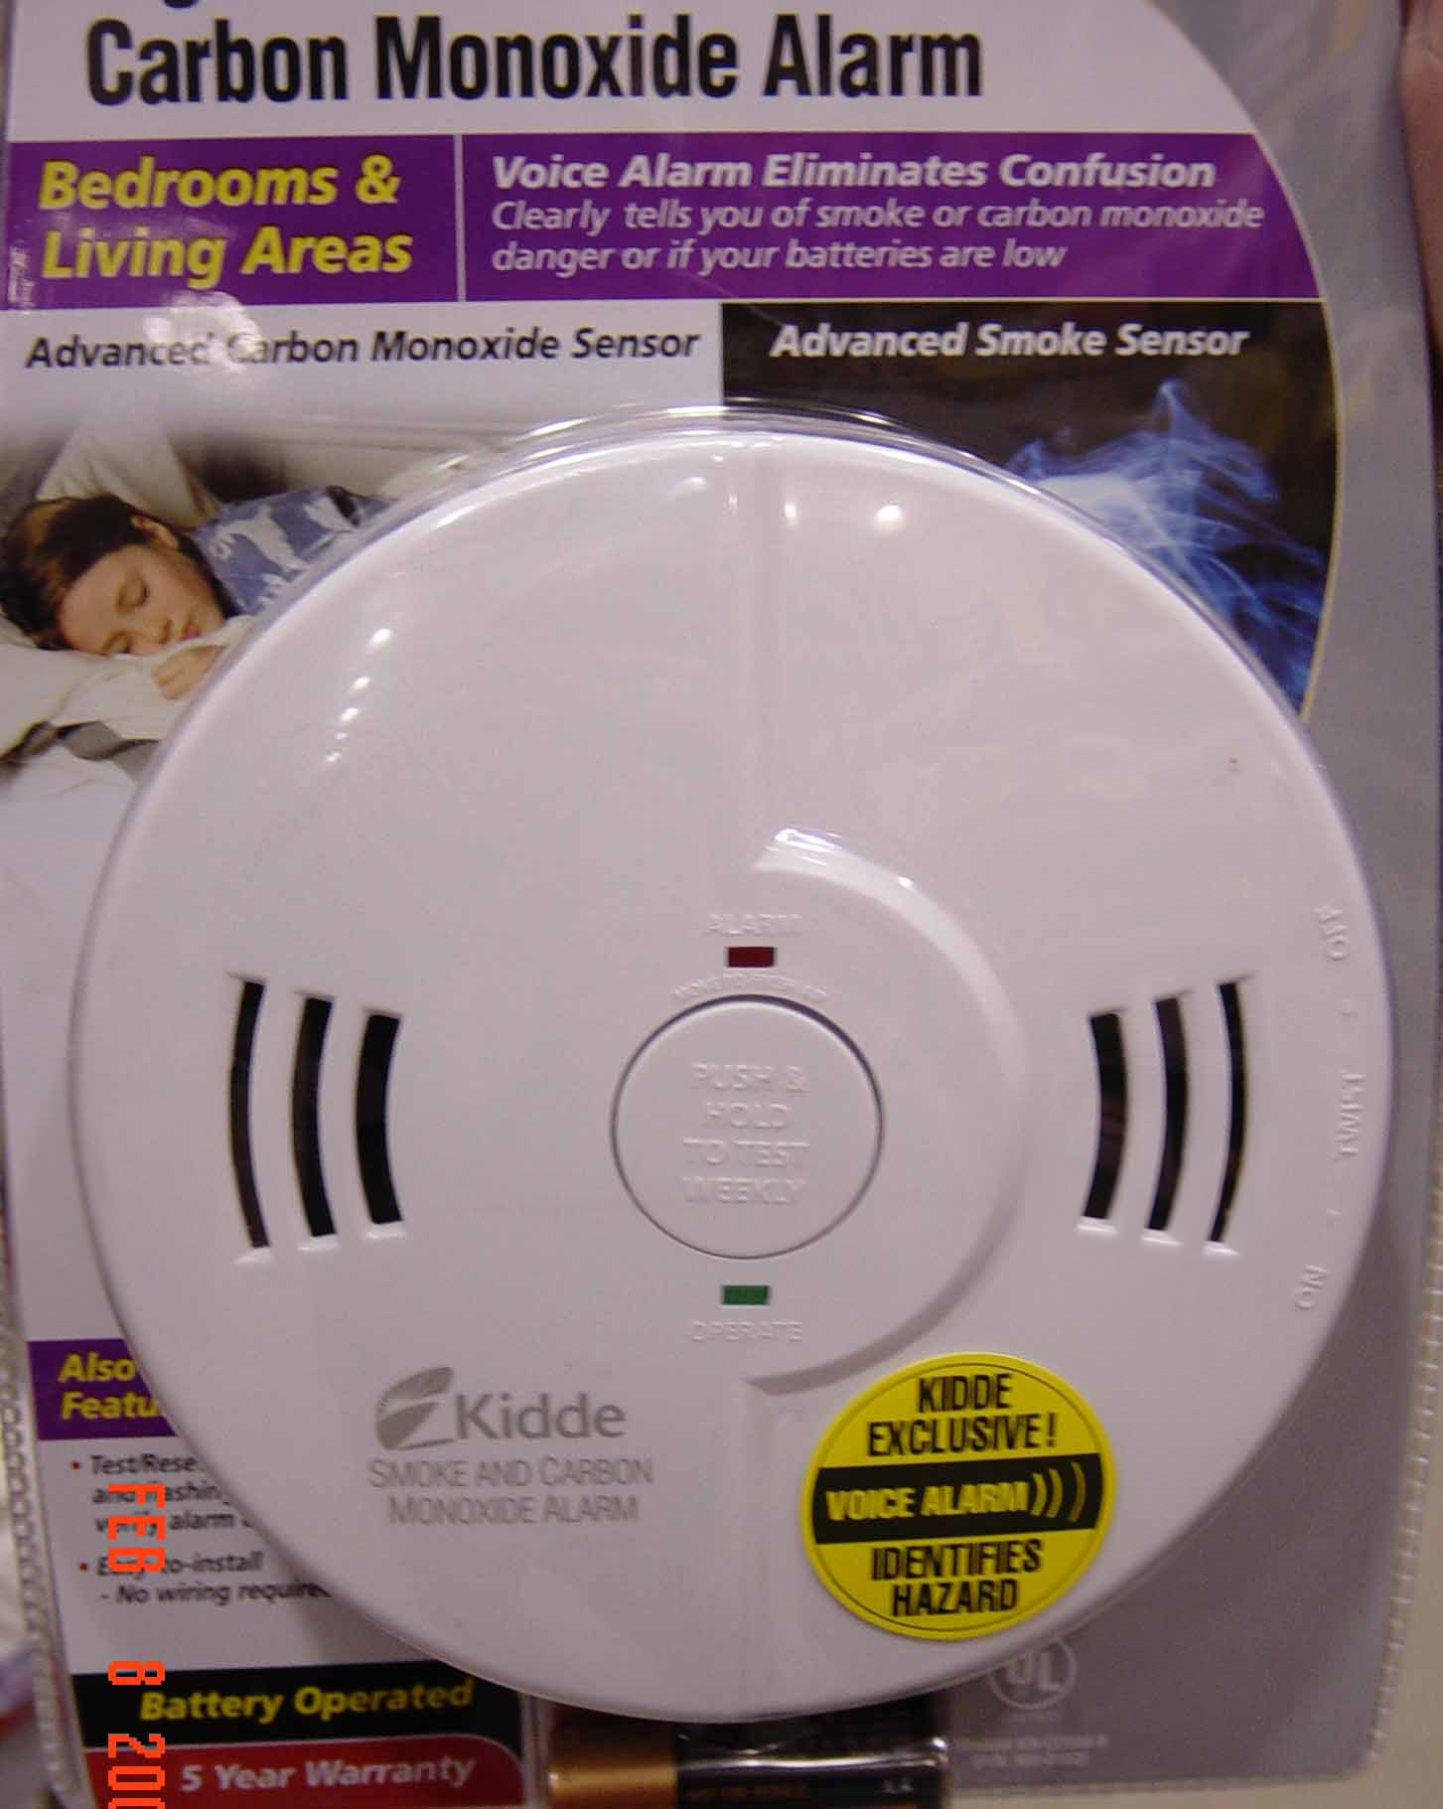
Carbon Monoxide Alarms

Slide 21
Portable Space Heaters
Follow manufacturer’s instructions.
Use Underwriters Laboratory (UL) or Factory Mutual models.
Keep combustible materials at least three feet away from space heaters.
Never use an extension cord with a portable heater.
Keep children and pets away from portable heaters.
Turn heaters off when you leave home or go to bed.
Never use gasoline or any other flammable liquid in a kerosene heater.

Slide 22
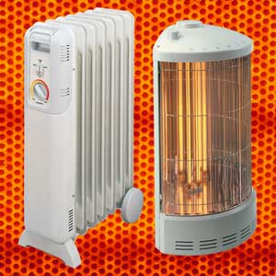
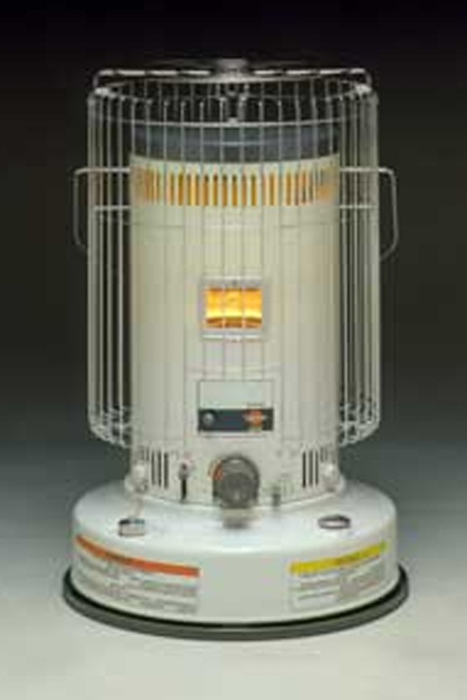
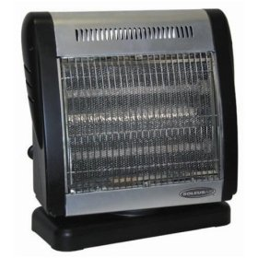
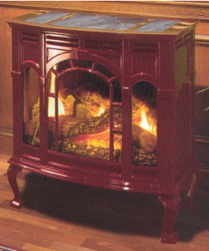
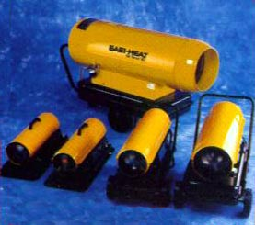
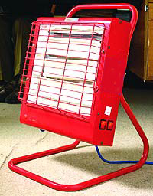
Portable Space Heaters

Slide 23
Grilling Safety Tips
All BBQ grills should only be used outdoors
The grill should be placed away from the home
Keep your grill clean
Never leave your grill unattended
Charcoal Grills
  Use only charcoal lighter fluid
  Let the charcoal be completely cold
Propane Grills
  Check for leaks annually
  If you smell gas and can’t control it, call 911

Slide 24
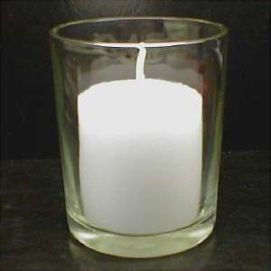
Candle Safety
Never leave burning candles unattended.
Keep combustible materials away from open flames.
Do not burn candles near windows or doorways.
Place candles in glass or ceramic containers.
Never leave candles burning when children or pets are present.
In a power outage, use a flashlight. Never use a candle.

Slide 25
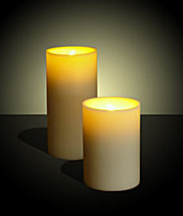
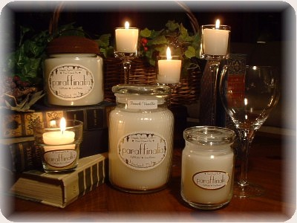
Candle Safety

Slide 26
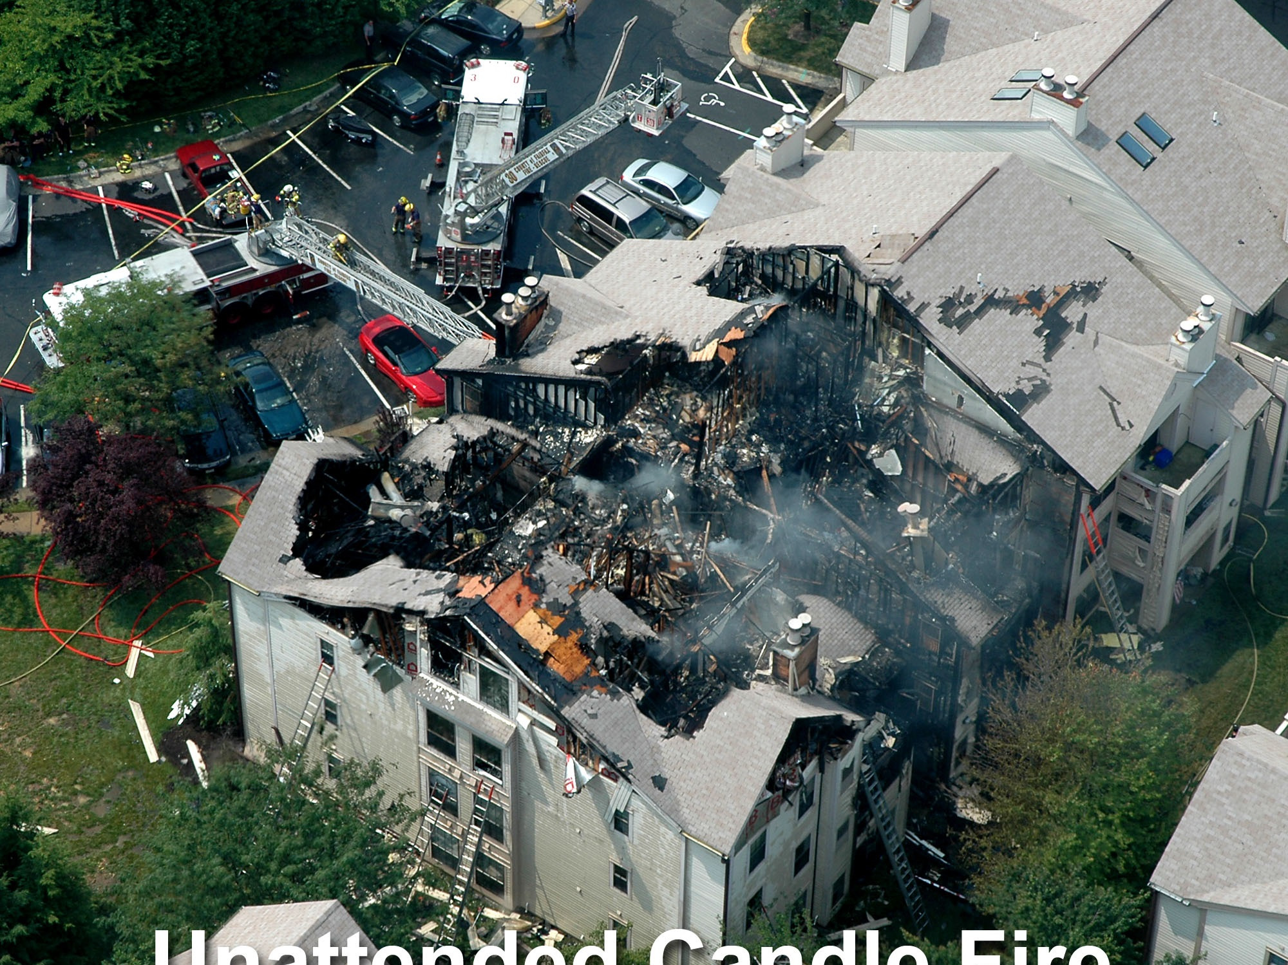
Unattended Candle Fire

Slide 27
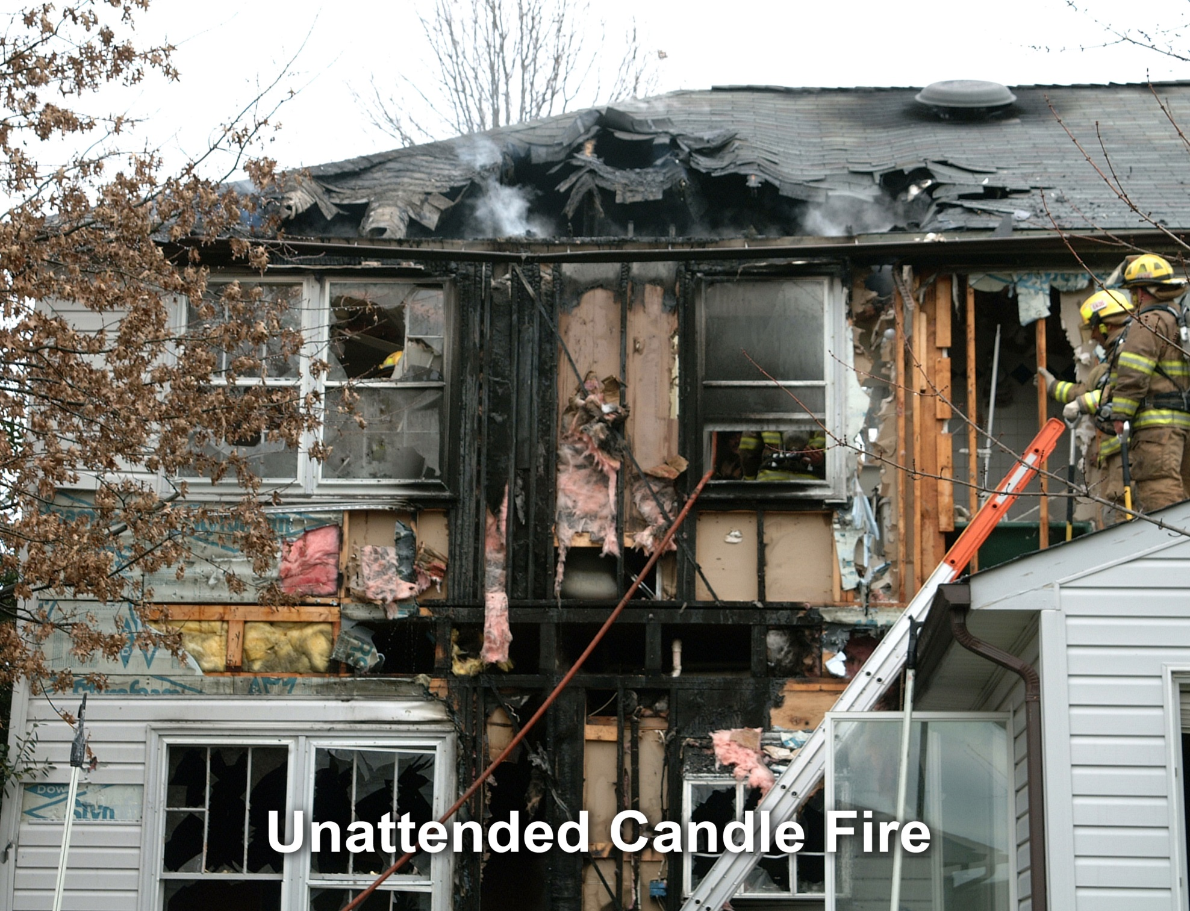

Slide 28
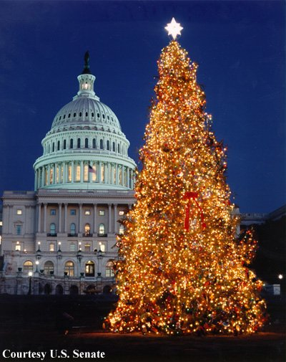
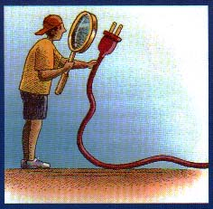
Holiday Tree Safety
Keep tree immersed in water.
Do not permit smoking near tree.
Use only lights that are U.L approved.
Use flame retardant decorations and paper.
Inspect lights for frayed or cracked wiring, broken plugs or defective electrical sockets.
Unplug lights at night and when leaving the home.
Remove the tree after needles dry out.

Slide 29
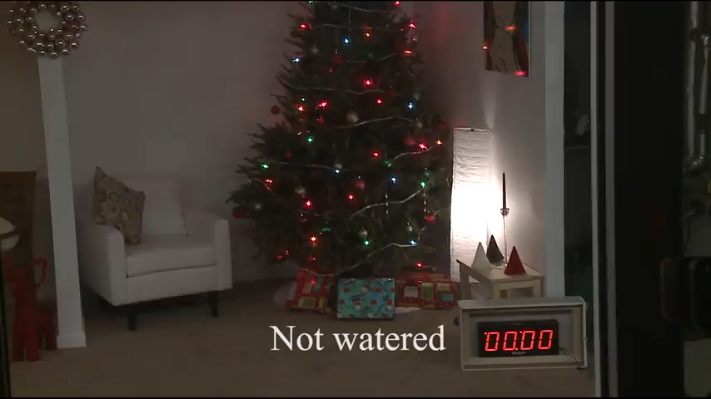
How Quickly Can Fire Spread?

Slide 30
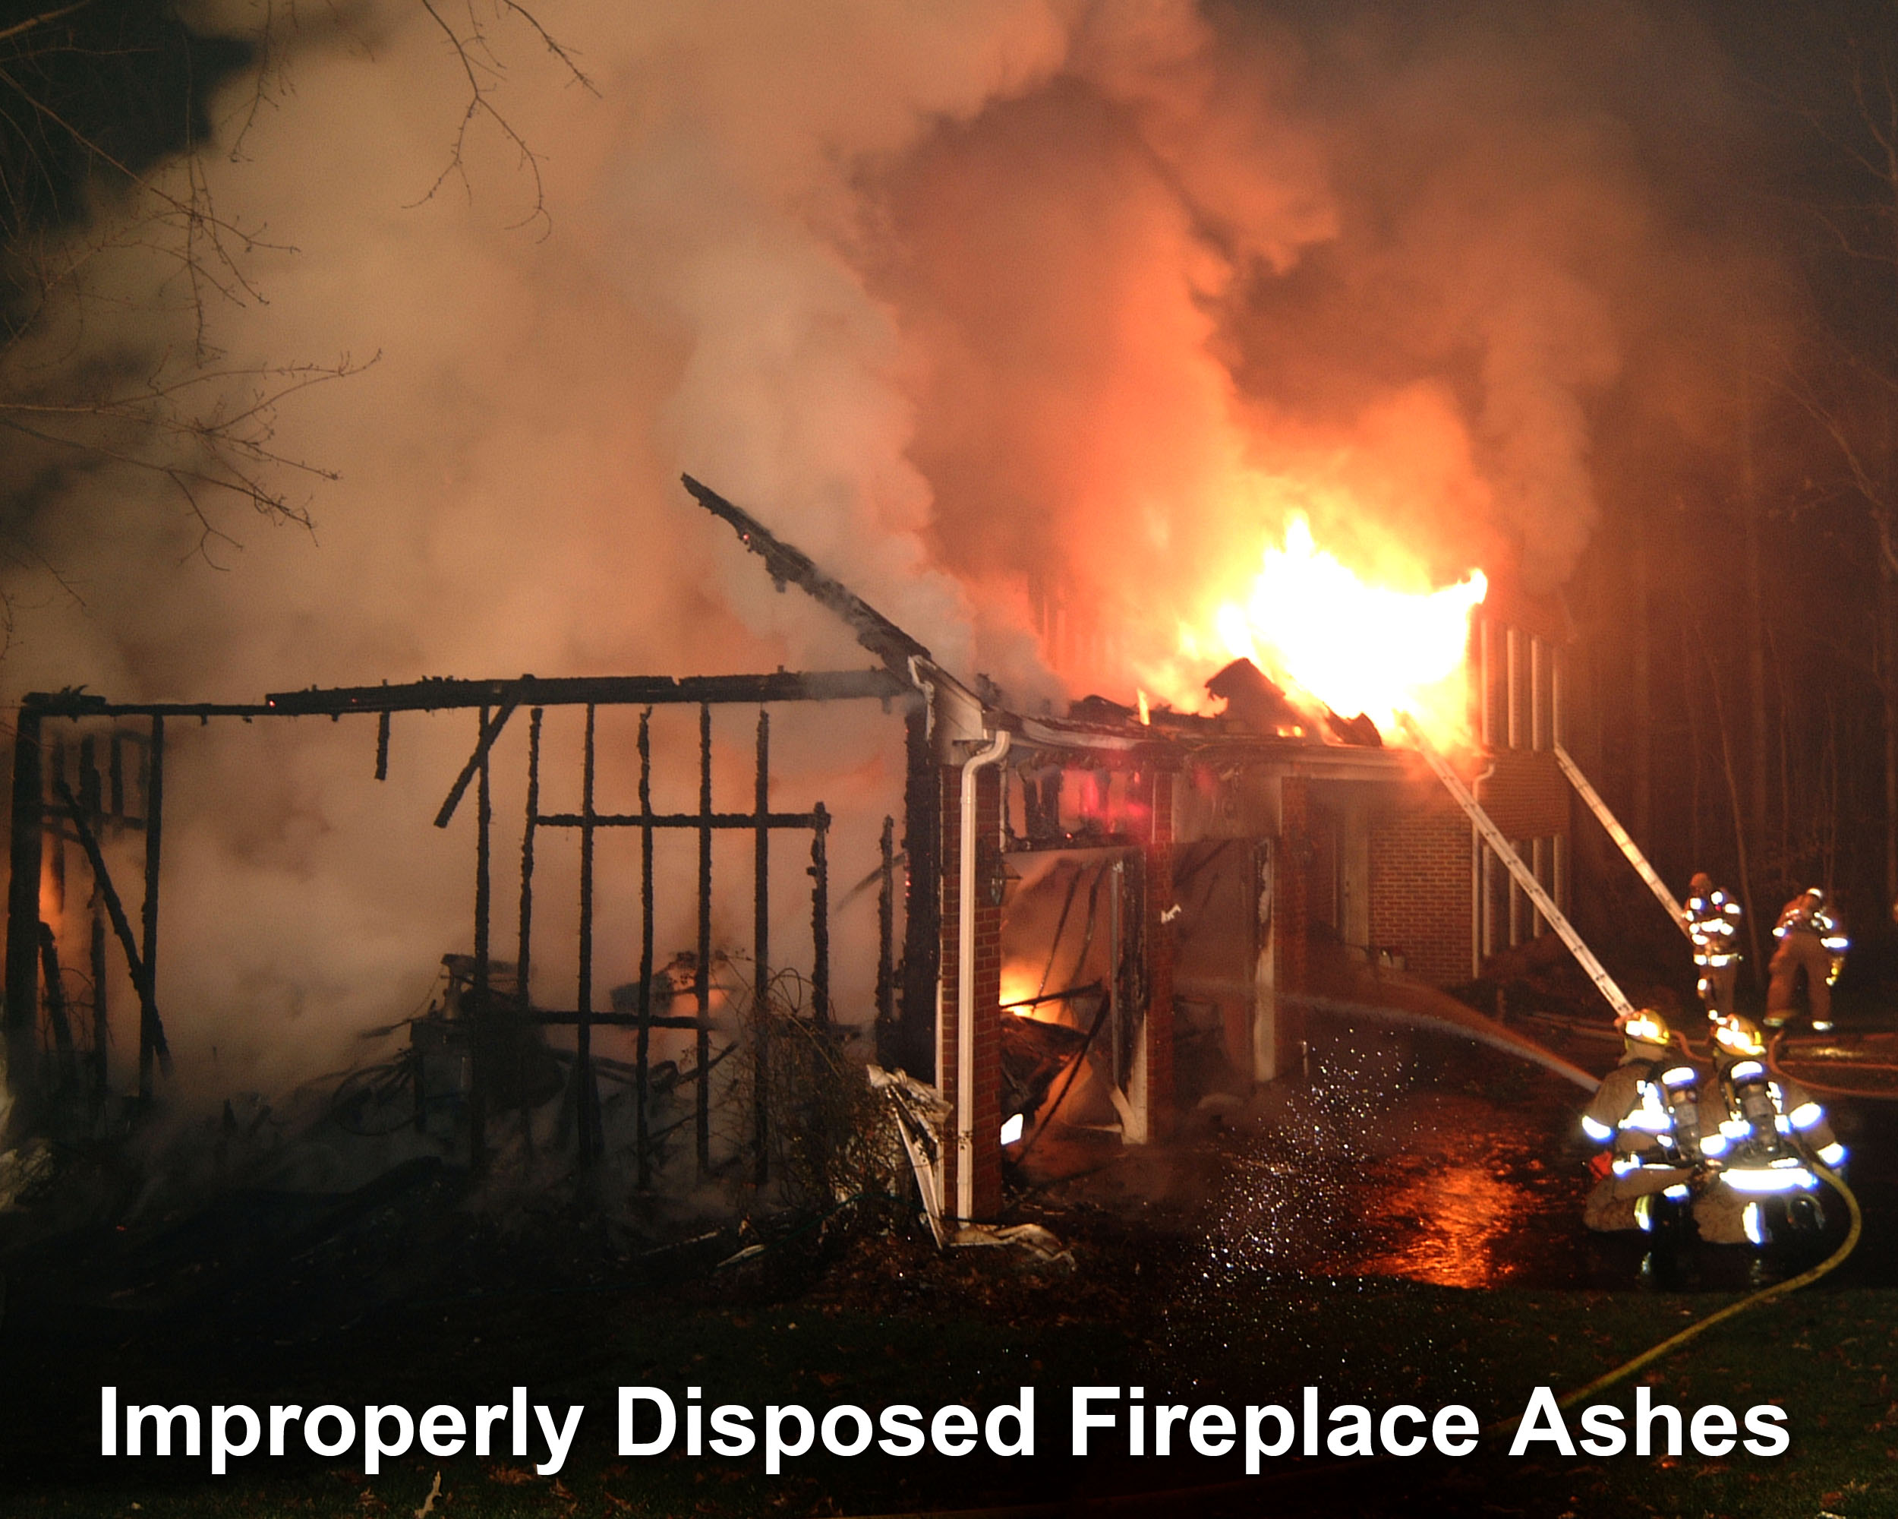
Fireplace ashes can remain hot for up to four days.

Slide 31
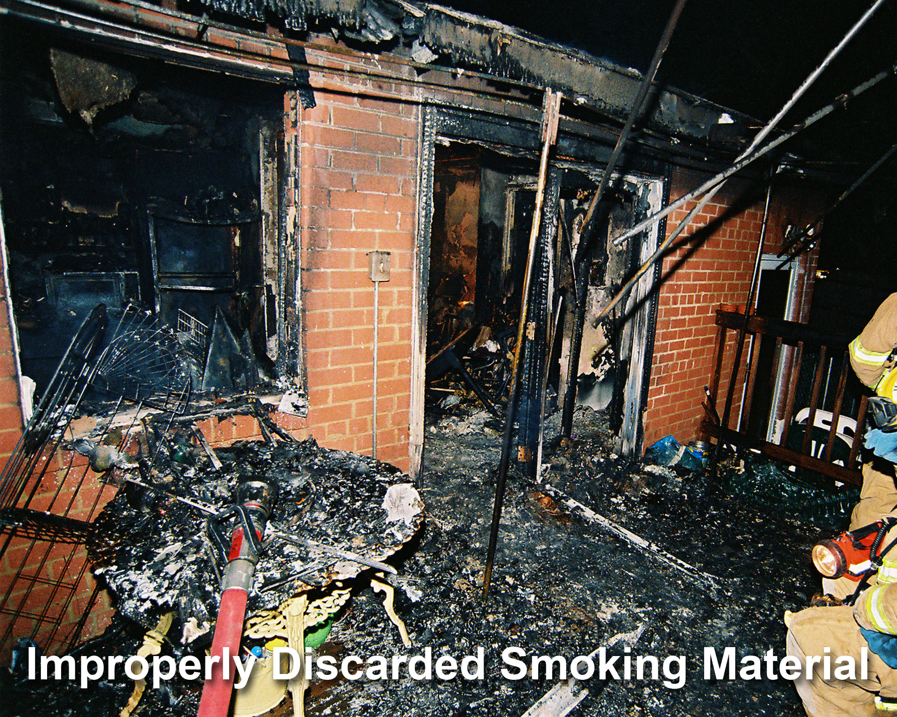

Slide 32
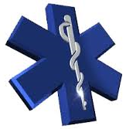
File Of Life
Written Medical Information
  Allergies
  Medications
  Medical Conditions
  Contact Information
Even if you don’t have File of Life:
  Have this information available for EVERY family member in easy to access place

Slide 33
COVID-19
What has it meant to Fire and Rescue

Slide 34
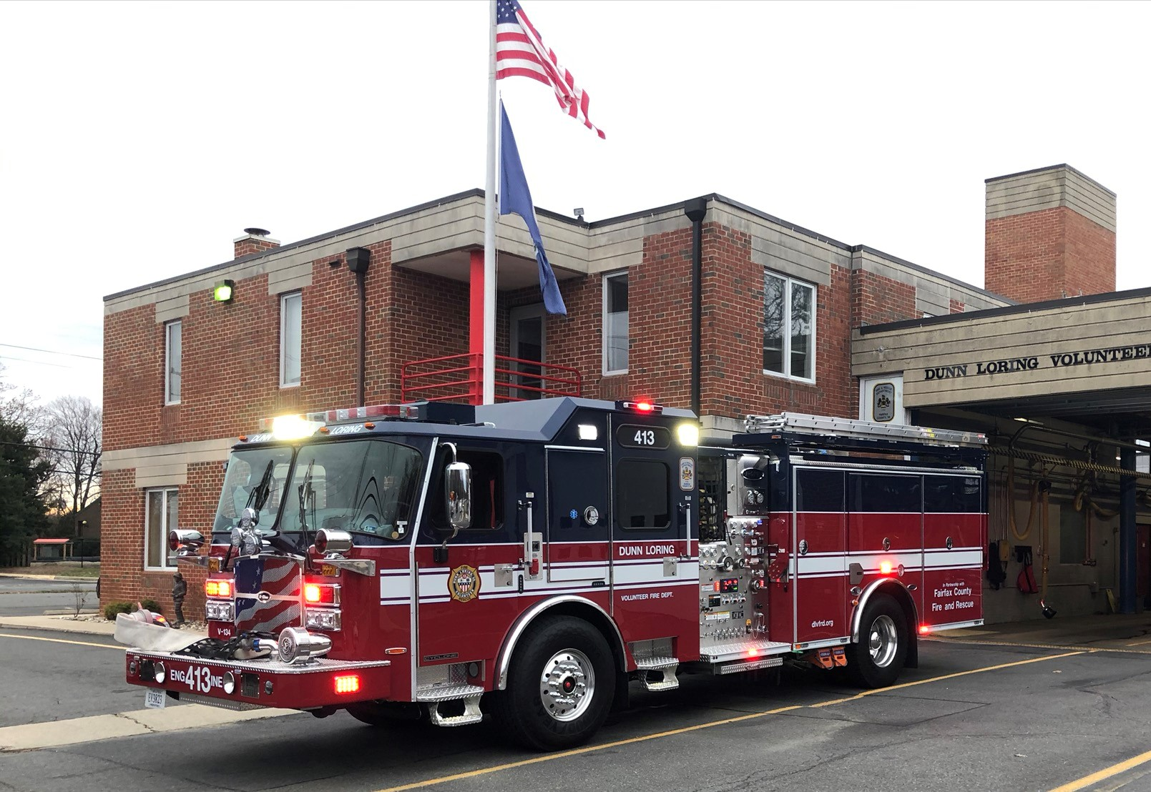
Questions and Thank you!
WWW.DLVFRD.ORG
Notes:
Request How can I get transported from the hospital to my home by ambulance?
A) The Fire and Rescue Department provides emergency transportation only. If you are looking for non-emergency transportation from a hospital to home, a number of private ambulance services are available. They can be found in the Yellow Pages under Ambulance Service.
Why did you send a fire engine when I called for an ambulance to get medical help?
A) Sometimes a fire engine will arrive first because it is the closest emergency equipment to the scene. While waiting for the Advanced Life Support unit, these emergency medical technicians and paramedics will render aid as necessary. Along with basic medical equipment, all fire engines are equipped with automatic defibrillators, a device used to monitor the heart and deliver an electrical charge to correct a life-threatening heart rhythm.
How can I obtain a copy of an incident report?
A) Submit a written request to the Fairfax County Fire and Rescue Department, Attention: EMS Administration, 4100 Chain Bridge Road, 5th Floor, Fairfax, Virginia 22030. Information provided in the request should include the location of the incident, the type of incident (e.g., house fire, vehicle crash, medical emergency), the date and approximate time of the incident, a daytime phone number of the requesting party and names of the parties involved, if known.
Medical reports requested by someone other than the patient treated require assigned medical release form by the patient, legal guardian, or appointee.
A minimum (non-refundable) processing payment of $5 per report must be submitted with each request. Checks must be made out to the “County of Fairfax.” Please allow five working days from the receipt of your request for processing. Reports can either be picked up or mailed.

