Slide 1
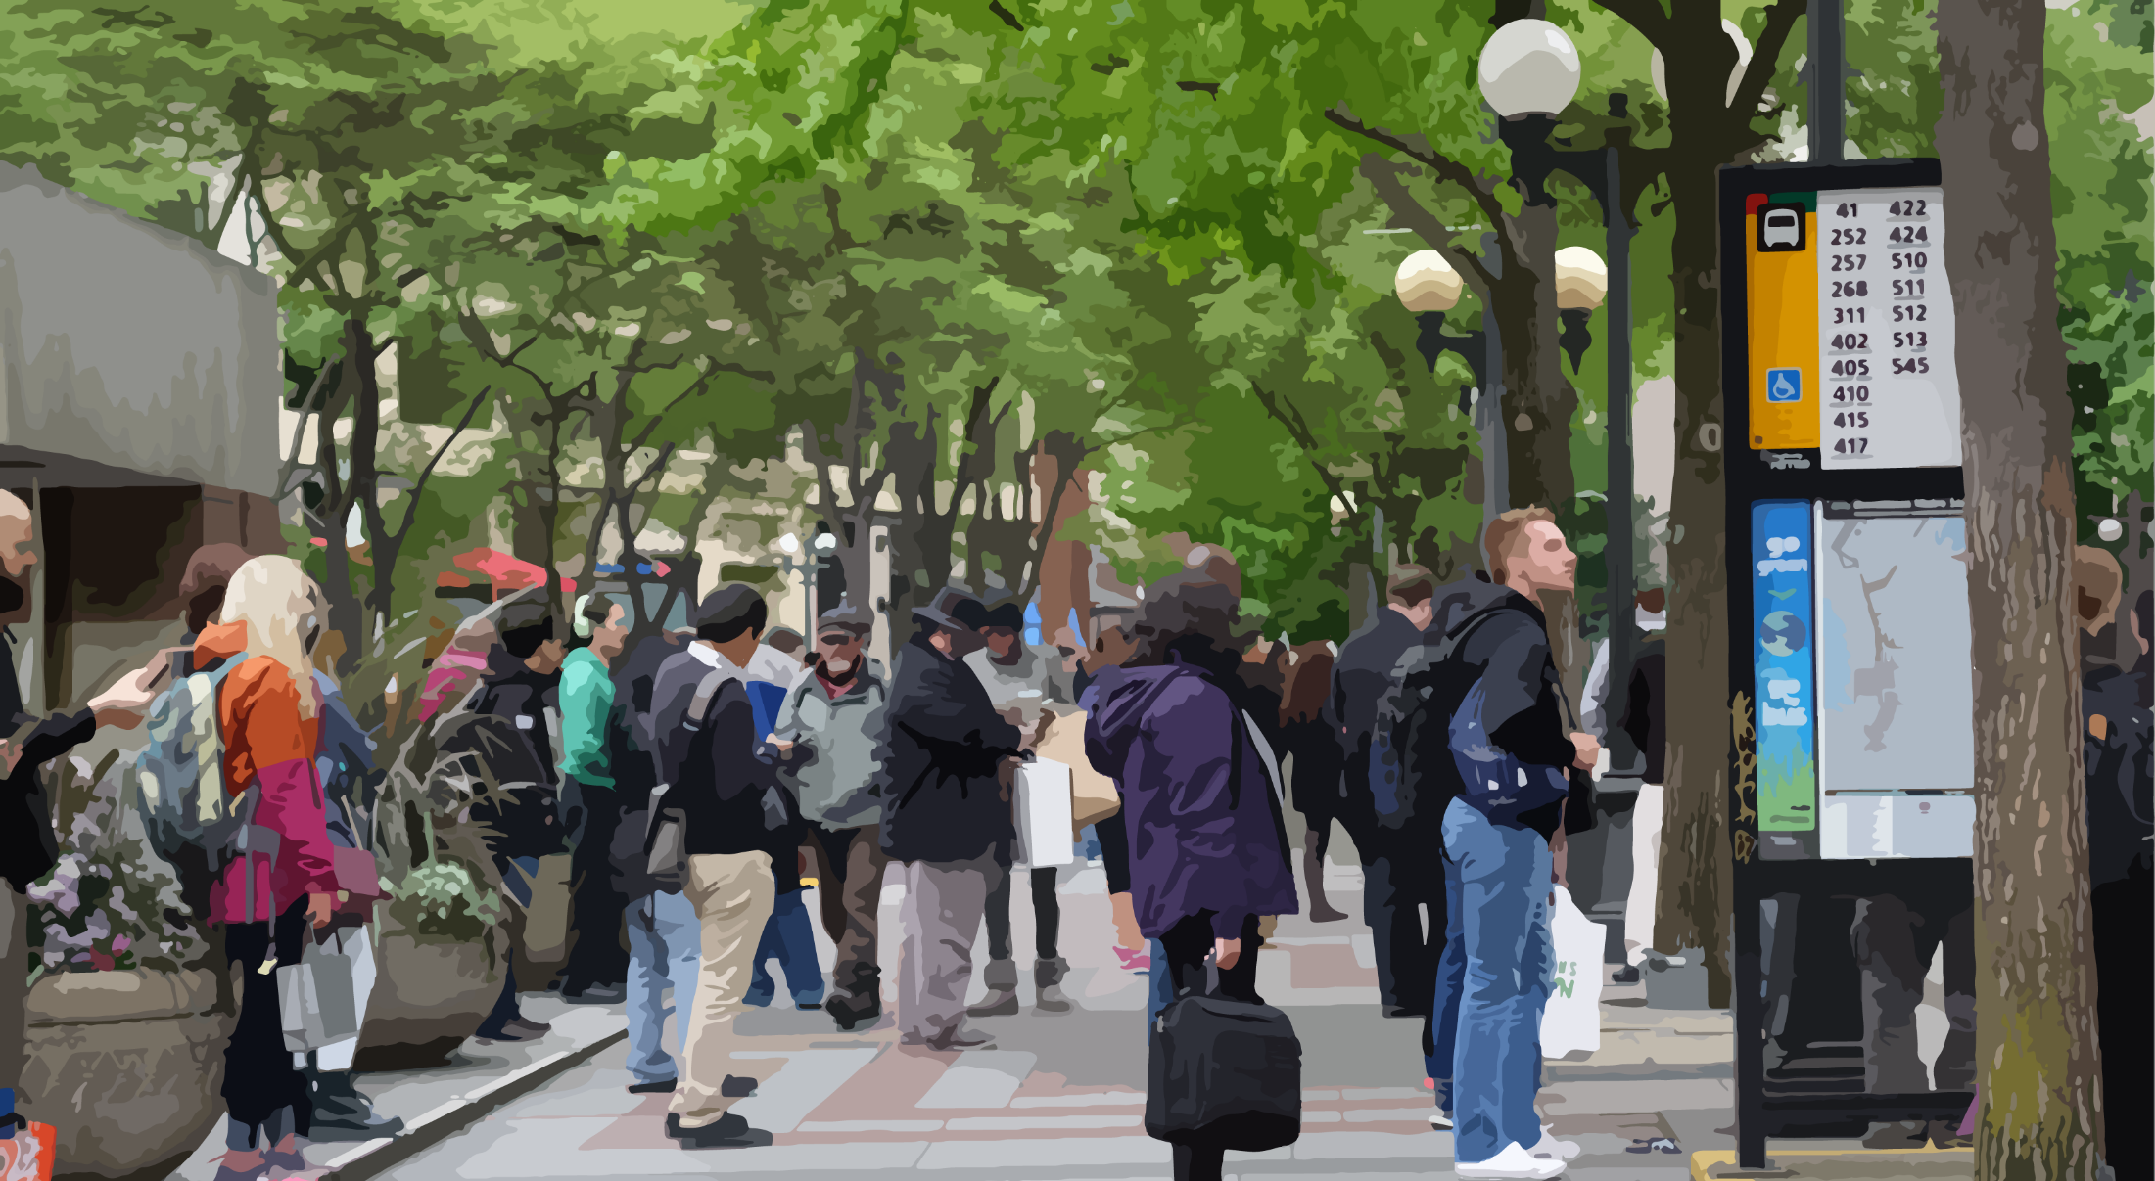
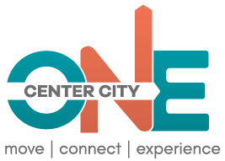
One Center City
Potential Near-term Strategies
National Federation of the Blind
February 18, 2017

Slide 2
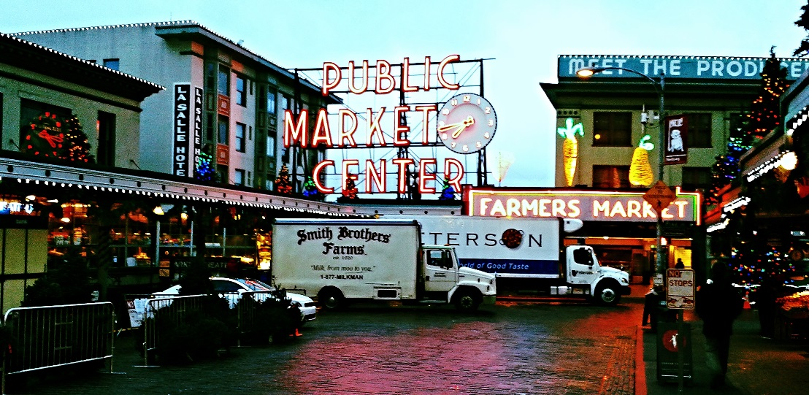
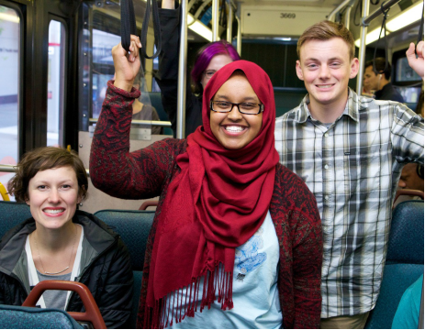
ONE CENTER CITY
Unified and integrated plan for how we:
  Move through,
  Connect to, and
  Experience
  Center City
Many communities, perspectives, and partners
Project sponsors
  City of Seattle
  King County Metro
  Sound Transit
  Downtown Seattle Association
  20-year Vision
  Action Plan for Near-Term, Mid-Term, and 20-year Horizon

Slide 3
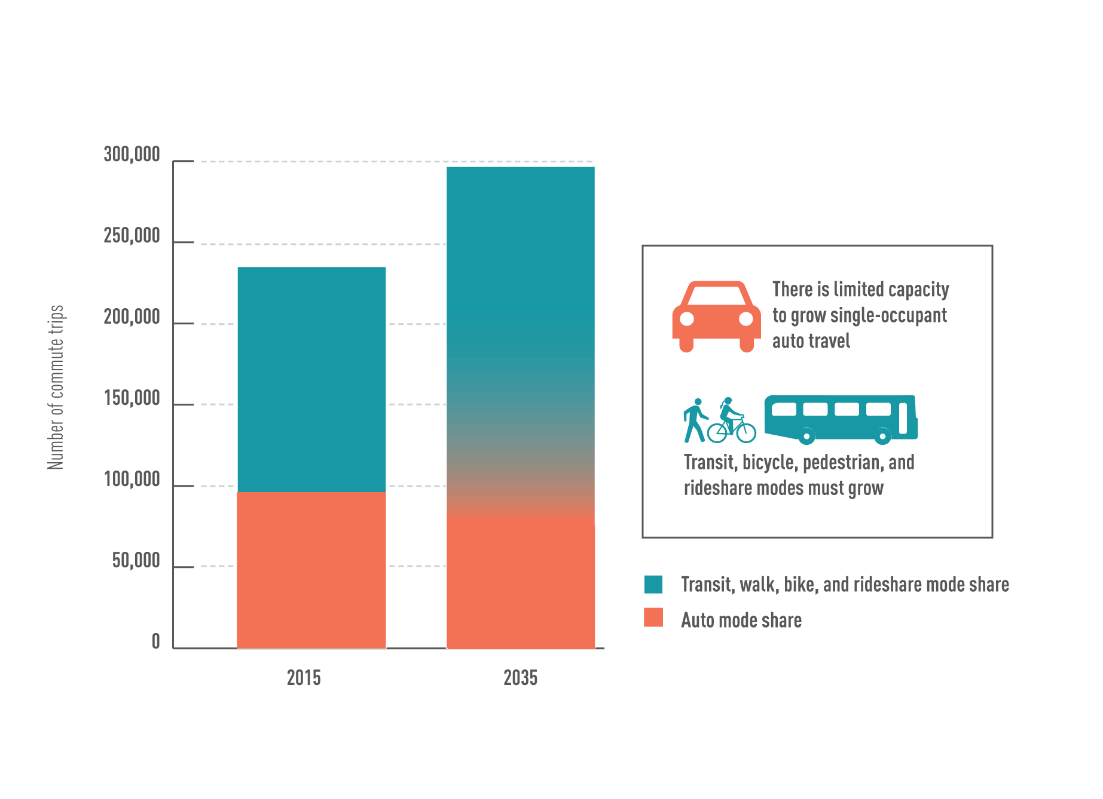
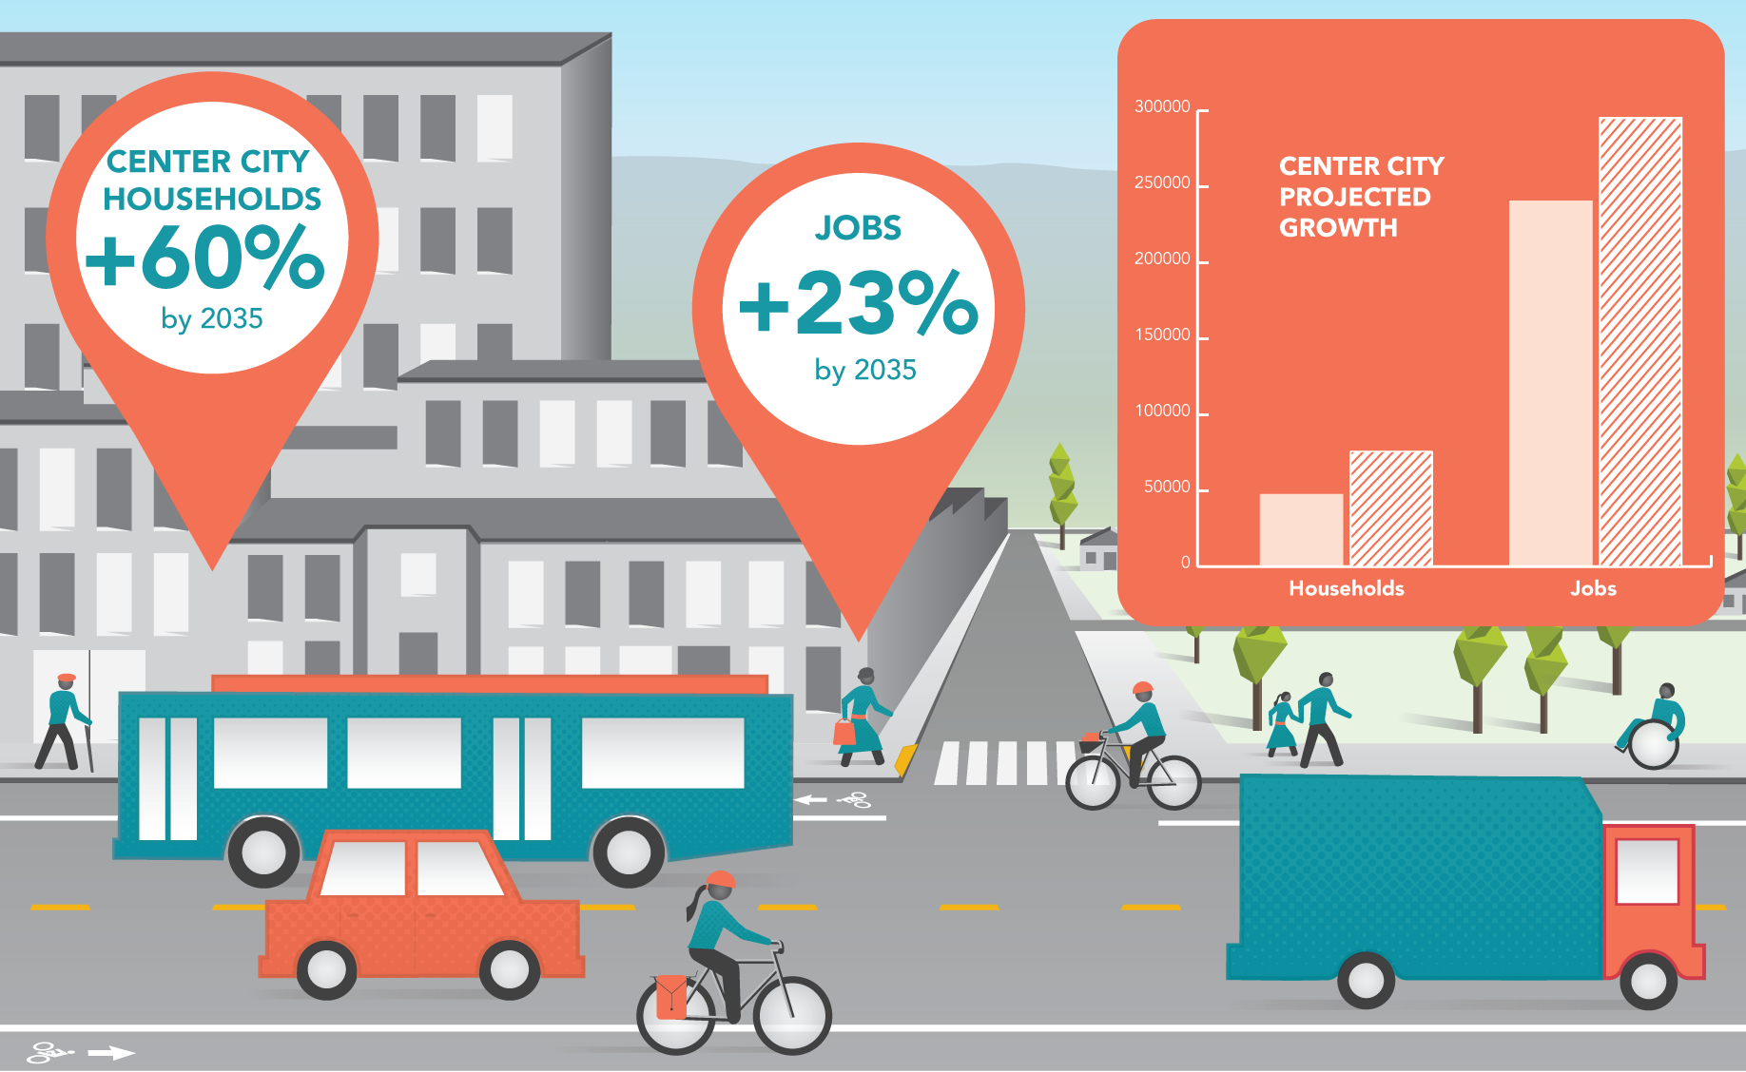
WHY ONE CENTER CITY?

Slide 4
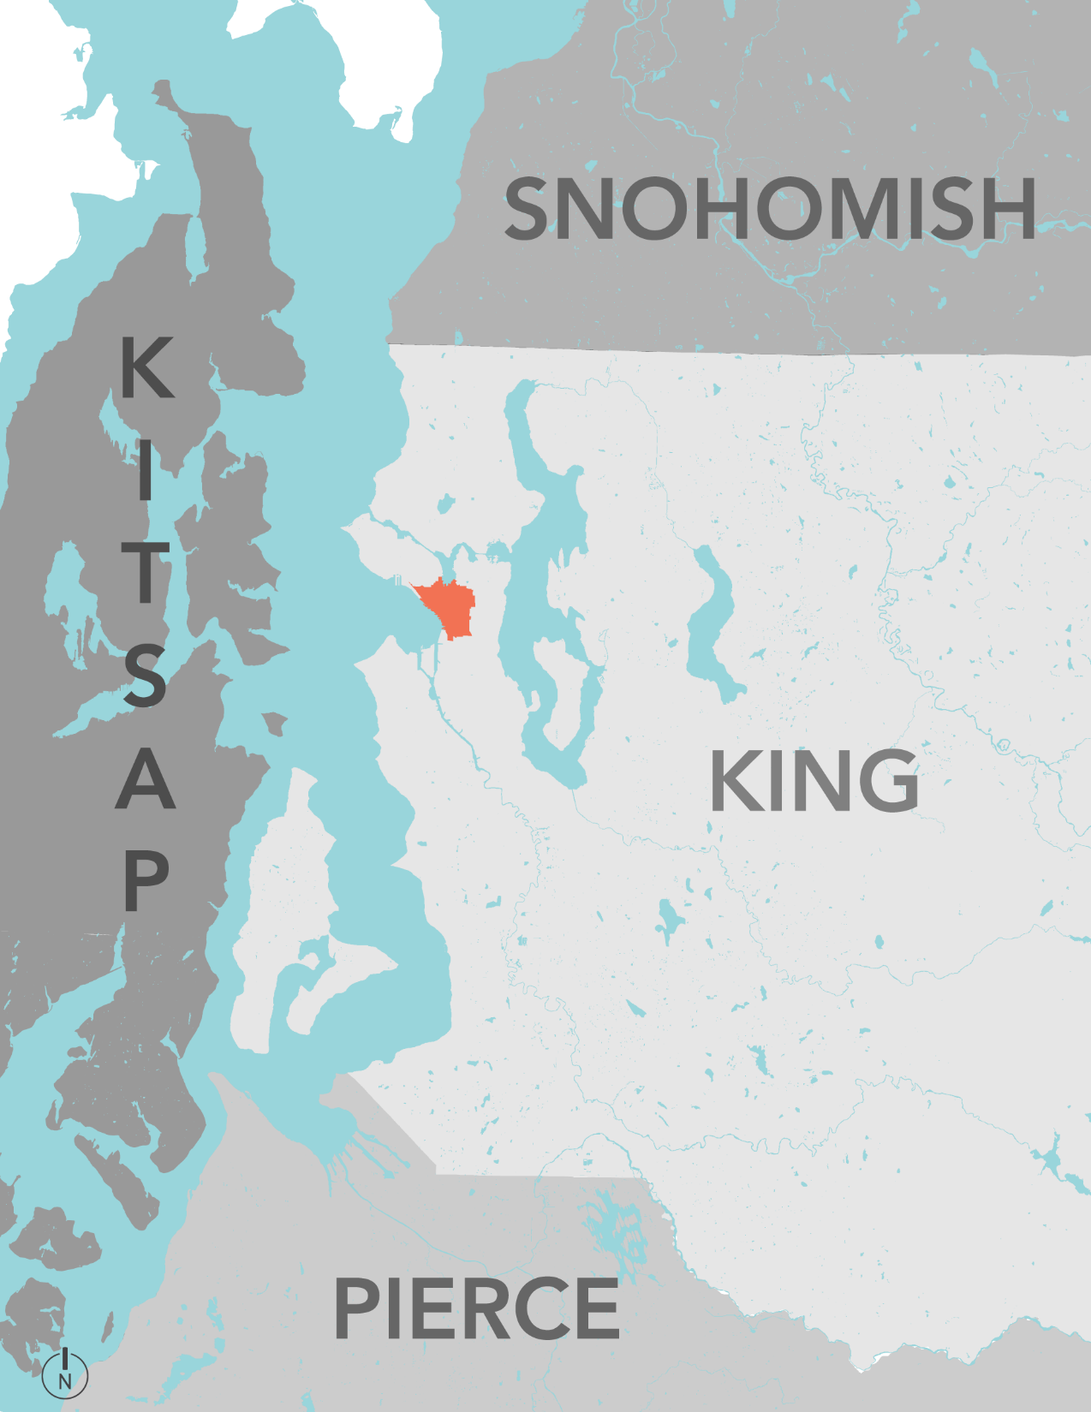
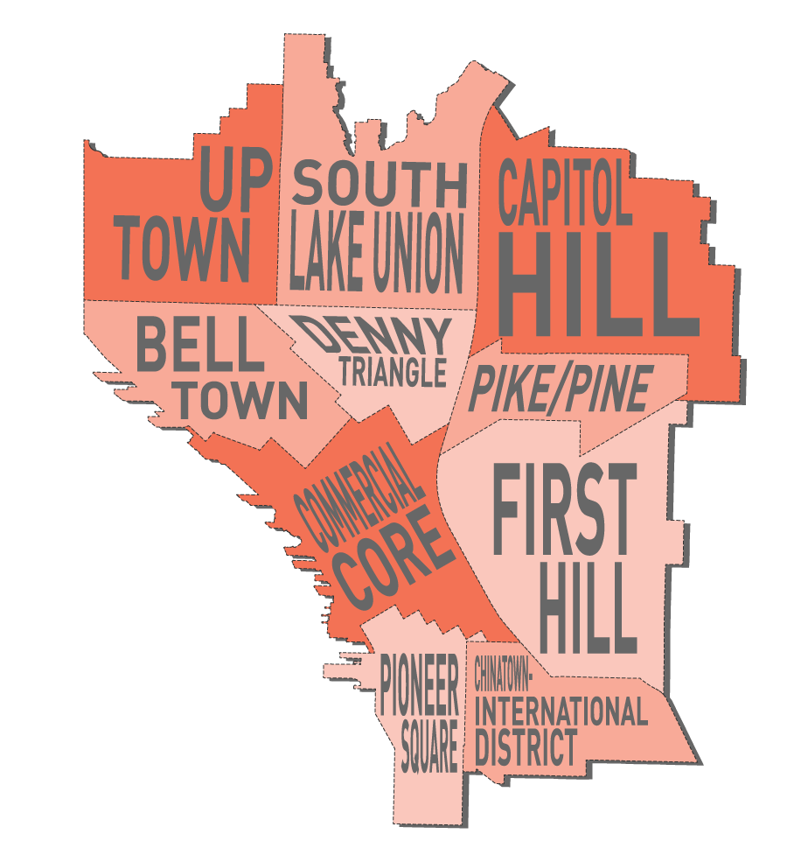
WHERE IS THE CENTER CITY?
Notes:
Where is this growth happening?
10 of the City’s higher-density, growing neighborhoods in
4 urban centers, designated in the City’s and Region’s Growth Management plans:
1) Downtown includes Commercial Core, Belltown, Denny Triangle, Pioneer Square, Chinatown-International District
2) Uptown
3) South Lake Union
4) First Hill/Capitol Hill, including Pike/Pine

Slide 5
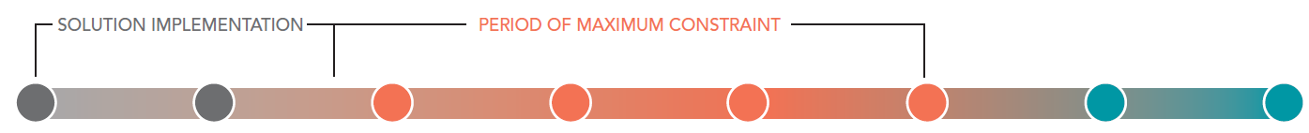
A TIMING CHALLENGE
Fall 2018
2017
2018
2019
2020
2021
2022
2023
OCC Near-Term Plan
2nd Ave PBL open
Center City Connector (CCC) construction begins
DSTT closes to buses
Convention Center construction begins
D2 Roadway closes
Madison BRT construction begins
Madison BRT open
SR 99 Tunnel open*
Alaskan Way Viaduct demolition*
Alaskan Way construction begins*
Convention Center open
Center City Connector open
Alaskan Way open to buses*
Northgate Link open
North Portal streets open*
Lynnwood & East Link open
Alaskan Way open to traffic*
2020
* - Alaskan Way Viaduct Replacement Program project timelines dependent on completion of the SR 99 Tunnel

Slide 6
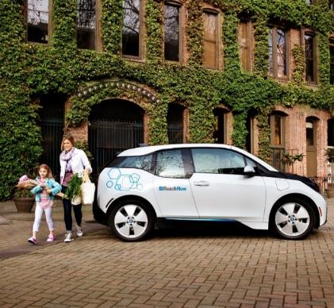
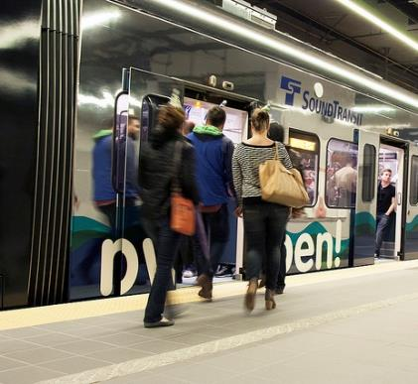
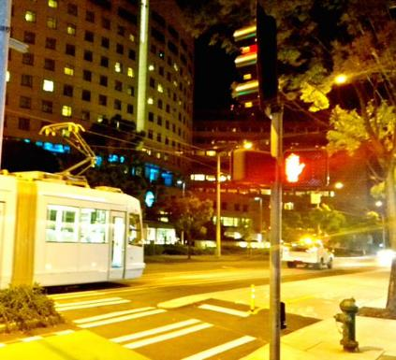
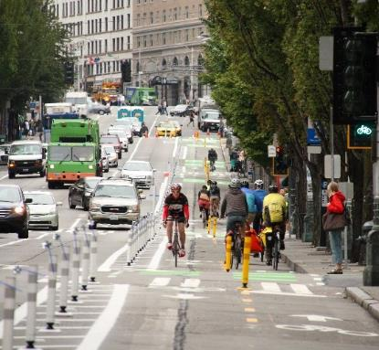
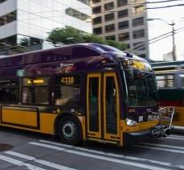
TRANSPORTATION SYSTEM CHANGES
  Light rail expansion
  Northgate Link
  East & Lynnwood Link
  Federal Way Link
  SR 99 tunnel and Seattle Waterfront
  Center City Connector Streetcar
  Rapid Ride Expansion
  13 new corridors in King County by 2024
  7 of the 13 in Seattle
  Center City Bike Network
Image: Capitolhillseattle.com

Slide 7
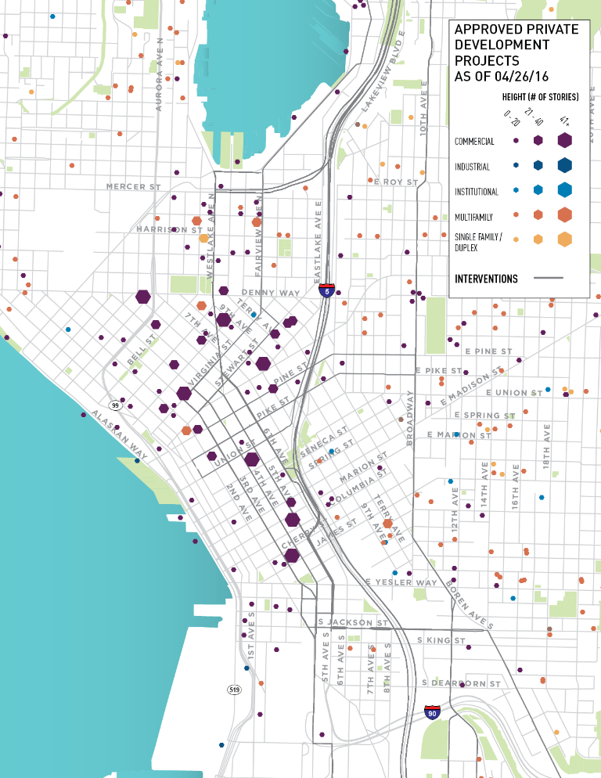
OPPORTUNITY AND GROWTH
10,000+ residential units under construction (June 2016)
11M+ square feet of institutional, office and retail space approved or under construction (June 2016)
Convention Center Addition

Slide 8
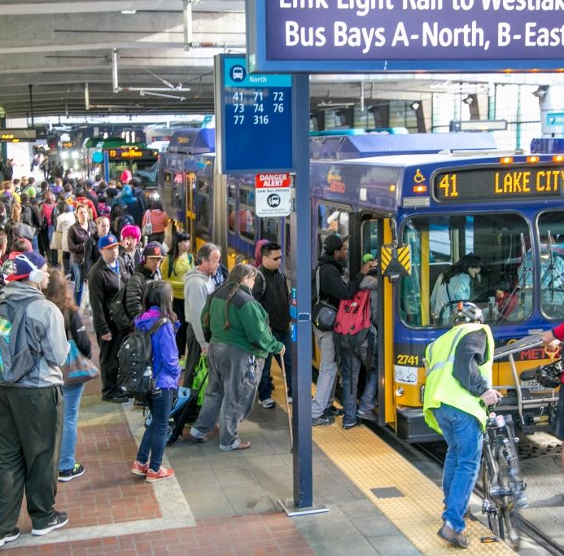
BUS OPERATIONS IN DOWNTOWN SEATTLE TRANSIT TUNNEL (DSTT)
Seven regional routes to downtown
40 buses per direction during PM peak hour
15,000 riders during the PM peak period (3-7 PM)

Slide 9
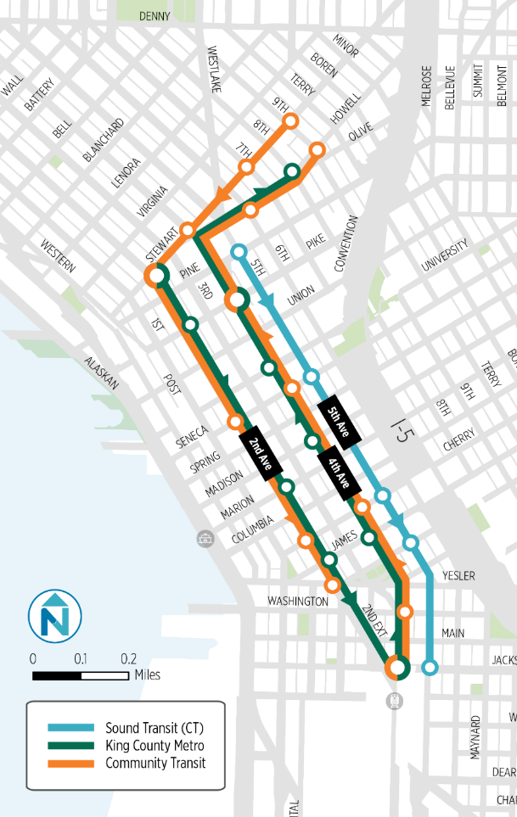
NO ACTION
NOT AN OPTION
Longer travel times
Reduced travel reliability
More passengers waiting on sidewalks
Less space for other uses
  Bikes
  Delivery vehicles
  Service providers
  Taxi and for-hire vehicles
Additional cost to transit providers
Notes:
6-7 minute increase for bus passengers compared to a trip in the tunnel
2-4 minute increase for passengers in buses on 2nd and 4th avenues
Up to 7-minute increase in travel time for autos and trucks on 2nd, 4th, and 5th avenues
Decreased reliability for all modes
$6-7 Million additional annual operating cost to maintain current service levels
15 additional transit vehicles needed to maintain current frequencies
More bus passengers waiting on sidewalks
Pressure on other uses of the right-of-way

Slide 10
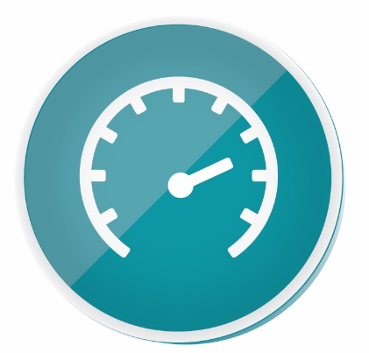


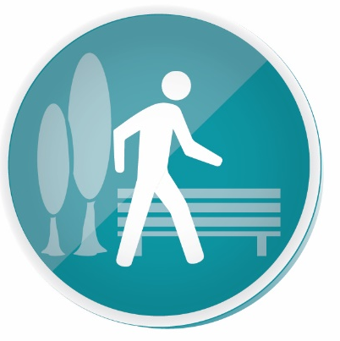
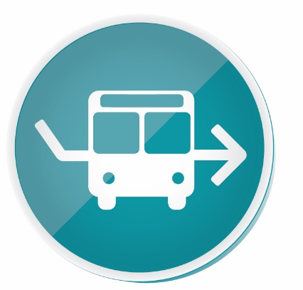
POTENTIAL NEAR-TERM STRATEGIES
Surface Street Operations
Programs &
Management
Strategies
CC Bike Network Implementation
Pedestrian & Public Realm
Transit Service Restructuring

Slide 11
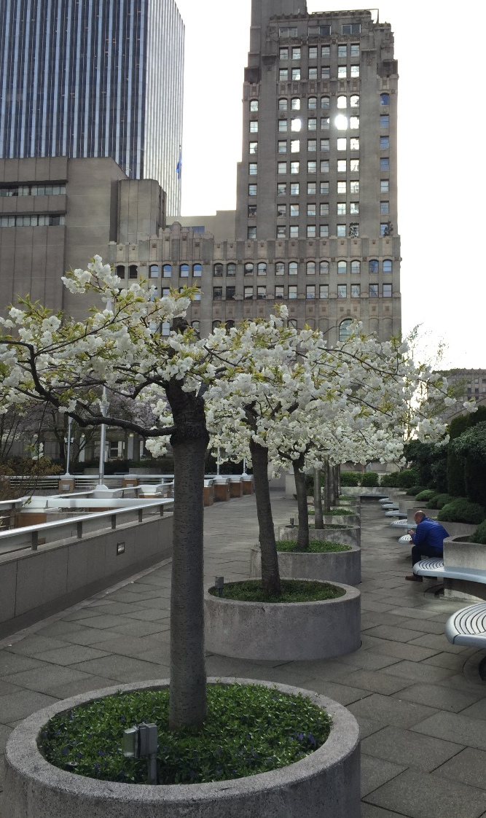
One Center City guiding Principles
Flexibility: Create flexible systems that can evolve over time by taking a system-wide view and challenging long-held assumptions.
User experience: Create an easy to use and intuitive system by prioritizing accessibility, pedestrian mobility, wayfinding, and multimodal connectivity.
Equity: Design for the health, safety and well-being of all who live in our community using established race and social justice guidelines.
Well-being: Support social sustainability and economic prosperity for all.

Slide 12
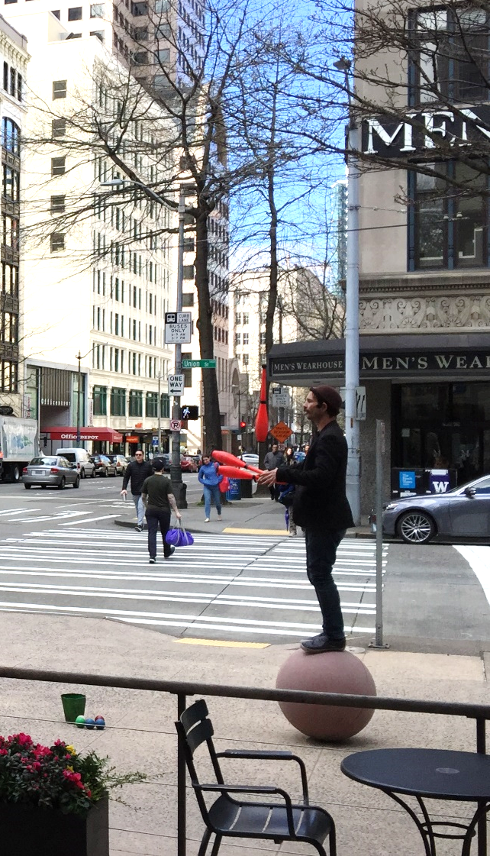
One Center City guiding Principles (CONT.)
Optimization: Optimize use of limited street and sidewalk space for people and goods.
Transportation: Provide safe, affordable, comfortable, reliable, and convenient transportation options for all users of all abilities – daytime and nighttime, commuters and non-commuters, and those needing timely multiple connections.
Public space: Design the street experience and public realm so that they are inviting, engaging, safe, and supportive of social connections and community-building.
Stewardship: Reduce vehicles and emissions and use sustainable building practices.

Slide 13
POTENTIAL SURFACE STREET OPERATIONS STRATEGIES
Option B: OPERATIONAL ENHANCEMENTS
Signal modifications
Passenger loading enhancements
North bound protected bike lane on 4th Avenue; south bound on 5th Avenue
Existing
Option B
Notes:
Key Takeaways
Modest operational improvements
Faster boarding could allow shift of some regional routes to 3rd Avenue
Low capital investment
Potential for substantial decrease in annual transit operating cost compared to No Action
Removes loading zones on 4th – as early as summer 2017 to extend bike lane north from Seneca into Belltown

Slide 14
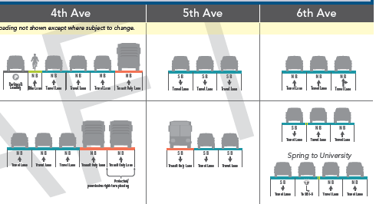
POTENTIAL SURFACE STREET OPERATIONS STRATEGIES
Option C: 4TH AND 5TH AVENUES TRANSIT COUPLET
Second northbound Transit Lane on 4th
Remove bike lane on 4th
Southbound transit lane on 5th
Two-way 6th Avenue
Existing
Option C
Notes:
Key Takeaways
Adds one full lane of transit capacity in each direction
No opportunity for north-south PBL
Reduction in on-street parking and loading
Modest capital investment
Potential for substantial decrease in annual transit operating cost compared to No Action

Slide 15
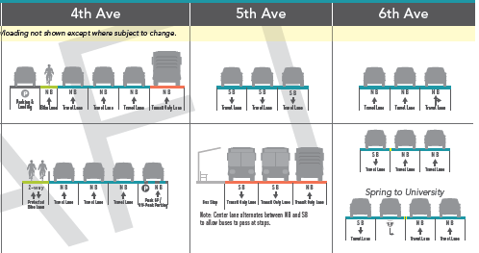
POTENTIAL SURFACE STREET OPERATIONS STRATEGIES
Option D: 5TH AVENUE TWO-WAY TRANSIT STREET
Two-way transit-only on 5th
Remove bus lanes on 2nd and 4th
Two-way protected bike lane on 4th
Two-way 6th Avenue
Existing
Option B
Notes:
Key Takeaways
Concentrates transit service on 1st, 3rd, and 5th avenues
Changes access to garages on 5th and 6th
Reduces parking and loading on 6th
Adds parking and loading on 2nd and 4th
Impacts streetscape and requires tree removal on 5th for bus stops
Large capital investment
Potential to reduce annual transit operating cost to 2016 level

Slide 16
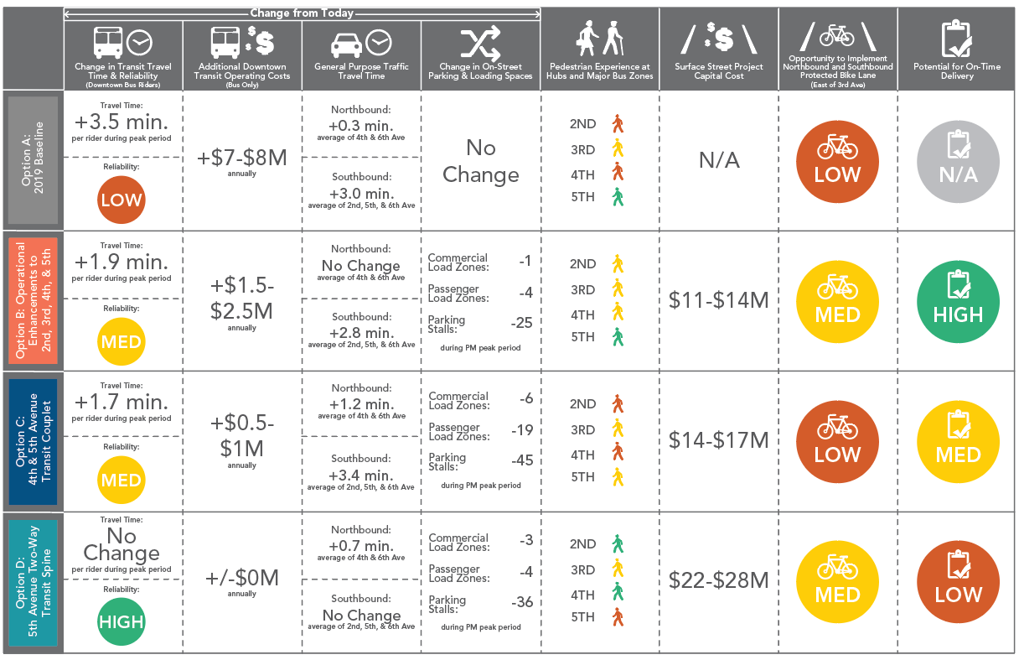
POTENTIAL SURFACE STREET OPERATIONS STRATEGIES
OVERVIEW

Slide 17
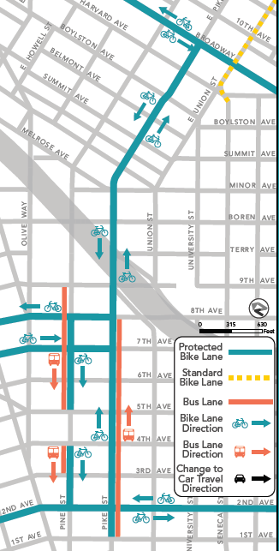
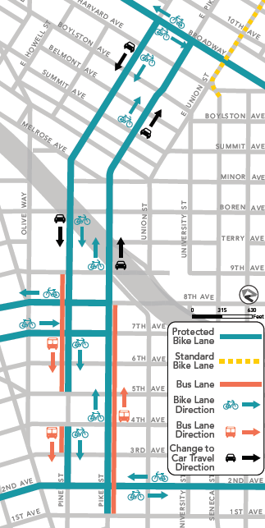
PIKE & PINE SURFACE STREET STRATEGIES
Bus lanes: 1st – 9th
Protected bike lanes: 2nd – Broadway
Option B – PBL pair on Pike (8th-Broadway)
Option C – One-way Couplet
Notes:
Key Takeaways
Minimal effect on transit speed and reliability
Reduction in on-street parking and loading – some downtown. East of I-5 with Option C
Delays to general purpose traffic on eastbound Pike
Protected bike lanes in key CCBN corridor
Option C – preserves more parking on Pike & Pine. Need traffic calming for one-way streets

Slide 18
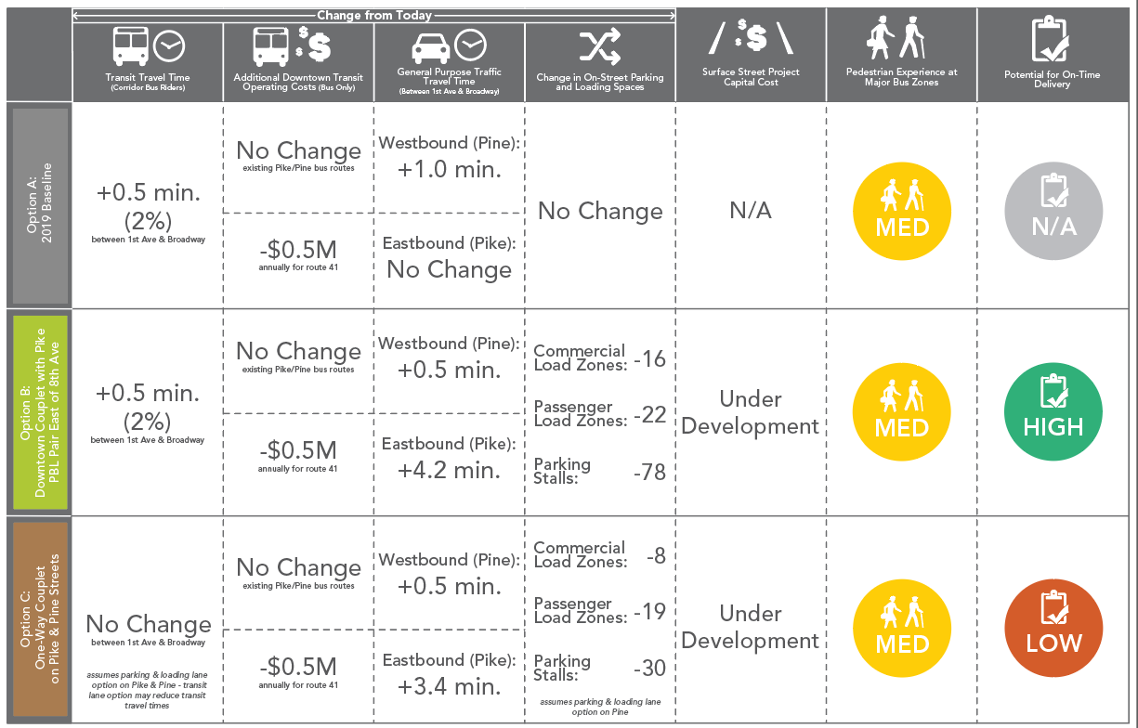
UNION, PIKE & PINE SURFACE STREET STRATEGIES
OVERVIEW

Slide 19
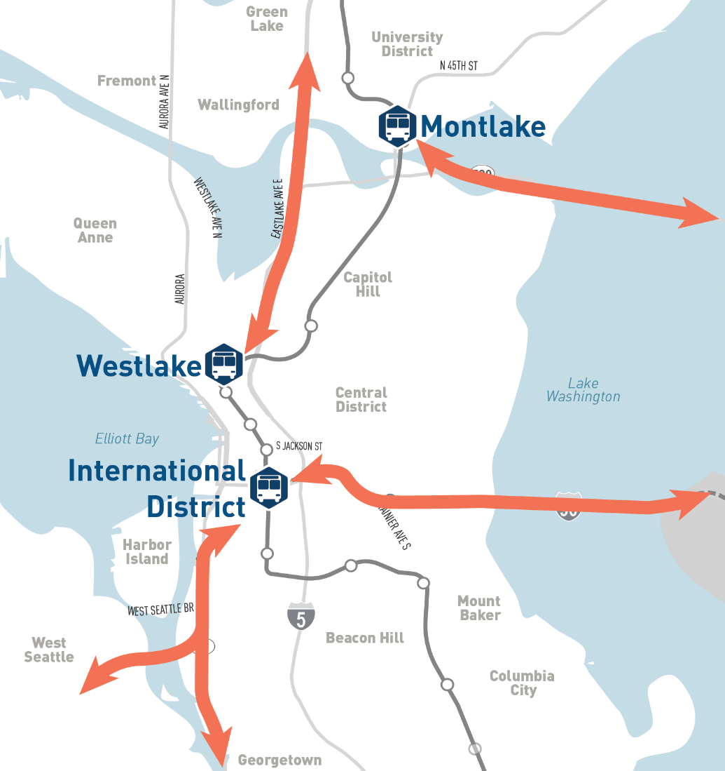
POTENTIAL TRANSIT SERVICE RESTRUCTURING STRATEGIES
  Change bus routes to reduce number of bus trips going through the downtown core
  Deliver transit riders to light rail or bus routes
Notes:
Key Takeaways
Optimizes use of transit hubs and light rail capacity
Adds a transfer for riders on affected routes
Improves reliability for some regional trips
Improves or maintains travel time compared to the No Action scenario for most riders
Reduces bus volumes on downtown streets

Slide 20
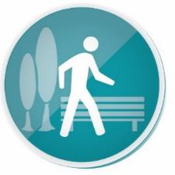
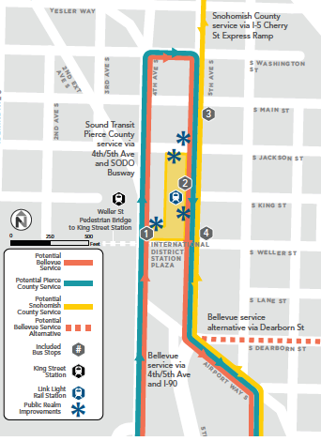
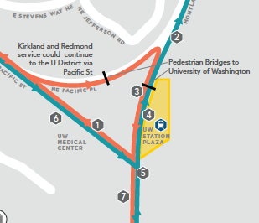
POTENTIAL Pedestrian and Public Realm STRATEGIES
  Improve pedestrian connections at transit hubs and major bus zones
  Activate public realm
  Declutter unnecessary street furniture, bus stop facilities, and signage
International District/Chinatown Station
University of Washington Station

Slide 21

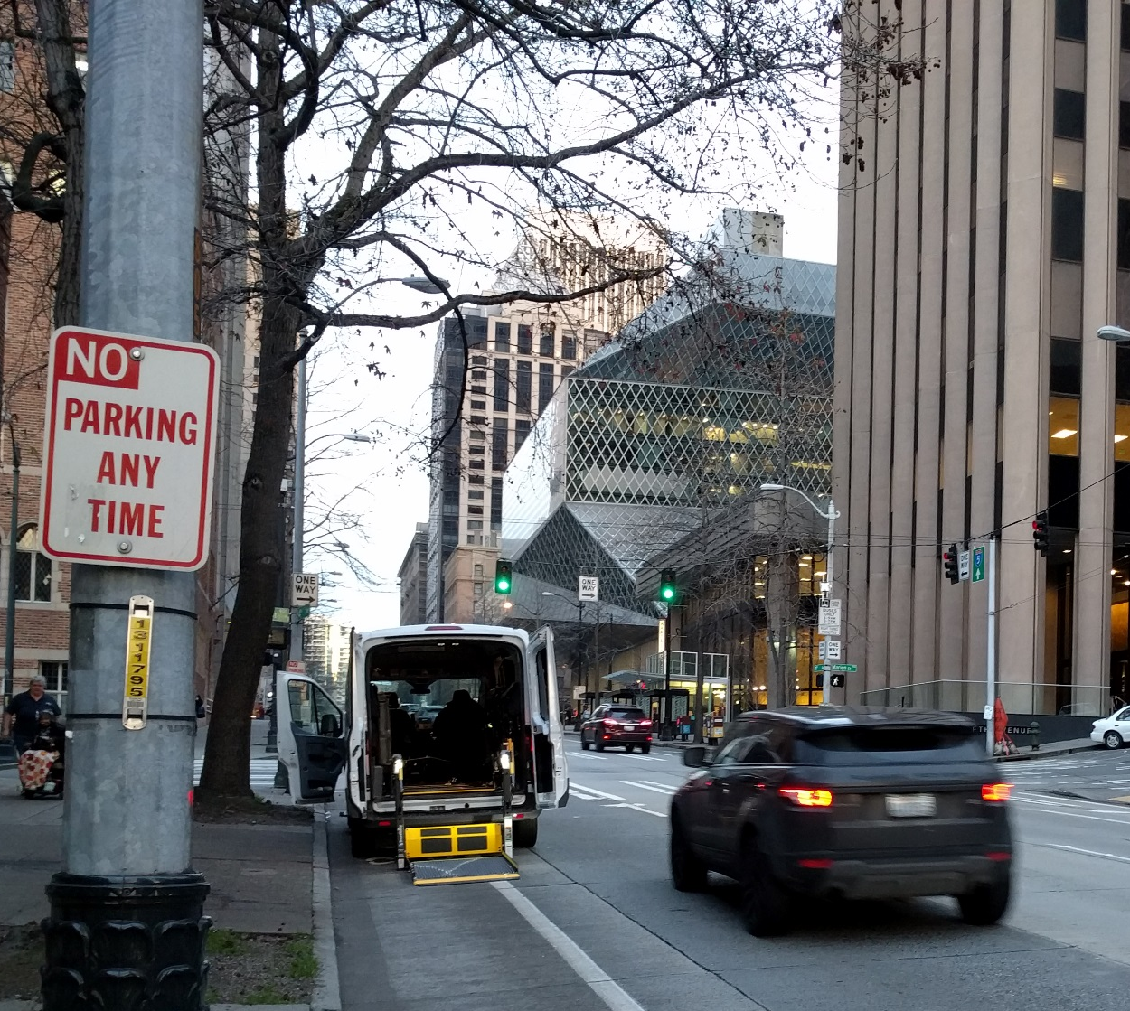
PROGRAMS AND MANAGEMENT STRATEGIES
Parking and curb management
Wayfinding
Real-time information
Transportation demand management
Urban goods delivery strategies
Shared mobility
Notes:
Parking/curb management – help people find off-street parking more quickly – minimize circling and congestion – could be through e-Park expansion
Manage parking spaces so 1-2 open per block (through an annual study and through price)
Load zones are high priority in downtown – if remove, trying to replace as close as possible
Could consider additional ways to structure, restrict or share zones for drop-off/pick-up, including permit and pricing changes
Could investigate how to promote off-hour deliveries (nighttime)
Real-time information – could be for transit, could be off-street parking, could also be for helping delivery drivers find spaces in advance
Urban goods strategies – Adopted FMP identified need for an urban goods delivery strategy. Now in UW partnership to explore the final 50’ of deliveries; gathering loading dock data and investigate building prototypes for process flow mapping
Shared mobility – looking at providing additional shared mobility space at transit HUBS to help people connect the first/last mile of their trips

Slide 22
NEAR-TERM STRATEGIES
PLEASE LET US KNOW…
How could these changes affect how you move to and through Center City?
What questions or concerns come to mind?
What would you need to make these changes work for you?
Who else should we be talking to and how?
Notes:
Include TDM and other measures to reduce auto demand
Include freight and delivery strategies
Include or incorporate safety improvements
Performance measures do not capture added capacity and safety benefits of the Center City Bike Network
How would increased bus volumes on 5th affect retail?

Slide 23
NEAR-TERM STRATEGIES
DECISION ROADMAP
JAN &
FEB
Solicit input from public through Advisory Group, in-person meetings and online open house
MAR
Draft recommended strategies for further outreach and analysis
Through early 2018
Outreach and analysis on specific strategies prior to recommendation and action by responsible legislative body
Through early 2018
Develop 20-year vision and public realm plan
23

Slide 24
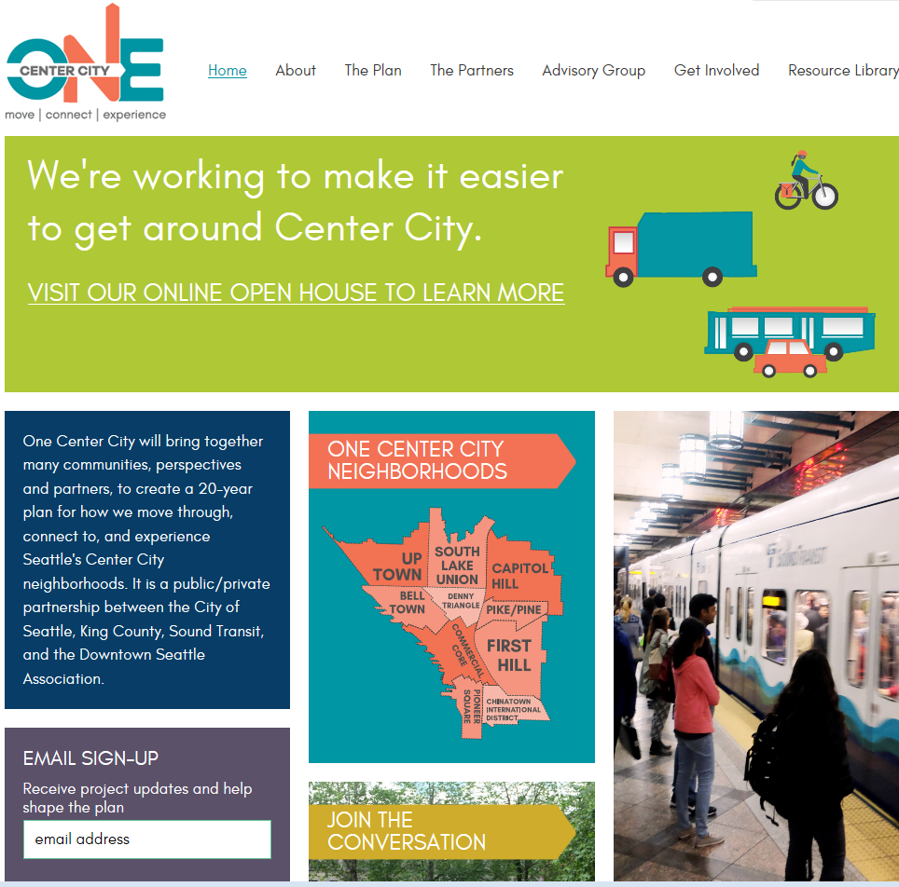
LEARN MORE - ONECENTERCITY.ORG

Slide 25
QUESTIONS
Diane Wiatr, Deputy Project Manager
diane.wiatr@seattle.gov | (206) 684-0811
onecentercity.org

