Slide 1
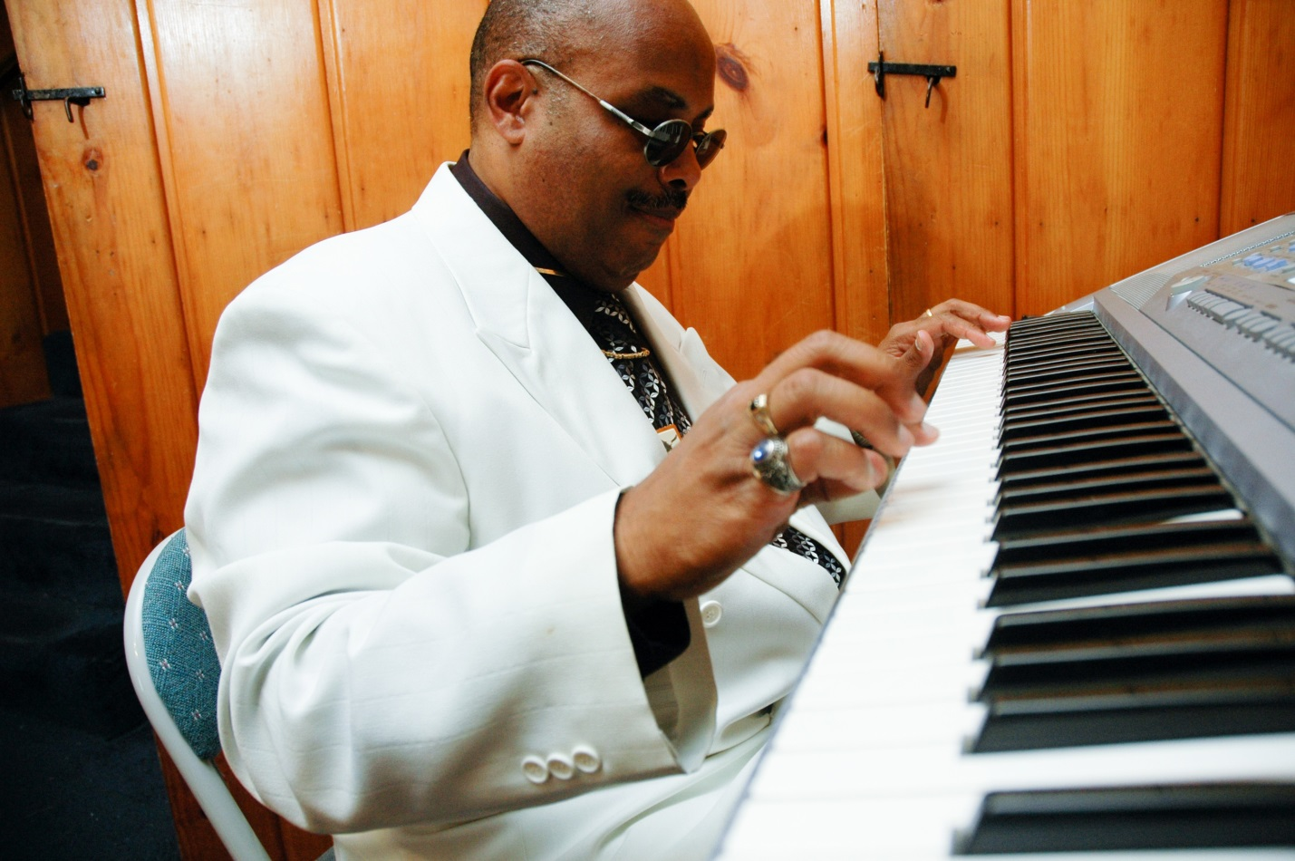
Arnold’s Bar and Grill is hosting a
Fundraising Event to Benefit Blind Ohioans!
AN EVENING WITH
“DR. FEELGOOD”
Wednesday April 29 7:00 PM – 9:00 PM
Dr. JW Smith characterizes his musical style as “easy on the ear and a combination of Gospel and R&B.” His influences range from Marvin Gaye and Ray Charles to Cee Lo Green.
Join us at 210 East Eighth Street
Great Food, Great Drinks, Raffles, & Silent Auctions
The National Federation of the Blind knows that blindness is not the characteristic that defines you or your future. Every day we raise the expectations of blind people, because low expectations create obstacles between blind people and our dreams. You can live the life you want; blindness is not what holds you back. Check out our website: NFB.org

